Slide 1


Eventual Consistency & Amazon Dynamo
Lab 4 Out
“Dynamo Machine”, Natalia Sergeevna Goncharova, 1913
“electric dynamo in the style of Natalia Sergeevna Goncharova”,
DALL-E 3

Slide 2
2PC Recap
Remember this?
If Coord + 1 Worker fail, no way to recover
  Coord may have told failed Worker about outcome, it may have exposed results

Slide 3
Failure Cases
Coordinator
Worker
1
PREPARE(T)
2
FW(PREPARE)
VOTE(T,YES/NO)
3
4
FW(COMMIT/ABORT)
5
COMMIT/ABORT(T)
6
FW(COMMIT/ABORT)
ACK
7
8
W(DONE), once all W’s ACK

Slide 4
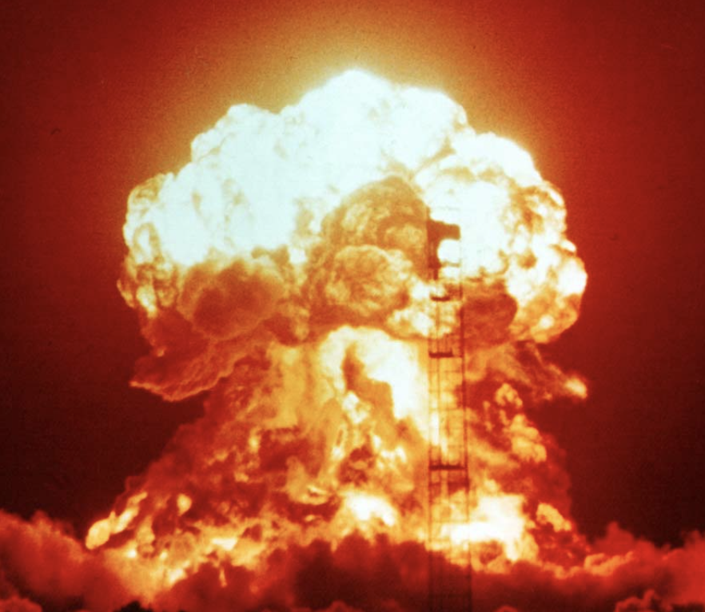
Failure Cases
What happens if Coordinator transmits COMMIT to some workers, then dies forever?
Coordinator
Worker
1
PREPARE(T)
2
FW(PREPARE)
Some workers think COMMIT took place, others can never obtain an outcome
VOTE(T,YES/NO)
3
4
FW(COMMIT/ABORT)
5
COMMIT/ABORT(T)
6
FW(COMMIT/ABORT)
ACK
7
8
W(DONE), once all W’s ACK

Slide 5
Amazon Operational DB Desiderata
”Always Available” shopping cart
  Should not go down even if a datacenter fails
  No centralized point of failure
Very low latency
  Lots of orders being processed
  Many lookups required to render a page
No need for complex analytics
Incrementally scalable

Slide 6

Enter Dynamo
“Always Available” shopping cart
Data replicated across multiple nodes
Favor availability over consistency
Very low latency
No need for complex analytics
Incrementally scalable
  Key value store
  CRUD semantics
  Keys partitioned across workers using consistent hashing
Notes:
CREATE READ UPDATE DELETE

Slide 7

Versus RDBMS
“Always Available” shopping cart
Data replicated across multiple nodes
Favor availability over consistency
Very low latency
No need for complex analytics
Incrementally scalable
  Key value store
  CRUD semantics
  Keys partitioned across workers using consistent hashing
Favor consistency above all else
Complex SQL queries can be slow
Can add new nodes in shared nothing but shuffle joins may not scale incrementally

Slide 8
Replication Primer
Replicating data helps with fault tolerance and performance
Reads:
  On a fault, reads can be directed to replica
  Also, reads can be handled by “nearest” replica
What about writes?
  Slower? (More nodes to write)
  Less available? (Have to write all nodes, what if some nodes crash?)

Slide 9
Availability
Availability: can the system process requests?
In large systems, even w/ very reliable nodes, failures happen!
Replication clearly provides read availability
What about writes?

Slide 10
Write Availability Tradeoff
If we write to all replicas, availability is worse!
If we only write some replicas, availability is better, but replicas can be stale
Availability and consistency are a spectrum:
Many models of consistency
Barge ahead if some writes fails
Write all replicas before proceeding
Monotonicity (always see a view of data moving forward in time)
1 copy serializability (“ACID”)
Replicas will eventually converge if updates stop
Eventual Consistency
HIGHLY AVAILABLE
Read your writes
Strong Consistency
NOT HIGHLY AVAILABLE

Slide 11
No Free Lunch
Pick one of availability or consistency
CAP Theorem
  Eric Brewer at PODC 02; system can have 2 of 3 properties
    Consistency
    Availability
    Partition Tolerance
CAP proof on systems with async communication

Slide 12
CAP Example
n1
n2
n3
x=4
x=4
x=4
Rx?
Wx=5
Partition
Options:
Wait for partition to heal (Consistent)
Forge ahead: n1 and n2 process write, somehow make n3 aware later? (Available)
If data is partitioned must choose either consistent or available!

Slide 13
NoSQL
Class of systems like Dynamo that generally offer:
  Key/value storage (not SQL!)
  Partitioned and replicated by key
  Not just strongly consistent / ACID semantics

Slide 14
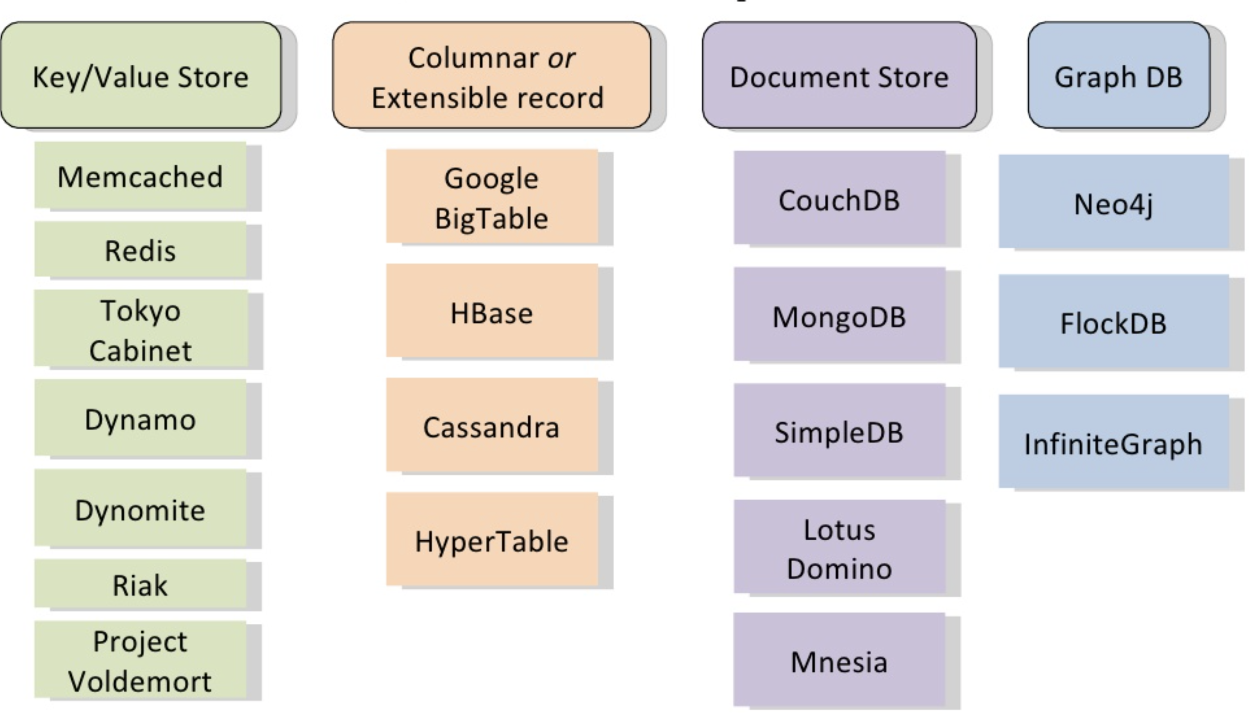
Early 2010’s saw MANY such systems, with slightly different data models and semantics
Source: https://www.slideshare.net/danglbl/schemaless-databases/7

Slide 15
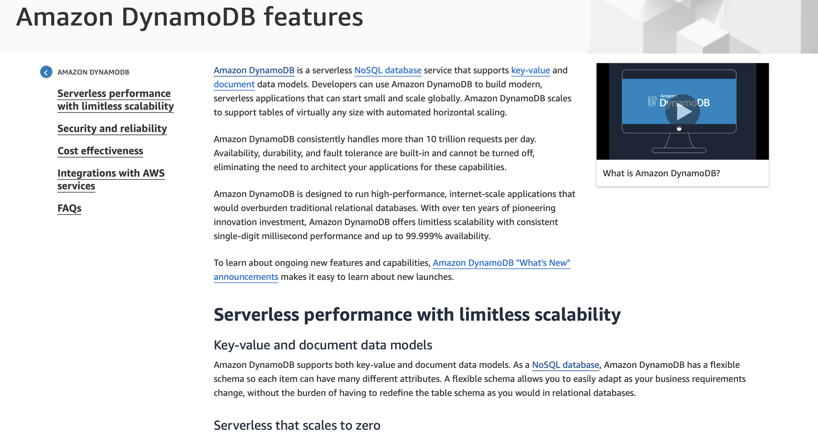

Slide 16
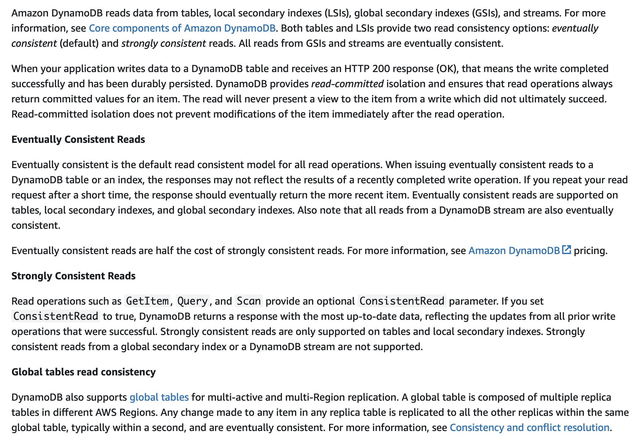

Slide 17
Dynamo Query Interface
Key / Value store
All keys and values are arbitrary byte arrays
  md5 on key to generate ID
get(key)
put(key, version, value)
  Version (aka context) is a sequence number done by coordinator of write
  More later
single-key atomicity
  I.e., each read/write is atomic, but only with respect to key
Commercial AWS allows you to batch a small number of key writes into an atomic action

Slide 18
Dynamo Data Partitioning and Replication
  All data replicated on N nodes
  Each node has an address on a “ring” representing space of hash values from say, 0→2¹²⁸
  Data stored on ring as well; location of data computed via hashing
“Overlay network”: Nodes are not actually in a physical ring, but are just machines on the Internet
Each node occupies one (or multiple) random locations on ring
N=3
k
A key hashed to location k is stored on N successors in ring

Slide 19
Consistent Hashing
Data and nodes mapped to ring
Data assigned to nearest successor(s)
When a node joins, it takes over only keys in range it joins
No need to rehash all values!
F takes over
F

Slide 20
Joining the Ring
Administrators explicitly add / remove nodes
When a node joins, it contacts a list of “seed nodes”
  Other nodes periodically “gossip” to learn about ring structure
When a node i learns about new node j, i sends j any keys j is responsible for
1
2
Each node has mapping of all other nodes.
This is small, even for thousands of nodes
External discovery service
Seed nodes are nodes clients and other nodes can ask for current mapping
10
Node | Loc
A | 1
B | 3
C | 5
…
Node | Loc
A | 1
B | 3
C | 5
F | 4
3
Node | Loc
A | 1
B | 3
C | 5
F | 4
Node | Loc
A | 1
B | 3
C | 5
…
Seed node list
9
F
4
8
B Table
C Table
5
7
6
Keys in range [3,4]

Slide 21
Handling Reads
Each item is replicated on N nodes
To read: hash key, send request to one replica
  Client either uses Amazon front end or reads mapping table from seeds
E compute Hash(“hi”) → k
E reads D, E, A
(Details of how many to read later)
Client selects one node to be coordinator
Read(”hi”, data)
N=3
k

Slide 22
Handling Writes
Route as in reads
Back to our availability conundrum
  Do we write all replicas? What if one has failed / isn’t available?
  Do we write just one replica? How do we ensure that our read will be visible to other nodes?
Client selects one node to be coordinator
N=3
k

Slide 23
Dynamo Consistency
“Quorum Writes”
R+W > N
  N = number of replicas of each data item
  R = number of replicas each read must be heard from
  W = number of replicas each write must be sent to
E.g., R = 2, W = 2, N = 3
  R1 R2 R3
  v1 v1 v1
  v2 v1 v2 ← write to 2 out of 3
  Any read of 2 will see v2!

Slide 24
Dynamo Consistency
“Quorum Writes”
R+W > N
  N = number of replicas of each data item
  R = number of replicas each read must be heard from
  W = number of replicas each write must be sent to
Need some way to ensure that if fewer than N nodes written to, write eventually propagates
  If a reader sees that a replica has a stale version, it writes back

Slide 25


Slide 26

Sloppy Quorum
Quorums still favor consistency too heavily, because:
  Decreased durability (want to write all data at least N times)
  Decreased availability in the case of partitioning.
Solution: Sloppy Quorum

Slide 27
Sloppy Quorum & Hinted Handoff
If fewer than N writes succeed, continue around ring, past successors
K=x
Hint: Owner=E
❌
N=3
”Hinted Handoff”: B will keep trying to read E to let it know about the value of K
k
2 our of 3 writes succeed
Continue around ring, write to B

Slide 28
Sloppy Quorum ➔ Divergence
If network is partitioned, hinted handoff can lead to divergent replicas
E.g., suppose N=3, W=2, R=2, Partitioned
✔(sloppy)
✔(sloppy)
k
Client 1
✔

Slide 29
Sloppy Quorum ➔ Divergence
If network is partitioned, hinted handoff can lead to divergent replicas
E.g., suppose N=3, W=2, R=2, Partitioned
(sloppy) ✔
Two different versions of key k, k1 and k2 now exist
✔
k
Client 2
✔

Slide 30
Vector Clocks
k
Provides a way to detect inconsistent versions
Each node keeps a monotonic version counter that increments for every write it coordinates
Each data item has a clock, consisting of a list of the most recent version it includes from each coordinator

Slide 31
Vector Clocks
k
Each node keeps a monotonic version counter that increments for every write it coordinates
Each data item has a clock, consisting of a list of the most recent version it includes from each coordinator
A | B | C | D | E | F

Slide 32
Vector Clocks
k
✔
✔
✔
Each node keeps a monotonic version counter that increments for every write it coordinates
Each data item has a clock, consisting of a list of the most recent version it includes from each coordinator
Client 1
Create k → C
C writes [C,1] to C, D, E
A | B | C | D | E | F
 |  | 1 [C,1] | 1 [C,1] | 1 [C,1]
[C,1]: Contains first version from C as coordinator

Slide 33
Vector Clocks
✔
✔
k
✔
C1
Each node keeps a monotonic version counter that increments for every write it coordinates
Each data item has a clock, consisting of a list of the most recent version it includes from each coordinator
Client 1
Create k → C
C writes [C,1] to C, D, E
A | B | C | D | E | F
 |  | 1 [C,1] | 1 [C,1] | 1 [C,1]
2 [C,2] | 2 [C,2] | 2 [C,2]
Client 1
Read k → C
C reads C, D, E
C returns [C,1]
Write k [C, 1] → C
C writes [C,2] → C, A, B

Slide 34
Vector Clocks
✔
✔
k
C2
✔
Each node keeps a monotonic version counter that increments for every write it coordinates
Each data item has a clock, consisting of a list of the most recent version it includes from each coordinator
Client 2
Read k → D
D reads D,E,F
D returns [C,1]
Write k [C, 1] → D
D writes [C,1][D,1]
to D, E, F
A | B | C | D | E | F
 |  | 1 [C,1] | 1 [C,1] | 1 [C,1]
2 [C,2] | 2 [C,2] | 2 [C,2]
 |  |  | 3 [C,1][D,1] | 3 [C,1][D,1] | 3 [C,1][D,1]
Incomparable (can’t totally order)

Slide 35
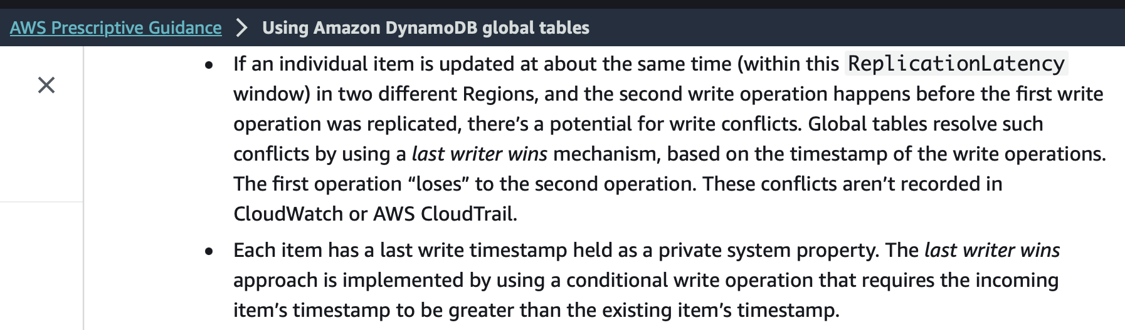
Read Repair
Possible for a client to read 2 incomparable versions
Need reconciliation; options:
  Latest writer wins
  Application specific reconciliation (e.g., shopping cart union)
After reconciliation, perform write back, so replicas know about new state

Slide 36
Clicker
Suppose there are three replicas, R1, R2, and R3. Three writes are performed to key K, resulting in three version clocks
V1 =<R1:0,R2:3,R3:2>
V2 =<R1:1,R2:3,R3:2>
V3 =<R1:0,R2:0,R3:3>
Which of the following are true statements?

Slide 37
Clicker
V1 =<R1:0,R2:3,R3:2>
V2 =<R1:1,R2:3,R3:2>
V3 =<R1:0,R2:0,R3:3>
V2 saw everything in V1, added some stuff
V3 did not see R2 1, 2, or 3, which are included in V1
The writer that produced V1 observed V2.
The writer that produced V2 observed V1.
The writer that produced V3 observed V1.
❌
✓
❌

Slide 38
Anti-entropy
Once a partition heals, or a node recovers, need a way to patch up
Could rely on read repair / hinted handoff
Dynamo also compares nodes responsible for each key range
  Comparison done via hashing, using a technique called Merkle trees
Here, for EA range, B and C are also responsible

Slide 39
Merkle Trees
Here, for EA range, B and C are also responsible
Suppose EA range has keys u,v,w,x,y,z, A and B are comparing

Slide 40
Merkle Trees
Here, for EA range, B and C are also responsible
Suppose EA range has keys u,v,w,x,y,z, A and B are comparing

Slide 41
Merkle Trees
Here, for EA range, B and C are also responsible
Suppose EA range has keys u,v,w,x,y,z, A and B are comparing

Slide 42
Merkle Trees
Here, for EA range, B and C are also responsible
Suppose EA range has keys u,v,w,x,y,z, A and B are comparing

Slide 43
Merkle Trees
Here, for EA range, B and C are also responsible
Suppose EA range has keys u,v,w,x,y,z, A and B are comparing
This whole tree is as big as data, but only need to exchange parts of it that are different, i.e., no need to send light gray nodes in diagram, since parent hashes are all equal

Slide 44
Summary
Problem | Technique | Purpose
Partitioning | Consistent hashing | Incremental scalability

Slide 45
Summary
Problem | Technique | Purpose
Partitioning | Consistent hashing | Incremental scalability
Highly available for writes | Vector clocks with read repair | Version size decoupled from update rate

Slide 46
Summary
Problem | Technique | Purpose
Partitioning | Consistent hashing | Incremental scalability
Highly available for writes | Vector clocks with read repair | Version size decoupled from update rate
Handle temporary failures | Sloppy quorum and hinted handoff | HA with some durability

Slide 47
Summary
Problem | Technique | Purpose
Partitioning | Consistent hashing | Incremental scalability
Highly available for writes | Vector clocks with read repair | Version size decoupled from update rate
Handle temporary failures | Sloppy quorum and hinted handoff | HA with some durability
Recovery from permanent failures | Anti-entropy | Sync replicas w/ Merkle Trees

Slide 48
Summary
Problem | Technique | Purpose
Partitioning | Consistent hashing | Incremental scalability
Highly available for writes | Vector clocks with read repair | Version size decoupled from update rate
Handle temporary failures | Sloppy quorum and hinted handoff | HA with some durability
Recovery from permanent failures | Anti-entropy | Sync replicas w/ Merkle Trees
Membership / failure detection | Gossip based membership | Symmetry and no centralized coordination

Slide 49

Photorealistic render high fantasy dynamo powering a magical contraption full of binary digits and a web of cylindrical objects vaguely representative of a data center

