Slide 1
Cluster Computing: Spark Some slides from Mosharaf Chowdhury, Michael Cafarella
DALLE 3
“metal sparks industry in heroic early 20th century style”, Stable Diffusion, November 26, 2022
”Steel Industry”, fresco in Pittsburgh US Courthouse and Post Office,
Howard Norton Cook, 1936

Slide 2
Last Time: High Performance Transactions
H-Store: In-memory transaction processing
Avoid concurrency control & 2PC by partitioning data, running one transaction at a time per partition
Works well for partitionable workloads
Calvin: Deterministic scheduling for distributed transactions
Avoid the use of 2PC by totally ordering transactions up front
Briefly discussed AWS Aurora – more today

Slide 3
Transactions in the Cloud
Several differences
Failures common
Must replicate across availability zones and even data centers
Highly-available shared object storage (e.g., S3) exists
Desire for “pay as you go” scaling
A number of new “cloud-native” database systems have emerged
E.g., AWS Aurora, Snowflake, SingleStore, FoundationDB, etc.
Build on top of existing cloud storage services in “shared-disk” fashion
Most separate compute and storage for flexibility

Slide 4
Cloud-native OLTP
Key Idea: Storage & Compute Separation
Use cloud object storage (e.g., S3) for persistent storage layer
Attach ephemeral machines to storage when needed
Allows for separate scaling of resources
Key Challenge: Performance
Object storage is often slow & over the network (upwards of 10ms instead of hundreds of microseconds of fast SSDs, and often rate-limited to tens of MBs per second)

Slide 5
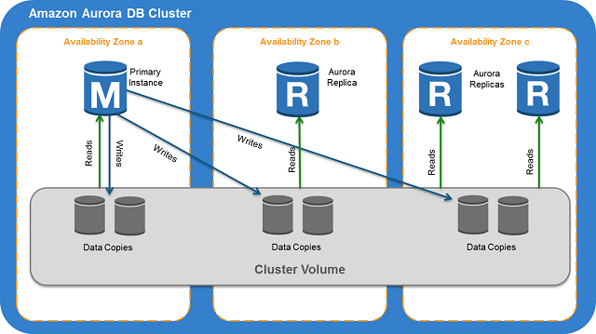
Example: Amazon Aurora
“Primary”
MySQL or Postgres Front End
Idea: take existing DBMS (e.g., PostgreSQL), and replace the storage layer
Optimized storage layer to reduce commit latency and materialize pages in S3 using logging
Data distributed across multiple storage nodes for read performance and high availability
Avoids use of 2PC by using quorum writes
Storage nodes

Slide 6
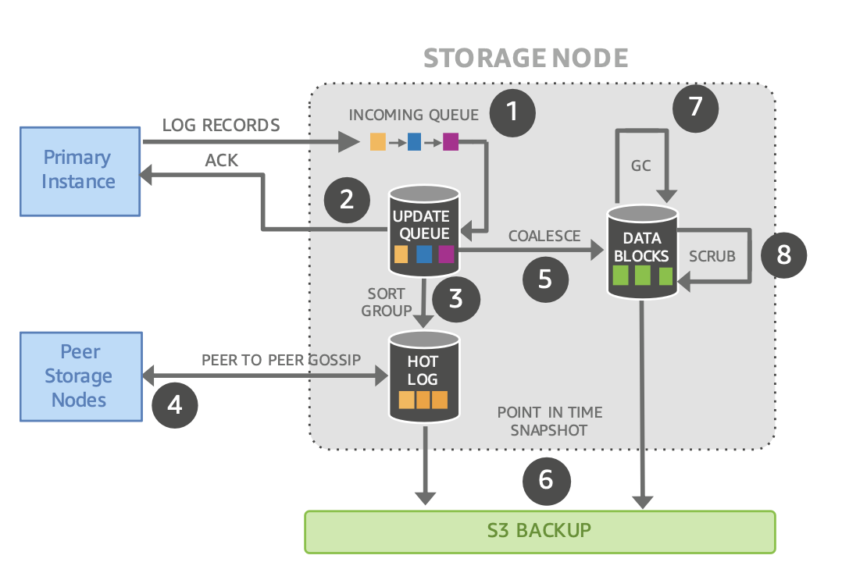
Aurora Execution
On write, storage node:
(1) receives redo records,
(2) appends them to an update queue, acks
In background, the storage node
(3) sorts and groups records,
(4) gossips with peers to fill in missing records,
(5) coalesces them into data blocks,
(6) backs them up to S3,
(7) garbage collects backed-up data
(8) periodically verifies checksums continue to match the data on disk.

Slide 7
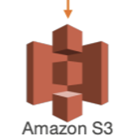
Storage
Every write is structured as a REDO log, with a unique LSN
Storage nodes flush blocks to S3 asynchronously
Data is partitioned into segments, which are replicated
Storage nodes replicate different segments
Each segment has a separate log
Storage Node 2
Seg 1 Redo Log
Data Blocks
Partition Map
A: Seg 1
B: Seg 2
C: Seg 3
Async
Seg 1
Redo A
Seg 2
Storage Node 3
Primary
Synchronous Ack
T1:
WA
WB
WC
Storage Node 1
Seg 2
Redo A
Seg 3
Seg 3
Seg 1 Redo Log
Synchronous Ack
Seg 1

Slide 8
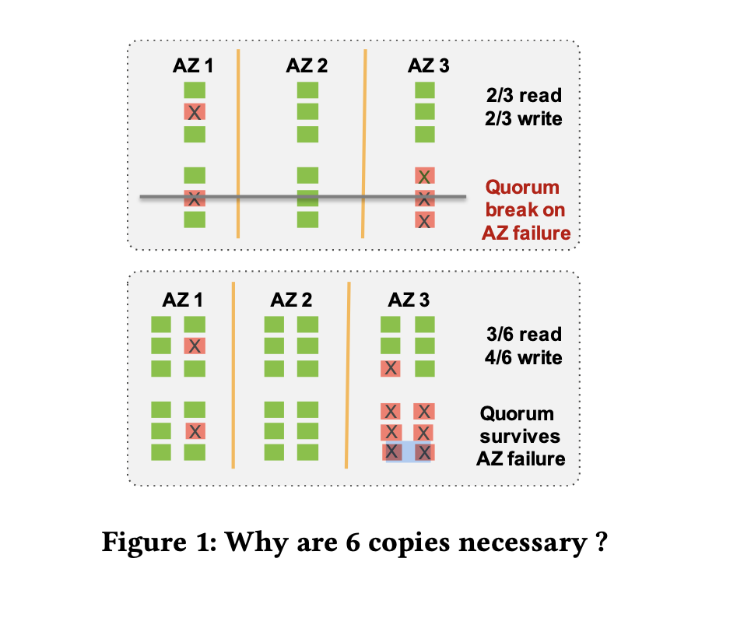
Quorum Writes
Rather than writing all replicas, primary writes to a quorum
Allows survival of failure of one or more replicas
Typically, Aurora uses N=6, W=4, meaning it can tolerate the failure of 2 replicas.
Replicas are spread across 3 availability zones
Tolerating 2 failures allows one AZ to be down and one other failure

Slide 9
Log Processing
Every write (log record) has an LSN, generated by primary
Storage nodes process log writes in order
Stall if missing a block
If a storage node is missing some log, it gossips with other nodes to fill in holes
Storage Node 2
Seg 1 Redo Log
Data Blocks
Redo A
Seg 1
Async
Seg 2
Storage Node 3
Log Gossip
Redo A
Storage Node 1
Seg 2
Seg 3
Seg 3
Seg 1 Redo Log
Seg 1

Slide 10
Reads
Surprising property: Aurora does not need to do quorum reads
Every read request has a read LSN (corresponding to the committed LSN at the start of the transaction)
Primary keeps track of the max LSN each replica is complete up to
Primary can dispatch reads to just one replica

Slide 11
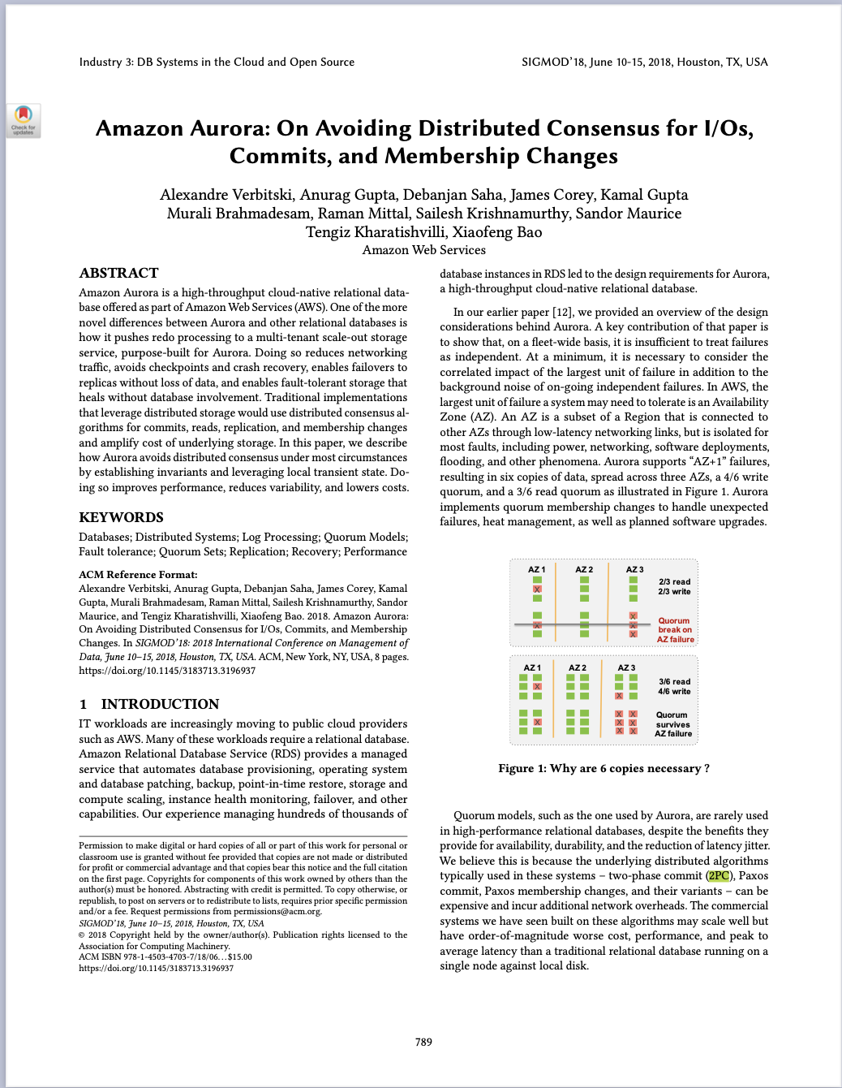
Commit
Transactions may write data stored in different segments
Since segments are on different replica sets, seems to require 2PC
However:
Primary does concurrency control, properly sequences writes
No deadlocks will be generated on storage nodes
Quorum writes ensure that replica sets will not fail
As long as a quorum of nodes stays up
➔ 2PC isn’t required
Commit point is when primary’s log has been replicated
Log is stored on one replica set
Recovery of primary is somewhat complicated; see paper
https://dl.acm.org/doi/10.1145/3183713.3196937

Slide 12
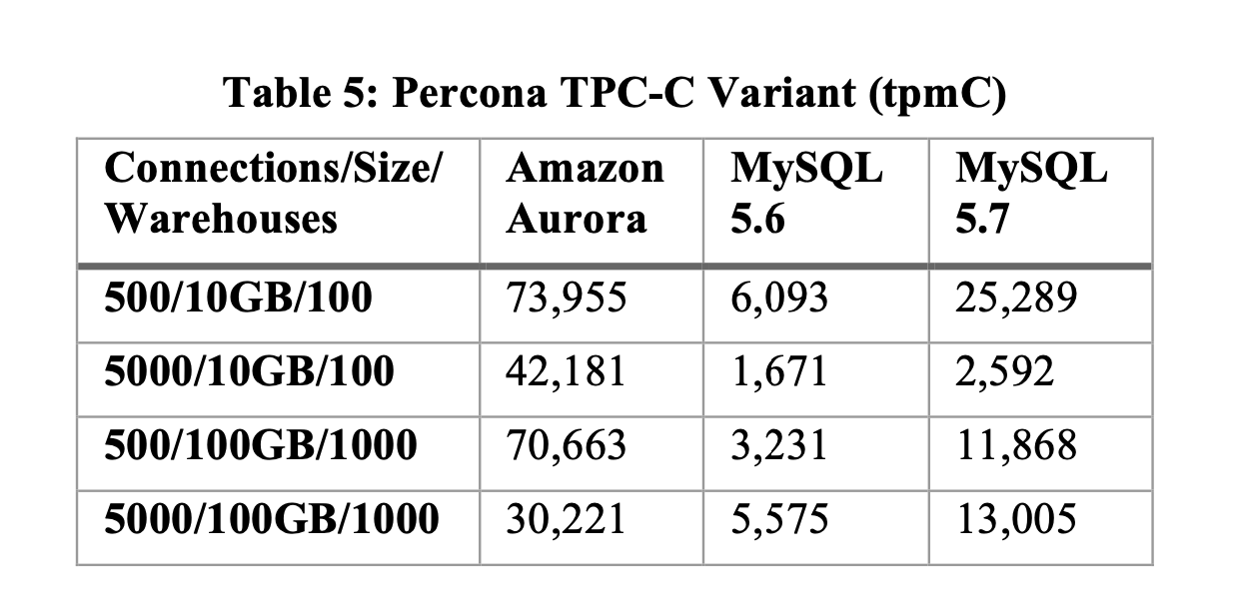
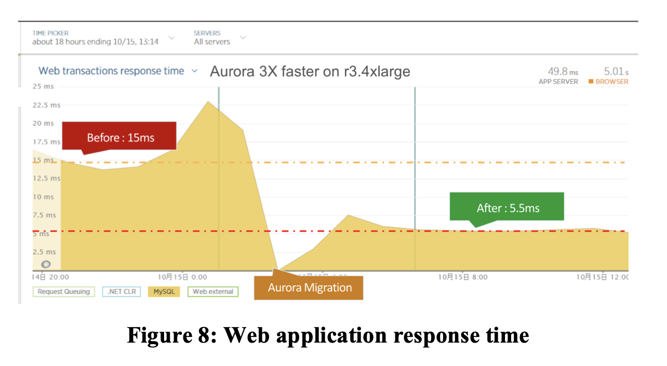
Performance
Aurora vs. MySQL on EBS (cloud storage)
Despite 4x+ write amplification, performance is good because:
Writes append to REDO log; no synchronous block writes
Data is spread across many storage nodes, allowing for high concurrency
No 2PC required for commit
No read amplification
Aurora is higher throughput and lower latency, because of use of log shipping and scalable backend

Slide 13
Takeaways
Transaction research is alive and well in new settings such as the autoscaling cloud
A Scaly Cloud

Slide 14
Where Are We???
H-Store
Calvin
DBs for Analytics
C-Store
DBs for Transaction Processing
Highly Available DBs
Specialization
DynamoDB
DBs for the Cloud
“Classic DB”
Row Store, Selinger Optimizer, 2PL + 2PC,
ARIES
Aurora
Systems for Data Science
Spark (Today)
DBs for Cloud Analytics
First 12 lectures
Snowflake (Next Time

Slide 15
Today
Data Systems for “Data Science”
Efficient Parallel Execution for “One Off” Data Processing Tasks
E.g., featurization for ML, indexing data, extracting information from data, etc
Often involving unstructured → structured data conversion
E.g., processing a set of text document into an inverted index of words and their locations in the documents
Not really SQL, but a set of parallel operations that are reminiscent of SQL filters and joins
MapReduce/Hadoop, briefly, and then Spark

Slide 16
MapReduce: programming model for processing large data sets across a distributed cluster.
Programmer specifies:
Map Function:
- Processes input key/value pairs to generate intermediate key/value pairs.
Reduce Function:
- Merges all intermediate values associated with the same intermediate key.
# Map Function
def map(key, value):
for word in value.split():
emit(word, 1)
# Reduce Function
def reduce(key, values):
total_count = sum(values)
emit(key, total_count)
# Example Input: [('doc1', 'hello world'), ('doc2', 'hello mapreduce’)]
# MapReduce Process Execution
# Example Output: [('hello', 2), ('world', 1), ('mapreduce', 1)]

Slide 17
MapReduce Execution
Input Splitting:
Data is divided into chunks for the map tasks.
Mapping:
Each chunk is processed by a map task independently.
Shuffling:
Intermediate key/value pairs are sorted and grouped by key.
Reducing:
Each group of intermediate values is processed by a reduce task.
Output:
Final output is generated from the reduce tasks.
Worker 1
doc1
Worker 2
doc2
map(doc1)
map(doc2)
Hello, 1
Hello, 1
World, 1
Shuffle
MapReduce, 1
Worker 3
Worker 4
reduce(
Hello, 1
World, 1
reduce(
)
)
Hello, 1
MapReduce, 1
Hello, 2
World, 1
MapReduce, 1

Slide 18
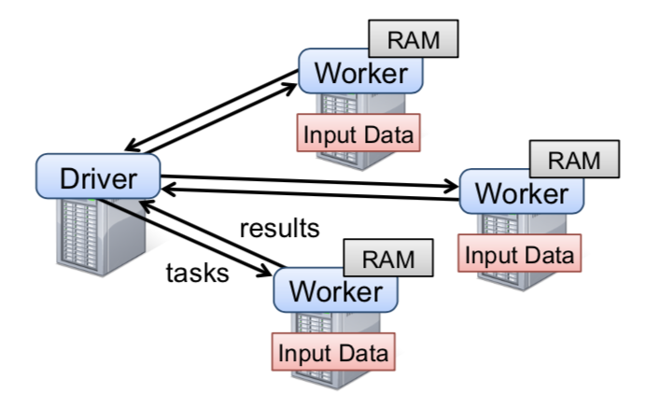
Motivation & Background
Frameworks back in 2012: MapReduce, a bit of Microsoft’s Dryad
Cons:
Little to no support for leveraging cluster memory
Large overhead for reusing data in iterative or interactive tasks (I/O, replication, serialization)
You didn’t have to think about schemas
Implementations had bad latency
Pros:
Allowed parallel computation without worrying low level details (e.g., work distribution, fault tolerance)
Provided a set of high-level operations (map, reduce)
You didn’t have to think about schemas

Slide 19
Spark: Resilient Distributed Datasets (RDDs)
Utilize Distributed Memory while providing efficient fault tolerance
Avoid storing data updates explicitly
Instead, obtain fault tolerance by logging transformations (lineage)
Limit operations to coarse-grained transformations (e.g., map, filter)
Allow user control of data persistence, partitioning, and caching
How did MapReduce obtain fault tolerance?

Slide 20
RDDs
Read-only, partitioned collection of records
Created from either data in stable storage or other RDDs
A sequence of transformations defines an RDD:
Map, filter, flatmap, sample, groupbykey, reducebykey, join, union
Actions return value or export data to storage system
count, collect, save, reduce, lookup
No need to actually run code until there’s an action
Read-only means we can exploit speculative (re)execution
MapReduce also does this

Slide 21
Example: Console Log Mining
lines = spark.textFile("hdfs://...")
errors = lines.filter(_.startsWith("ERROR"))
errors.count()
HDFS File
definition
Base RDD: lines
Transformation: filter
Transformed RDD: errors
Action: count
Number of lines with ERROR
Notes:
Note: the “underscore” syntax here in Scala is something called “placeholder syntax”
It’s way of creating an anonymous function --- akin to lambda in Python --- without even being explicit about the incoming parameter.
You can read the “_.startsWith(“ERROR”)” text as a way to write a small boolean function. It takes a line of input and returns true or false

Slide 22
RDDs: Fault Tolerance
Limit operations to coarse-grained transformations and only log the transformations instead of replicating data for recovering
Lineage: transformations used to build a dataset
Recover lost partition by applying lineage from corresponding data partition in stable storage
Because data is read-only, this is always possible

Slide 23
Example: Console Log Mining
lines = spark.textFile("hdfs://...")
errors = lines.filter(_.startsWith("ERROR"))
errors.count()
HDFS File
definition
Base RDD: lines
Transformation: filter
Transformed RDD: errors
Action: count
Number of lines with ERROR
“Base RDD” and “Transformed RDD” may never be actually stored on disk
Notes:
Note: the “underscore” syntax here in Scala is something called “placeholder syntax”
It’s way of creating an anonymous function --- akin to lambda in Python --- without even being explicit about the incoming parameter.
You can read the “_.startsWith(“ERROR”)” text as a way to write a small boolean function. It takes a line of input and returns true or false

Slide 24
Example
RDD 0
p1
p2
p3
Worker 3
Coordinator
RDD 1a
RDD 1b
p1
p2
p3
p1
p2
p3
Worker 1
Worker 2
RDD 2
p1
p2
p3
4 RDDs
3 partitions. (e.g., all p1s are on worker 1)
What’s a possible program that leads to this dataflow? Take a minute.
RDD 3
p1
p2
p3
Notes:
RDD 0: initialization (reading from an input file)
RDD 1a/b: some mapping or filtering
RDD 2: some joining
RDD 3: some filtering
What happens when Worker 3 goes down?
All partitions on worker 3 disappear.So we have to rebuild Worker 3’s partitions.
So we have to go back up the lineage and rebuild each partition from each ancestor.

Slide 25
Example
RDD 0
employeeids
p1
p2
p3
Worker 3
Coordinator
RDD 1a
RDD 1b
names
p1
p2
p3
p1
p2
p3
Worker 1
Worker 2
RDD 2
salaries
fullEmps
p1
p2
p3
employeeIds = spark.textFile("hdfs://...")
names = map( # map from ID to name)
salaries = map( # map from ID to salary) fullEmps = join( # names, salaries on empId)
execs = fullEmps.filter( # filter on salary)
RDD 3
p1
p2
p3
execs
Notes:
RDD 0: initialization (reading from an input file)
RDD 1a/b: some mapping or filtering
RDD 2: some joining
RDD 3: some filtering
What happens when Worker 3 goes down?
All partitions on worker 3 disappear.So we have to rebuild Worker 3’s partitions.
So we have to go back up the lineage and rebuild each partition from each ancestor.

Slide 26
Example
RDD 0
p1
p2
p3
Worker 3
Coordinator
RDD 1a
RDD 1b
p1
p2
p3
p1
p2
p3
Worker 1
Worker 2
RDD 2
p1
p2
p3
RDD 3
p1
p2
p3
Notes:
RDD 0: initialization (reading from an input file)
RDD 1a/b: some mapping or filtering
RDD 2: some joining
RDD 3: some filtering
What happens when Worker 3 goes down?
All partitions on worker 3 disappear.So we have to rebuild Worker 3’s partitions.
So we have to go back up the lineage and rebuild each partition from each ancestor.

Slide 27
Example
RDD 0
p1
p2
p3
Worker 3
Coordinator
RDD 1a
RDD 1b
p1
p2
p3
p1
p2
p3
Worker 1
Worker 2
RDD 2
p1
p2
p3
RDD 3
p1
p2
p3
Notes:
RDD 0: initialization (reading from an input file)
RDD 1a/b: some mapping or filtering
RDD 2: some joining
RDD 3: some filtering
What happens when Worker 3 goes down?
All partitions on worker 3 disappear.So we have to rebuild Worker 3’s partitions.
So we have to go back up the lineage and rebuild each partition from each ancestor.

Slide 28
Example
RDD 0
p1
p2
p3
Worker 3
Coordinator
RDD 1a
RDD 1b
p1
p2
p3
p1
p2
p3
Worker 1
Worker 2
RDD 2
p1
p2
p3
RDD 3
p1
p2
p3
Notes:
RDD 0: initialization (reading from an input file)
RDD 1a/b: some mapping or filtering
RDD 2: some joining
RDD 3: some filtering
What happens when Worker 3 goes down?
All partitions on worker 3 disappear.So we have to rebuild Worker 3’s partitions.
So we have to go back up the lineage and rebuild each partition from each ancestor.

Slide 29
Example
RDD 0
p1
p2
p3
Worker 3
Coordinator
RDD 1a
RDD 1b
p1
p2
p3
p1
p2
p3
Worker 1
Worker 2
RDD 2
p1
p2
p3
RDD 3
p1
p2
p3
Notes:
RDD 0: initialization (reading from an input file)
RDD 1a/b: some mapping or filtering
RDD 2: some joining
RDD 3: some filtering
What happens when Worker 3 goes down?
All partitions on worker 3 disappear.So we have to rebuild Worker 3’s partitions.
So we have to go back up the lineage and rebuild each partition from each ancestor.

Slide 30
Example
RDD 0
p1
p2
p3
Worker 3
Coordinator
RDD 1a
RDD 1b
p1
p2
p3
p1
p2
p3
Worker 1
Worker 2
RDD 2
p1
p2
p3
RDD 3
p1
p2
p3
Notes:
RDD 0: initialization (reading from an input file)
RDD 1a/b: some mapping or filtering
RDD 2: some joining
RDD 3: some filtering
What happens when Worker 3 goes down?
All partitions on worker 3 disappear.So we have to rebuild Worker 3’s partitions.
So we have to go back up the lineage and rebuild each partition from each ancestor.

Slide 31
Example
RDD 0
p1
p2
p3
Worker 3
Coordinator
RDD 1a
RDD 1b
p1
p2
p3
p1
p2
p3
Worker 1
Worker 2
RDD 2
p1
p2
p3
RDD 3
p1
p2
p3
Notes:
RDD 0: initialization (reading from an input file)
RDD 1a/b: some mapping or filtering
RDD 2: some joining
RDD 3: some filtering
What happens when Worker 3 goes down?
All partitions on worker 3 disappear.So we have to rebuild Worker 3’s partitions.
So we have to go back up the lineage and rebuild each partition from each ancestor.

Slide 32
RDDs
User can control
Persistence: indicate storage strategy (e.g. in-memory)
Partitioning: placement optimization (e.g. hash partitioning)

Slide 33
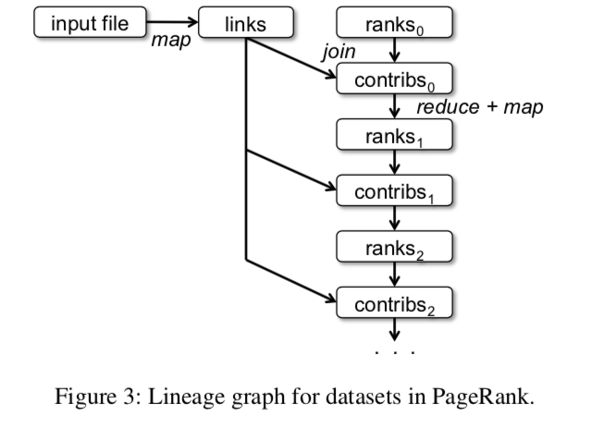
Example : PageRank
TRY IT! Don’t look at the next slide!
Try to write down pseudocode for implementing PageRank
In terms of join, map, and reduce
val links = spark.textFile(...).map
var ranks = // RDD of (URL, rank) pairs, initialized to 1
PageRank is an iterative algorithm for computing rank (centrality) of web graph nodes
The PageRank paper shows that if you keep recomputing this value then the quantities will converge
The size of the lineage graph depends on how many iterations you perform
Damping factor
Page rank of p_{i}
Number of links from p_{j}
Number of documents
Pages that link to p_{i}
Notes:
p_j \in M(p_i) means “the set of pages that link to p_i”
AND
“PR(p_j)” means “the page rank of p_j”
AND
L(p_j) means “the number of outbound links from page p_j

Slide 34
val links = spark.textFile(...).map(...).persist() var ranks = // RDD of (URL, rank) pairs, initialized to 1 for (i <- 1 to ITERATIONS) {
// Build an RDD of (targetURL, float) pairs
// with the contributions sent by each page
val contribs = links.join(ranks).flatMap {
(url, (links, rank)) =>
links.map(dest => (dest, rank/links.size))
}
// Sum contributions by URL and get new ranks
ranks = contribs.reduceByKey((x,y) => x+y)
.mapValues(sum => 1-d/N + (d)*sum)
}
🤮
Notes:
p_j \in M(p_i) means “the set of pages that link to p_i”
AND
“PR(p_j)” means “the page rank of p_j”
AND
L(p_j) means “the number of outbound links from page p_j

Slide 35
URL | Link
http://a | http://b
http://b | http://c
http://c | http://a
http://a | http://c
Ranks
(http://a,1)
(http://1,1)
(http://c,1)
(a, b) => (a + b)
Defines a function that takes two parameters a and b and sums them
val contribs = links.join(ranks).flatMap {
(url, (links, rank)) =>
links.map(dest => (dest, rank/links.size))
}

Slide 36
URL | Links | Rank
http://a | {http://b, http://c} | 1
http://b | {http://c} | 1
http://c | {http://a} | 1
(a, b) => (a + b)
Defines a function that takes two parameters a and b and sums them
val contribs = links.join(ranks).flatMap {
(url, (links, rank)) =>
links.map(dest => (dest, rank/links.size))
}

Slide 37
URL | Links | Rank
http://a | {http://b, http://c} | 1
http://b | {http://c} | 1
http://c | {http://a} | 1
(a, b) => (a + b)
Defines a function that takes two parameters a and b and sums them
val contribs = links.join(ranks).flatMap {
(url, (links, rank)) =>
links.map(dest => (dest, rank/links.size))
}
Function which takes each row of table
And applies this map to link in links set

Slide 38
URL | Links | Rank
http://a | {http://b, http://c} | 1
http://b | {http://c} | 1
http://c | {http://a} | 1
(a, b) => (a + b)
Defines a function that takes two parameters a and b and sums them
Inner map on each row
{(http://b, 1/2), (http://c, 1/2)}
{(http://c, 1)}
{(http://a, 1)}
For each row in join
val contribs = links.join(ranks).flatMap {
(url, (links, rank)) =>
links.map(dest => (dest, rank/links.size))
}
Apply function to it
This function maps over link in row’s links set
Flattened
(http://b, 1/2)
(http://c, 1/2)
(http://c, 1)
(http://a, 1)
Example
http://a | {http://b, http://c} | 1
Apply map() to both of these
{(http://b, 1/2), (http://c, 1/2)}

Slide 39
(http://b, .5)
(http://c, .5)
(http://c, 1)
(http://a, 1)
(a, b) => (a + b)
Defines a function that takes two parameters a and b and sums them
// Sum contributions by URL and get new ranks
ranks = contribs.reduceByKey((x,y) => x+y)
.mapValues(sum => 1-d/N + (d)*sum)
Apply x+y to combine rows that have the same key
Compute the weighted rank
(http://a, 1)
(http://b, .5)
(http://c, 1.5)
d = .7; 1-d/N = .1
(http://a, .1 + .7 = .8)
(http://b, .1 + .35 = .45 )
(http://c, .1 + 1.05 = 1.15)
New ranks table; b is weighted less because only a links to it, and a links to 2 pages. c is weighted more because both a and b link to it.

Slide 40
PageRank Challenges
What problems might we face, failure-wise, that we wouldn’t face if we wrote similar code with MapReduce?
Take 60 seconds and write down your answer
What problems might we face, runtime-wise, if we implement this naïvely?
Take 60 seconds and write down your answer

Slide 41
PageRank Challenges
What problems might we face, failure-wise, that we wouldn’t face if we wrote similar code with MapReduce?
Very long lineage chain for ranks; slow. Soln: Use explicit persistence to avoid having to regenerate ranks from lineage (not necessary for links)
What problems might we face, runtime-wise, if we implement this naïvely?
Very slow joins. Soln: Partition both links and ranks in the same way, so joins always happen on a single machine.

Slide 42
Example : PageRank
Use Spark support for controlling partitioning!
Partition rank and corresponding links on the same machine to eliminate cross-machine communication
Links
Ranks
facebook.com
google.com
mit.edu
facebook.com
google.com
mit.edu
facebook.com
google.com
mit.edu
facebook.com
google.com
mit.edu
facebook.com
google.com
mit.edu
PageRank with hash partitioning
PageRank without partitioning

Slide 43
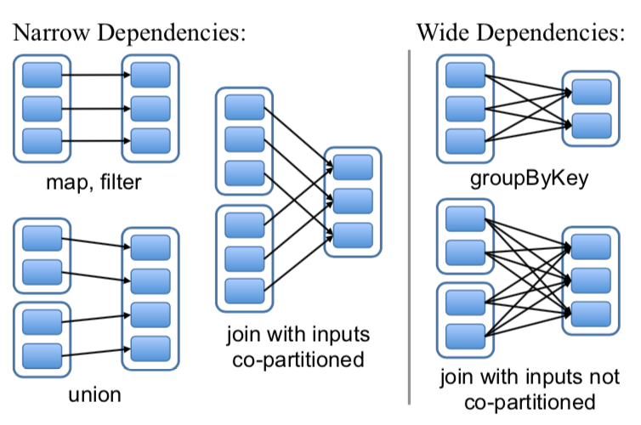
RDD Representation
Partitions: atomic pieces of the RDD
Dependencies: relations with parent RDDs
Narrow Dependencies: A parent RDD partition is used by at most one child partition (e.g. map, filter). Can be pipelined
Wide Dependencies: A parent RDD partition is used by multiple child partitions (e.g. join, groupByKey). Need internode communication
Notes:
narrow dependencies: each partition of the parent RDD is used by at most one partition of the child RDD,
wide dependencies: multiple child partitions may depend on one parent RDD.
Narrow: pipelined execution on one node, efficient, as only the lost parent partitions need to be recomputed in parallel on different nodes.
Wide: need internode communication

Slide 44
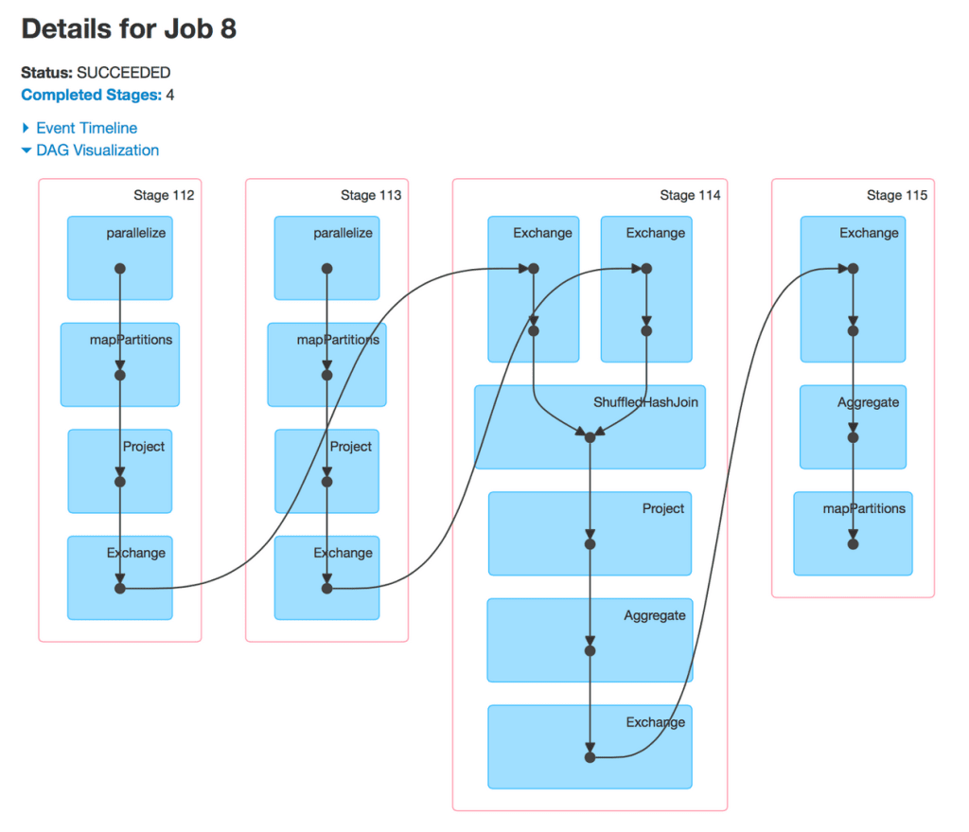
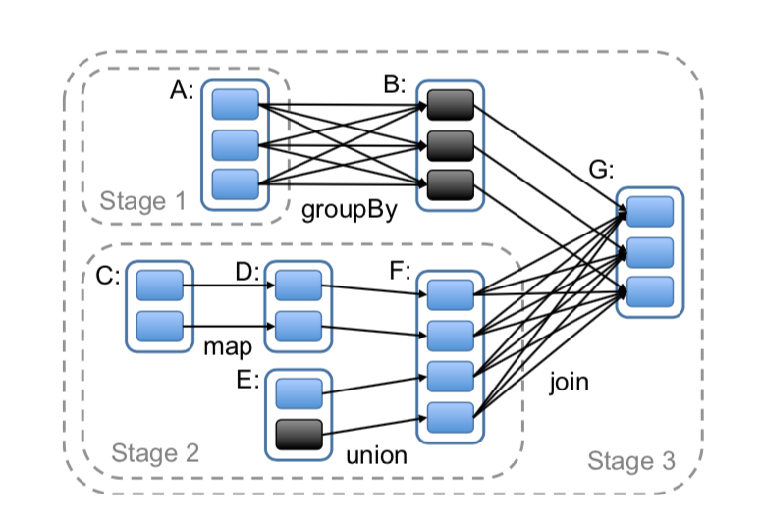
Job Scheduling
Build DAG of stages to execute
Each stage contains as much as possible pipelined transformations with narrow dependencies
Stages are linked by wide dependencies
Assign tasks based on data locality
Execute tasks when their inputs are ready
Notes:
2 co-locate data and computation
Group narrow dependencies into a stage, which can be pipelined on 1 node.

Slide 45
A Moment About Data Storage
This paper doesn’t talk about data storage much
Spark usually operates on S3 or HDFS (Hadoop Distributed File System)
Core elements:
UNIX-style bytestream files (not relations)
A single hierarchical file namespace
Reading a file usually means connecting to multiple machines
Designed for streaming reads and writes. Ill-suited for single-byte reads or writes
Chunk locations can be exposed to clients
Notes:
2 co-locate data and computation
Group narrow dependencies into a stage, which can be pipelined on 1 node.

Slide 46
Fault Tolerance
Task failures
Stage’s parents available: rerun on another node
Some stages unavailable: resubmit tasks to compute missing partitions in parallel
Does not tolerate scheduler failures
Solution: Lineage graph replication
46

Slide 47
Memory Management
Three storage strategies:
In-memory storage as deserialized Java objects, (fastest performance, since JVM can access each RDD element natively)
In-memory storage as serialized data, (more memory-efficient than Java object graphs, useful when space is limited)
On-disk storage (useful when RDDs are larger than RAM, but expensive to recompute from lineage)
LRU policy for eviction at RDD level when there is not enough RAM
Or, use user-specified “persistence priority” for eviction

Slide 48
Checkpointing and Failures with Spark
Short lineage chain?
Just recompute from lineage
Long lineage chain with narrow dependencies?
Fast to recompute from lineage using pipelined execution
Long lineage chain with wide dependencies?
This can be time-consuming. A node failure might require recomputing everything!
Use persistence as a checkpoint to prevent long recoveries
A lot more is left to the user than with MapReduce or RDBMS

Slide 49
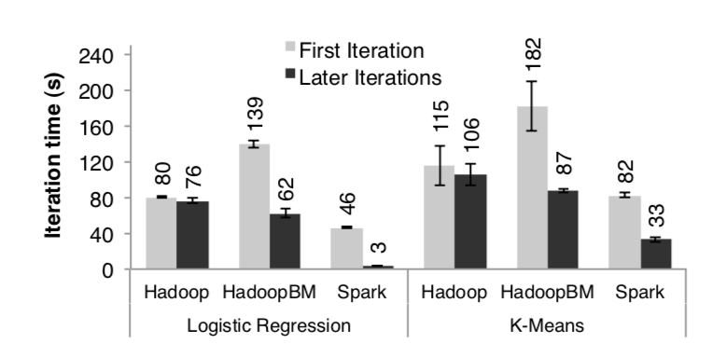
Performance: Iterative Machine Learning
K-Means and Logistic Regression
Experiment Setup:
10 iterations
10GB datasets
25-100 machines
Note: HadoopBM in its first iteration converts text input data to a more efficient binary format

Slide 50
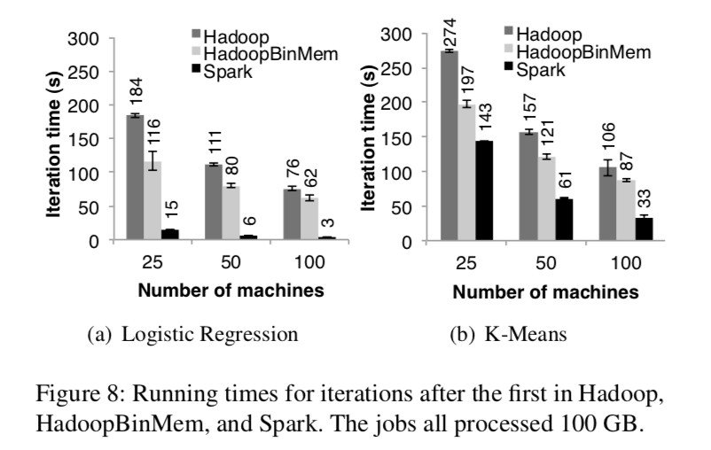
Performance: Iterative Machine Learning
Notes:
Outperforms HadoopBinMemory
1. Minimum overhead of the Hadoop software stack
2. Overhead of HDFS while serving data
3. Deserialization cost to convert binary records to us- able in-memory Java objects.

Slide 51
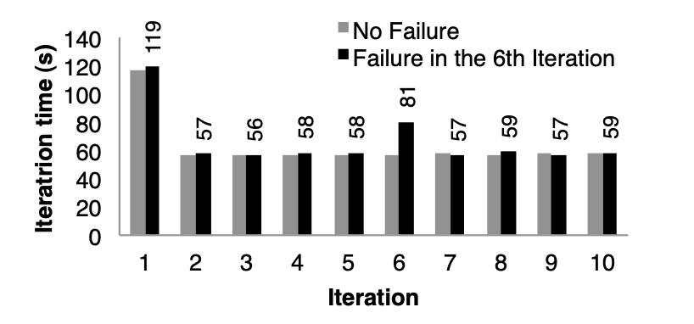
Failure and Recovery

Slide 52
Spark and MapReduce
Spark has pretty much taken over “large-scale arbitrary compute jobs” from MapReduce
Are there any advantages to MapReduce? Not really; you can express a MapReduce program almost exactly using Spark

Slide 53
Spark and RDBMS
Spark doesn’t have anything to say about transactions
Spark has more optimization opportunities than MapReduce, but they’re still mostly manual. Nothing like RDBMS optimizer (is it even possible with Spark?)
Some room for exploiting RDBMS techniques, like joins
(Certainly, more room than with MapReduce)
Scala programs or SQL queries?
Spark SQL exists as SQL layer, much like Hive for MapReduce
Likely prefer a RDBMS for updates or data that is re-accessed frequently.

Slide 54
Abstract representation of a RDBMS
fighting the Spark systems high fantasy
photorealistic render

