Slide 1
6.5830 Lecture 3
http://dsg.csail.mit.edu/6.5830/
Sam Madden
Lab 0 Due
Lab 1 Out ( due 9/27)
Key ideas:
Advanced SQL
Schema Design

Slide 2
Recap: Zoo Tables
Primary key
Animals
Schema:
Animals: (aid, name, age, species, acageno)
Cages: (no, feedtime, bldg)
Keepers: (id, name)
aid | name | age | species | acageno
1 | Sam | 3 | Salamander | 1
2 | Mike | 12 | Giraffe | 1
3 | Sally | 1 | Student | 2
Keeps: (kid, cageno)
Cages
no | feedtime | bldg
1 | 12:30 | 1
2 | 1:30 | 2
Foreign Key
Keepers
Keeps
id | name
1 | Jane
2 | Joe
kid | cageno
1 | 1
1 | 2
2 | 1

Slide 3
Recap: Relational Principles
Simple representation
Set-oriented programming model that doesn't require "navigation"
No physical data model description required(!)

Slide 4
Recap: Relational Data Model
All data is represented as tables of records (tuples)
Tables are unordered sets (no duplicates)
Database is one or more tables
Each relation has a schema that describes the types of the columns/fields
Each field is a primitive type -- not a set or relation
Physical representation/layout of data is not specified (no index types, nestings, etc)

Slide 5
Recap: Relational Algebra
“Algebra” – Closed under its own operations
Every expression over relations produces a relation
Projection (π(T,c1, …, cn))
select a subset of columns c1 .. cn
Selection (𝛔(T, pred))
select a subset of rows that satisfy pred
Cross Product (T1 x T2)
combine two tables
Join (⨝(T1, T2, pred)) = 𝛔(T1 x T2, pred)
combine two tables with a predicate
Plus set operations (UNION, DIFFERENCE, etc)

Slide 6
Recap: Logical Data Independence
What if I want to change the schema without changing the code?
No problem if just adding a column or table
Views allow us to map old schema to new schema, so old programs work
Even when changing existing fields

Slide 7
Views Example
Animals2
Animals
id | Name | Feedtime | …
1 | Sam | 1:30
2 | Jenny | 2:30
Suppose I want to add multiple feedtimes?
How to support old programs?
Rename existing animals table to animals2
Create feedtimes table
Copy feedtime data from animals2
Remove feedtime column from animals2
Create a view called animals that is a query over animals2 and feedtimes
CREATE VIEW animals as (
SELECT id, name, age, species, cageno,
(SELECT feedtime FROM feedtimes WHERE animalid = id LIMIT 1) as feedtime
FROM animals2
)
Feedtime
animalid | Feedtime | …
1 | 1:30
2 | 2:30
Note: in this example feedtimes are associated with animals, but they are associated with cages in the earlier DB

Slide 8
Correlated Subquery
SELECT id, name, age, species, cageno,
(SELECT feedtime FROM feedtimes
WHERE animalid = id LIMIT 1) as feedtime
FROM animals2
Evaluated once for each animal in animals2 table
Doesn’t exist in feedtime table!
Return at most 1 feedtime
id | Name | Feedtime | …
1 | Sam | 1:30
2 | Jenny | 2:30
id | name | … | feedtime
1 | Sam |  | 1:30
2 | Jenny |  | 2:30
subquery
1:30
animalid | Feedtime | …
1 | 1:30
2 | 2:30
2:30

Slide 9
This Lecture
Fancy SQL
Database Design and Normalization

Slide 10
Expanded Animal DB, as a Graph
Keepers
Cages
Cage6
Joe
Kid=2
Cage3
Anant
Kid=4
Cage1
4. Barry the Bear
Sam the Salamander
Tim the Giraffe
Yuan
Kid=3
Cage5
Jane
Kid=1
Cage2
5. Turdy the Turtle
6. Mork the Mink
7. Ollie the Otter
3. Sally the Student
Cage4

Slide 11
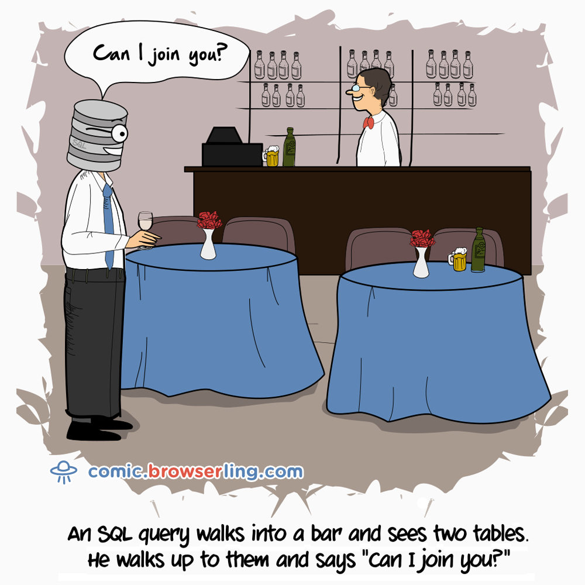
Cages in Building 32
Animals: (aid, name, age, species, acageno)
Cages: (no, feedtime, bldg)
Keepers: (id, name)
Keeps: (kid, cageno)
NESTED LOOPS
Imperative
for each row a in animals
for each row c in cages
if a.acageno = c.no and c.bldg = 32
output a
Declarative
SELECT name
FROM animals, cages
WHERE acageno = no AND bldg = 32
JOIN
Alternate Syntax
SELECT name
FROM animals JOIN cages on acageno = no
WHERE bldg = 32

Slide 12
Aliases and Ambiguity
Animals: (aid, name, age, species, acageno)
Cages: (no, feedtime, bldg)
Keepers: (id, name)
Keeps: (kid, cageno)
Keepers who keep bears
SELECT name
FROM keepers JOIN keeps ON id = kid
JOIN cages on cageno = no
JOIN animals on acageno =no
WHERE species = 'bear'
This doesn’t work. Why?
Keepers
⨝
Unclear which “name” we are referring to
⨝
Keeps
⨝
Cages
Animals
4 table join
((keepers ⨝ keeps) ⨝ cages) ⨝ animals

Slide 13
Aliases and Ambiguity
Animals: (aid, name, age, species, acageno)
Cages: (no, feedtime, bldg)
Keepers: (id, name)
Keeps: (kid, cageno)
Keepers who keep bears
SELECT animals.name
FROM keepers JOIN keeps ON id = kid
JOIN cages on cageno = no
JOIN animals on acageno =no
WHERE species = ‘bear’
This doesn’t work. Why?
Keepers
⨝
⨝
Keeps
⨝
Cages
Animals
4 table join
((keepers ⨝ keeps) ⨝ cages) ⨝ animals

Slide 14
Poll: SQL Comprehension
Fill in the blank to complete this query to “find cages kept by Jane”? SELECT no FROM ____________ WHERE name = 'jane'
keepers, cages
keepers JOIN cages ON keepers.id = cages.no
keepers JOIN keeps ON id = kid JOIN cages ON cageno = no
cages JOIN keepers on keepers.id = cages.no JOIN keeps ON cageno = no
Animals: (aid, name, age, species, acageno)
Cages: (no, feedtime, bldg)
Keepers: (id, name)
Keeps: (kid, cageno)
https://clicker.mit.edu/6.8530/

Slide 15
Aggregation
Find the number of keepers of each cage
SELECT no,count(*)
FROM cages JOIN keeps ON no=cageno
GROUP BY no
What about cages with 0 keepers?
Animals: (aid, name, age, species, acageno)
Cages: (no, feedtime, bldg)
Keepers: (id, name)
Keeps: (kid, cageno)

Slide 16
Left Join?
T1 LEFT JOIN T2 ON pred produces all rows in T1 x T2 that satisfy pred, plus all rows in T1 that don’t join with any row in T2
For those rows, fields of T2 are NULL
Example:
SELECT no, MAX(kid)
FROM cages LEFT JOIN keeps
ON no=cageno
GROUP BY no
keeps
cages
kid | cageno
1 | 1
1 | 2
2 | 1
3 | 2
3 | 4
2 | 3
4 | 5
no | …
1
2
3
4
5
6
no | MAX
1 | 2
2 | 3
3 | 2
4 | 3
5 | 4
6 | NULL
Can also use “RIGHT JOIN” and “OUTER JOIN” to get all rows of T2 or all rows of both T1 and T2
What about COUNT?

Slide 17
Left Join?
T1 LEFT JOIN T2 ON pred produces all rows in T1 x T2 that satisfy pred, plus all rows in T1 that don’t join with any row in T2
For those rows, fields of T2 are NULL
Example:
SELECT no, COUNT(*)
FROM cages LEFT JOIN keeps
ON no=cageno
GROUP BY no
keeps
cages
kid | cageno
1 | 1
1 | 2
2 | 1
3 | 2
3 | 4
2 | 3
4 | 5
no | …
1
2
3
4
5
6
no | COUNT
1 | 2
2 | 2
3 | 1
4 | 1
5 | 1
6 | 1
Not what we wanted!

Slide 18
Left Join?
T1 LEFT JOIN T2 ON pred produces all rows in T1 x T2 that satisfy pred, plus all rows in T1 that don’t join with any row in T2
For those rows, fields of T2 are NULL
Example:
SELECT no, COUNT(cageno)
FROM cages LEFT JOIN keeps
ON no=cageno
GROUP BY no
keeps
cages
kid | cageno
1 | 1
1 | 2
2 | 1
3 | 2
3 | 4
2 | 3
4 | 5
no | …
1
2
3
4
5
6
no | COUNT
1 | 2
2 | 2
3 | 1
4 | 1
5 | 1
6 | 0
COUNT(*) counts all rows including NULLs, COUNT(col) only counts rows with non-null values in col

Slide 19
Self Joins
Keepers who keep bears and giraffes
SELECT keepers.name
FROM keepers JOIN keeps ON id = kid
JOIN cages ON cageno = no
JOIN animals ON acageno = cageno
WHERE species = 'Bear’ AND species = 'Giraffe'
Doesn’t work!
OR species = ‘Giraffe’?
Also doesn’t work!

Slide 20
Self Joins
Keepers who keep bears and giraffes
Need to build two tables, Bear keepers and Giraffe keepers, and intersect them
SELECT bear_keepers.name
FROM keepers AS bear_keepers
JOIN keeps AS bear_keeps ON bear_keepers.id = bear_keeps.kid
JOIN cages AS bear_cages ON bear_keeps.cageno = bear_cages.no
JOIN animals AS bear_animals ON bear_animals.acageno = bear_cages.no
JOIN keepers AS giraffe_keepers
JOIN keeps AS giraffe_keeps ON giraffe_keepers.id = giraffe_keeps.kid
JOIN cages AS giraffe_cages ON giraffe_keeps.cageno = giraffe_cages.no
JOIN animals AS giraffe_animals ON giraffe_animals.acageno = giraffe_cages.no
WHERE bear_animals.species = 'Bear'
AND giraffe_animals.species = 'Giraffe'
AND giraffe_keepers.id = bear_keepers.id

Slide 21
Self Joins
⨝
⨝
Keepers who keep bears and giraffes
Need to build two tables, Bear keepers and Giraffe keepers, and intersect them
⨝
𝛔_{(species=‘Bear’)}
Keepers
Keeps
Cages
SELECT bear_keepers.name
FROM keepers AS bear_keepers
JOIN keeps AS bear_keeps ON bear_keepers.id = bear_keeps.kid
JOIN cages AS bear_cages ON bear_keeps.cageno = bear_cages.no
JOIN animals AS bear_animals ON bear_animals.acageno = bear_cages.no
JOIN keepers AS giraffe_keepers
JOIN keeps AS giraffe_keeps ON giraffe_keepers.id = giraffe_keeps.kid
JOIN cages AS giraffe_cages ON giraffe_keeps.cageno = giraffe_cages.no
JOIN animals AS giraffe_animals ON giraffe_animals.acageno = giraffe_cages.no
WHERE bear_animals.species = 'Bear'
AND giraffe_animals.species = 'Giraffe'
AND giraffe_keepers.id = bear_keepers.id
Animals

Slide 22
Self Joins
Keepers who keep bears and giraffes
Need to build two tables, Bear keepers and Giraffe keepers, and intersect them
⨝
⨝
⨝
𝛔_{(species=‘Bear’)}
Keepers
Keeps
Cages
Animals
SELECT bear_keepers.name
FROM keepers AS bear_keepers
JOIN keeps AS bear_keeps ON bear_keepers.id = bear_keeps.kid
JOIN cages AS bear_cages ON bear_keeps.cageno = bear_cages.no
JOIN animals AS bear_animals ON bear_animals.acageno = bear_cages.no
JOIN keepers AS giraffe_keepers
JOIN keeps AS giraffe_keeps ON giraffe_keepers.id = giraffe_keeps.kid
JOIN cages AS giraffe_cages ON giraffe_keeps.cageno = giraffe_cages.no
JOIN animals AS giraffe_animals ON giraffe_animals.acageno = giraffe_cages.no
WHERE bear_animals.species = 'Bear'
AND giraffe_animals.species = 'Giraffe'
AND giraffe_keepers.id = bear_keepers.id
Bears

Slide 23
Self Joins
Keepers who keep bears and giraffes
Need to build two tables, Bear keepers and Giraffe keepers, and intersect them
⨝
⨝
⨝
⨝
⨝
⨝
𝛔_{(species=‘Giraffe’)}
𝛔_{(species=‘Bear’)}
Keepers
Keeps
Cages
Animals
Keepers
Keeps
Cages
Animals
SELECT bear_keepers.name
FROM keepers AS bear_keepers
JOIN keeps AS bear_keeps ON bear_keepers.id = bear_keeps.kid
JOIN cages AS bear_cages ON bear_keeps.cageno = bear_cages.no
JOIN animals AS bear_animals ON bear_animals.acageno = bear_cages.no
JOIN keepers AS giraffe_keepers
JOIN keeps AS giraffe_keeps ON giraffe_keepers.id = giraffe_keeps.kid
JOIN cages AS giraffe_cages ON giraffe_keeps.cageno = giraffe_cages.no
JOIN animals AS giraffe_animals ON giraffe_animals.acageno = giraffe_cages.no
WHERE bear_animals.species = 'Bear'
AND giraffe_animals.species = 'Giraffe'
AND giraffe_keepers.id = bear_keepers.id
Giraffes
Bears

Slide 24
Self Joins
⨝
Keepers who keep bears and giraffes
Need to build two tables, Bear keepers and Giraffe keepers, and intersect them
giraffe_keepers.id = bear_keepers.id
⨝
⨝
⨝
⨝
⨝
⨝
𝛔_{(species=‘Giraffe’)}
𝛔_{(species=‘Bear’)}
Keepers
Keeps
Cages
Animals
Keepers
Keeps
Cages
Animals
SELECT bear_keepers.name
FROM keepers AS bear_keepers
JOIN keeps AS bear_keeps ON bear_keepers.id = bear_keeps.kid
JOIN cages AS bear_cages ON bear_keeps.cageno = bear_cages.no
JOIN animals AS bear_animals ON bear_animals.acageno = bear_cages.no
JOIN keepers AS giraffe_keepers
JOIN keeps AS giraffe_keeps ON giraffe_keepers.id = giraffe_keeps.kid
JOIN cages AS giraffe_cages ON giraffe_keeps.cageno = giraffe_cages.no
JOIN animals AS giraffe_animals ON giraffe_animals.acageno = giraffe_cages.no
WHERE bear_animals.species = 'Bear'
AND giraffe_animals.species = 'Giraffe'
AND giraffe_keepers.id = bear_keepers.id
Giraffes
Bears
7-way join, for a pretty simple query!

Slide 25
Nested Queries
SELECT bear_keepers.name
FROM (
SELECT id, keepers.name FROM
keepers JOIN keeps ON id = kid
JOIN cages ON cageno = no
JOIN animals ON acageno = no
WHERE species = 'Bear'
) AS bear_keepers
JOIN (
SELECT id, keepers.name FROM
keepers JOIN keeps ON id = kid
JOIN cages ON cageno = no
JOIN animals ON acageno = no
WHERE species = 'Giraffe'
) AS giraffe_keepers
ON giraffe_keepers.id = bear_keepers.id
Every query is a relation (table)
Anywhere you can use a table, you can use a query!

Slide 26
Simplify with Common Table Expressions (CTEs)
WITH bear_keepers AS (
SELECT id, keepers.name FROM
keepers JOIN keeps ON id = kid
JOIN cages ON cageno = no
JOIN animals ON acageno = no
WHERE species = 'Bear'
),
giraffe_keepers AS (
SELECT id, keepers.name FROM
keepers JOIN keeps ON id = kid
JOIN cages ON cageno = no
JOIN animals ON acageno = no
WHERE species = 'Giraffe'
)
SELECT bear_keepers.name
FROM bear_keepers JOIN giraffe_keepers
ON giraffe_keepers.id = bear_keepers.id
CTEs work better than nested expressions when the CTE needs to be referenced in multiple places

Slide 27
SQL can get complex
ios15_trip_stats as (
select tag_mac_address, count(*) ios15_num_trips,
sum(case when mmh_display_distance_km isnull then 1 else 0 end) ios15_num_trips_no_phone,
sum(case when mmh_display_distance_km isnull then 1 else 0 end) / count(*)::float ios15_frac_none,
from triplog_trips join ios15_tags using(tag_mac_address)
where created_date >= '10/11/2021'::date
and trip_start_ts >= '10/09/2021'::date
and substring(model_number, 1, 8) = 'iPhone13'
group by tag_mac_address
having count(*) > 0
),
ios14_trip_stats as (
select tag_mac_address, count(*) ios14_num_trips,
sum(case when mmh_display_distance_km isnull then 1 else 0 end) ios14_num_trips_no_phone,
sum(case when mmh_display_distance_km isnull then 1 else 0 end) / count(*)::float ios14_frac_none,
from triplog_trips join ios14_tags using(tag_mac_address)
where created_date >= '9/15/2021'::date and created_date <= '9/20/2021'::date
and trip_start_ts >= '9/13/2021'::date and trip_start_ts <= '9/20/2021'::date
and substring(model_number, 1, 8) = 'iPhone13'
group by tag_mac_address
having count(*) > 0
)
select tag_mac_address,ios14_num_trips,ios14_num_trips_no_phone,ios14_frac_none,
ios15_num_trips,ios15_num_trips_no_phone,ios15_frac_none
from ios15_trip_stats join ios14_trip_stats using(tag_mac_address)
with one_phone_tags as (
select tag_mac_address
from mapmatch_history
where uploadtime > '9/1/2021'::date and uploadtime < '9/10/2021'::date
and json_extract_path_text(device_config,'manufacturer') = 'Apple’
group by 1
having count(distinct device_config_hint) = 1
),
ios15_tags as (
select json_extract_path_text(device_config,'version_release') os_version,
json_extract_path_text(device_config,'model') model_number,
tag_mac_address
from mapmatch_history
where uploadtime >= '10/11/2021'::date
and json_extract_path_text(device_config,'manufacturer') = 'Apple'
and tag_mac_address in (select tag_mac_address from one_phone_tags)
and substring(os_version, 1, 2) = '15'
group by 1,2,3
),
ios14_tags as (
select json_extract_path_text(device_config,'version_release') os_version,
json_extract_path_text(device_config,'model') model_number,
tag_mac_address
from mapmatch_history
where uploadtime >= '9/15/2021'::date and uploadtime <= '9/20/2021'::date
and json_extract_path_text(device_config,'manufacturer') = 'Apple'
and tag_mac_address in (select tag_mac_address from one_phone_tags)
and substring(os_version, 1, 2) = '14'
group by 1,2,3 ),

Slide 28
Study Break
Write a SQL query to find animals kept by a keeper who keeps Giraffes
I.e., for our graph:
Joe
Kid=2
Cage3
keepers (id, name)
cages (no, feedtime, bldg)
animals (aid, age, species, acageno, name)
keeps (kid, cageno)
Cage1
4. Barry the Bear
Sam the Salamander
Tim the Giraffe
The keepers who keep Giraffes and the animals they keep are:
Joe, who keeps Sam, Barry, and Tim
Jane, who keeps Sally, Sam, and Tim
Sam, Barry, Sally
Jane
Kid=1
Cage2
3. Sally the Student

Slide 29
Solution
Write a SQL query to find animals kept by a keeper who keeps Giraffes
WITH giraffe_keepers AS (
SELECT id
FROM keepers JOIN keeps ON id = kid
JOIN cages ON cageno = no
JOIN animals ON acageno = no
WHERE species = 'Giraffe'
), giraffe_keeper_cages AS (
SELECT cageno FROM
giraffe_keepers JOIN keeps ON kid = id
)
SELECT name,species
FROM animals JOIN giraffe_keeper_cages
ON cageno = acageno
WHERE species != 'Giraffe'
Joe
Kid=2
Cage3
Cage1
4. Barry the Bear
Sam the Salamander
Tim the Giraffe
Jane
Kid=1
Cage2
3. Sally the Student

Slide 30
Solution
keepers (id, name)
cages (no, feedtime, bldg)
animals (aid, age, species, acageno, name)
keeps (kid, cageno)
Write a SQL query to find animals kept by a keeper who keeps Giraffes
WITH giraffe_keepers AS (
SELECT id
FROM keepers JOIN keeps ON id = kid
JOIN cages ON cageno = no
JOIN animals ON acageno = no
WHERE species = 'Giraffe'
), giraffe_keeper_cages AS (
SELECT cageno FROM
giraffe_keepers JOIN keeps ON kid = id
)
SELECT name,species
FROM animals JOIN giraffe_keeper_cages
ON cageno = acageno
WHERE species != 'Giraffe'
Joe
Kid=2
Cage3
Cage1
4. Barry the Bear
Sam the Salamander
Tim the Giraffe
Jane
Kid=1
Cage2
3. Sally the Student

Slide 31
Solution
keepers (id, name)
cages (no, feedtime, bldg)
animals (aid, age, species, acageno, name)
keeps (kid, cageno)
Write a SQL query to find animals kept by a keeper who keeps Giraffes
WITH giraffe_keepers AS (
SELECT id
FROM keepers JOIN keeps ON id = kid
JOIN cages ON cageno = no
JOIN animals ON acageno = no
WHERE species = 'Giraffe'
), giraffe_keeper_cages AS (
SELECT cageno FROM
giraffe_keepers JOIN keeps ON kid = id
)
SELECT name,species
FROM animals JOIN giraffe_keeper_cages
ON cageno = acageno
WHERE species != 'Giraffe'
Joe
Kid=2
Cage3
Cage1
4. Barry the Bear
Sam the Salamander
Tim the Giraffe
Jane
Kid=1
Cage2
3. Sally the Student

Slide 32
Solution
keepers (id, name)
cages (no, feedtime, bldg)
animals (aid, age, species, acageno, name)
keeps (kid, cageno)
Write a SQL query to find animals kept by a keeper who keeps Giraffes
WITH giraffe_keepers AS (
SELECT id
FROM keepers JOIN keeps ON id = kid
JOIN cages ON cageno = no
JOIN animals ON acageno = no
WHERE species = 'Giraffe'
), giraffe_keeper_cages AS (
SELECT cageno FROM
giraffe_keepers JOIN keeps ON kid = id
)
SELECT name,species
FROM animals JOIN giraffe_keeper_cages
ON cageno = acageno
WHERE species != 'Giraffe'
Joe
Kid=2
Cage3
Cage1
4. Barry the Bear
Sam the Salamander
Tim the Giraffe
Jane
Kid=1
Cage2
3. Sally the Student

Slide 33
Solution
keepers (id, name)
cages (no, feedtime, bldg)
animals (aid, age, species, acageno, name)
keeps (kid, cageno)
Write a SQL query to find animals kept by a keeper who keeps Giraffes
WITH giraffe_keepers AS (
SELECT id
FROM keepers JOIN keeps ON id = kid
JOIN cages ON cageno = no
JOIN animals ON acageno = no
WHERE species = 'Giraffe'
), giraffe_keeper_cages AS (
SELECT cageno FROM
giraffe_keepers JOIN keeps ON kid = id
)
SELECT name,species
FROM animals JOIN giraffe_keeper_cages
ON cageno = acageno
WHERE species != 'Giraffe'
Run it:
Sally|Student
Sam|Salamander
Sally|Student
Barry|Bear
1,2
1
2
1
3
Problem: Duplicates!

Slide 34
Solution
keepers (id, name)
cages (no, feedtime, bldg)
animals (aid, age, species, acageno, name)
keeps (kid, cageno)
Write a SQL query to find animals kept by a keeper who keeps Giraffes
WITH giraffe_keepers AS (
SELECT id
FROM keepers JOIN keeps ON id = kid
JOIN cages ON cageno = no
JOIN animals ON acageno = no
WHERE species = 'Giraffe'
), giraffe_keeper_cages AS (
SELECT cageno FROM
giraffe_keepers JOIN keeps ON kid = id
)
SELECT DISTINCT name,species
FROM animals JOIN giraffe_keeper_cages
ON cageno = acageno
WHERE species != 'Giraffe'
Run it:
Sally|Student
Sam|Salamander
Barry|Bear

Slide 35
Recursive Queries
Suppose there is a breakout of a dangerous disease that spreads through humans and animals, and we need to find all animals that have been in contact with a keeper or animal who might be sick
A: Sam, Mike, Sally Barry, Turdy
Joe
Kid=2
Cage3
Anant
Kid=4
Cage1
Barry the Bear
Yuan
Kid=3
Sam the Salamander
Mike the Giraffe
Sally the Student
Cage5
Mork the Mink
Ollie the Otter
Jane
Kid=1
Cage2
Turdy the Turtle
Cage4
Challenge: each successive join follows one set of edges. Size of graph is unbounded!

Slide 36
Recursive Queries
Recursive WITH clause can join with itself
Example: define a table t with one column n, iteratively join with with itself
WITH RECURSIVE t(n) AS
( VALUES (1)
UNION
SELECT n+1
FROM t WHERE n < 100
)
SELECT sum(n) FROM t;
n
1
n
1
2
n
1
2
3
n
1
2
3
4
n
1
2
3
4
5

Slide 37
The Power of Recursion
Recursion makes SQL Turing complete
Some logical are surprisingly easy to express, e.g., Sudoku solver:
WITH RECURSIVE
input(sud) AS (VALUES('53..7....6..195....98....6.8...6...34..8.3..17...2...6.6....28....419..5....8..79')),
digits(z, lp) AS (
VALUES('1', 1)
UNION ALL SELECT
CAST(lp+1 AS TEXT), lp+1 FROM digits WHERE lp<9
),
x(s, ind) AS (
SELECT sud, instr(sud, '.') FROM input
UNION ALL
SELECT substr(s, 1, ind-1) || z || substr(s, ind+1),
instr( substr(s, 1, ind-1) || z || substr(s, ind+1), '.' )
FROM x, digits AS z WHERE ind>0
AND NOT EXISTS (
SELECT 1
FROM digits AS lp
WHERE z.z = substr(s, ((ind-1)/9)*9 + lp, 1)
OR z.z = substr(s, ((ind-1)%9) + (lp-1)*9 + 1, 1)
OR z.z = substr(s, (((ind-1)/3) % 3) * 3
+ ((ind-1)/27) * 27 + lp
+ ((lp-1) / 3) * 6, 1))
)
SELECT s FROM x WHERE ind=0;
Puzzle encoding
(“.” = blank)
Table of digits, 1-9
5 | 3 |  |  | 7
6 |  |  | 1 | 9 | 5
 | 9 | 8 |  |  |  |  | 6
8 |  |  |  | 6 |  |  |  | 3
4 |  |  | 8 |  | 3 |  |  | 1
7 |  |  |  | 2 |  |  |  | 6
 | 6 |  |  |  |  | 2 | 8
 |  |  | 4 | 1 | 9 |  |  | 5
 |  |  |  | 8 |  |  | 7 | 9
Solution, given “.” at position ind
Find an assignment to a “.” that satisfies constraints of Sudoku
Expression of constraints

Slide 38
Recursion Example #2
WITH RECURSIVE
xaxis(x) AS (VALUES(-2.0) UNION ALL SELECT x+0.05 FROM xaxis WHERE x<1.2),
yaxis(y) AS (VALUES(-1.0) UNION ALL SELECT y+0.1 FROM yaxis WHERE y<1.0),
m(iter, cx, cy, x, y) AS (
SELECT 0, x, y, 0.0, 0.0 FROM xaxis, yaxis
UNION ALL
SELECT iter+1, cx, cy, x*x-y*y + cx, 2.0*x*y + cy FROM m
WHERE (x*x + y*y) < 4.0 AND iter<28
),
m2(iter, cx, cy) AS (
SELECT max(iter), cx, cy FROM m GROUP BY cx, cy
),
a(t) AS (
SELECT group_concat( substr(' .+*#', 1+min(iter/7,4), 1), '')
FROM m2 GROUP BY cy
)
SELECT group_concat(rtrim(t),x'0a') FROM a;
" ....#
..#*..
..+####+.
.......+####.... +
..##+*##########+.++++
.+.##################+.
.............+###################+.+
..++..#.....*#####################+.
...+#######++#######################.
....+*################################.
#############################################...
....+*################################.
...+#######++#######################.
..++..#.....*#####################+.
.............+###################+.+
.+.##################+.
..##+*##########+.++++
.......+####.... +
..+####+.
..#*..
....#
+."
Mandelbrot Fractal!

Slide 39
Recursive Queries
Suppose we need to find all animals that have been in contact with a keeper or animal who might be sick
Base case: keepers of Mike (note: no need to look at cages table)
Each successive iteration: keepers who keep the same cage as a keeper who might be sick
Animals kept in the cages that possibly sicky keepers keep
WITH recursive sick_keepers as (
SELECT kid as sick_id -- keepers who keep an animal who is sick
FROM keeps
JOIN animals on acageno = cageno
WHERE animals.name = 'Mike'
UNION
SELECT k1.kid -- keepers who keep the same cage as another
-- keeper who might be sick
FROM keeps k1
JOIN keeps k2 on k2.cageno = k1.cageno
JOIN sick_keepers on k2.kid = sick_id
)
SELECT distinct(name) FROM animals -- animals in cages with keepers who might be sick
JOIN keeps on cageno = acageno
JOIN sick_keepers ON sick_id = kid
keepers (id, name)
cages (no, feedtime, bldg)
animals (aid, age, species, acageno, name)
keeps (kid, cageno)

Slide 40
Recursion Example
WITH recursive sick_keepers as (
SELECT kid as sick_id
FROM keeps
JOIN animals on acageno = cageno
WHERE animals.name = 'Mike'
UNION
SELECT k1.kid
FROM keeps k1
JOIN keeps k2 on k2.cageno = k1.cageno
JOIN sick_keepers on k2.kid = sick_id
)
Mike is in cageno 1, kept by keepers 1 & 2
keeps
animals
kid | cageno
1 | 1
1 | 2
2 | 1
3 | 2
3 | 4
2 | 3
4 | 5
Name | cageno
Mike | 1
Sam | 2
Sally | 1
Barry | 3
Turdy | 4
Mork | 5
Ollie | 5
Base case
Sick_id
1
2

Slide 41
Recursion Example
WITH recursive sick_keepers as (
SELECT kid as sick_id
FROM keeps
JOIN animals on acageno = cageno
WHERE animals.name = 'Mike'
UNION
SELECT k1.kid
FROM keeps k1
JOIN keeps k2 on k2.cageno = k1.cageno
JOIN sick_keepers on k2.kid = sick_id
)
Mike is in cageno 1, kept by keepers 1 & 2
keeps
animals
kid | cageno
1 | 1
1 | 2
2 | 1
3 | 2
3 | 4
2 | 3
4 | 5
Name | cageno
Mike | 1
Sam | 2
Sally | 1
Barry | 3
Turdy | 4
Mork | 5
Ollie | 5
Base case
Sick_id
1
2

Slide 42
Recursion Example
WITH recursive sick_keepers as (
SELECT kid as sick_id
FROM keeps
JOIN animals on acageno = cageno
WHERE animals.name = 'Mike'
UNION
SELECT k1.kid
FROM keeps k1
JOIN keeps k2 on k2.cageno = k1.cageno
JOIN sick_keepers on k2.kid = sick_id
)
Mike is in cageno 1, kept by keepers 1 & 2
keeps
animals
kid | cageno
1 | 1
1 | 2
2 | 1
3 | 2
3 | 4
2 | 3
4 | 5
Name | cageno
Mike | 1
Sam | 2
Sally | 1
Barry | 3
Turdy | 4
Mork | 5
Ollie | 5
Base case
Sick_id
1
2

Slide 43
Recursion Example
WITH recursive sick_keepers as (
SELECT kid as sick_id
FROM keeps
JOIN animals on acageno = cageno
WHERE animals.name = 'Mike'
UNION
SELECT k1.kid
FROM keeps k1
JOIN keeps k2 on k2.cageno = k1.cageno
JOIN sick_keepers on k2.kid = sick_id
)
Mike is in cageno 1, kept by keepers 1 & 2
keeps
animals
kid | cageno
1 | 1
1 | 2
2 | 1
3 | 2
3 | 4
2 | 3
4 | 5
Name | cageno
Mike | 1
Sam | 2
Sally | 1
Barry | 3
Turdy | 4
Mork | 5
Ollie | 5
Base case
Sick_id
1
2

Slide 44
Recursion Example
WITH recursive sick_keepers as (
SELECT kid as sick_id
FROM keeps
JOIN animals on acageno = cageno
WHERE animals.name = 'Mike'
UNION
SELECT k1.kid
FROM keeps k1
JOIN keeps k2 on k2.cageno = k1.cageno
JOIN sick_keepers on k2.kid = sick_id
)
Mike is in cageno 1, kept by keepers 1 & 2
keeps
animals
kid | cageno
1 | 1
1 | 2
2 | 1
3 | 2
3 | 4
2 | 3
4 | 5
Name | cageno
Mike | 1
Sam | 2
Sally | 1
Barry | 3
Turdy | 4
Mork | 5
Ollie | 5
Iter 1
Base case
Sick_id
1
2
3
Sick_id
1
2

Slide 45
Recursion Example
WITH recursive sick_keepers as (
SELECT kid as sick_id
FROM keeps
JOIN animals on acageno = cageno
WHERE animals.name = 'Mike'
UNION
SELECT k1.kid
FROM keeps k1
JOIN keeps k2 on k2.cageno = k1.cageno
JOIN sick_keepers on k2.kid = sick_id
)
Mike is in cageno 1, kept by keepers 1 & 2
keeps
animals
kid | cageno
1 | 1
1 | 2
2 | 1
3 | 2
3 | 4
2 | 3
4 | 5
Name | cageno
Mike | 1
Sam | 2
Sally | 1
Barry | 3
Turdy | 4
Mork | 5
Ollie | 5
Iter 1
Base case
Sick_id
1
2
3
Sick_id
1
2

Slide 46
Recursion Example
WITH recursive sick_keepers as (
SELECT kid as sick_id
FROM keeps
JOIN animals on acageno = cageno
WHERE animals.name = 'Mike'
UNION
SELECT k1.kid
FROM keeps k1
JOIN keeps k2 on k2.cageno = k1.cageno
JOIN sick_keepers on k2.kid = sick_id
)
Mike is in cageno 1, kept by keepers 1 & 2
keeps
animals
kid | cageno
1 | 1
1 | 2
2 | 1
3 | 2
3 | 4
2 | 3
4 | 5
Name | cageno
Mike | 1
Sam | 2
Sally | 1
Barry | 3
Turdy | 4
Mork | 5
Ollie | 5
Iter 1
Iter 2
Base case
Sick_id
1
2
3
Sick_id
1
2
3
Sick_id
1
2

Slide 47
Recursion Example
SELECT distinct(name) FROM animals
JOIN keeps on cageno = acageno
JOIN sick_keepers ON sick_id = kid
keeps
animals
kid | cageno
1 | 1
1 | 2
2 | 1
3 | 2
3 | 4
2 | 3
4 | 5
Name | cageno
Mike | 1
Sam | 2
Sally | 1
Barry | 3
Turdy | 4
Mork | 5
Ollie | 5
Sick_keepers
Iter 1
Iter 2
Base case
Sick_id
1
2
3
Sick_id
1
2
3
Sick_id
1
2

Slide 48
Recursion Example
SELECT distinct(name) FROM animals
JOIN keeps on cageno = acageno
JOIN sick_keepers ON sick_id = kid
keeps
animals
kid | cageno
1 | 1
1 | 2
2 | 1
3 | 2
3 | 4
2 | 3
4 | 5
Name | cageno
Mike | 1
Sam | 2
Sally | 1
Barry | 3
Turdy | 4
Mork | 5
Ollie | 5
Sick_keepers
Iter 1
Iter 2
Base case
Sick_id
1
2
3
Sick_id
1
2
3
Sick_id
1
2

Slide 49
Take a Break

Slide 50
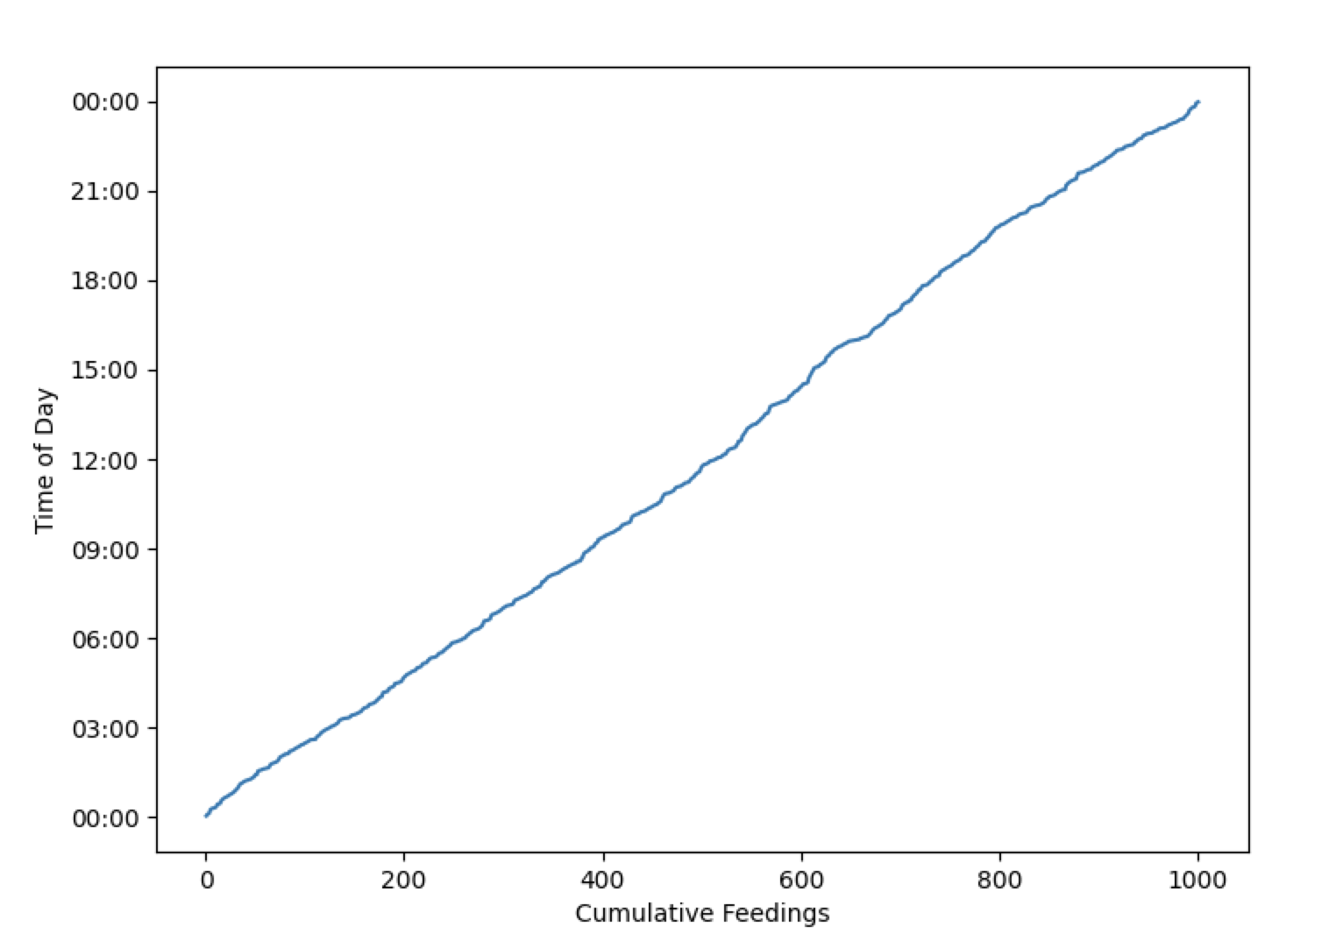
Window Functions
Suppose I want to compute a CDF of animal feedtimes
Consider a table like:
times (hour int, minute int, animalid int)
Tricky to do this in regular SQL; idea:
Sort by hour, minute
For each row X, select the number of rows with hour <= X.hour and minute <= X.minute
What if we want to partition this and get a CDF for each animal separately?
What if we want the 7 day moving average of feedtimes?
Generally a pain to work with ordered data in SQL….
Correlated subexpression: references outer table, evaluated once per outer table row!
SELECT hour, minute,
(SELECT count(*)
FROM times t2
WHERE (t.hour = t2.hour AND t. minute >= t2.minute)
OR (t.hour > t2.hour))
FROM times t
ORDER BY hour, minute

Slide 51
Window Functions
hour | minute
4 | 30
1 | 15
2 | 00
times (hour int, minute int, animalid int)
Compute the value of window_func for each row of each partition
SELECT x, y, ..., window_func(params)
OVER (PARTITION BY alist1 ORDER BY alist2)
Split the rows into partitions by alist1
Within each partition order rows by alist2
Example:
SELECT hour, minute, RANK() OVER (ORDER BY hour, minute) FROM times
Compute the rank of each row
hour | minute
1 | 15
2 | 00
4 | 30
1
2
3

Slide 52
Window Functions
hour | min | animalid
4 | 30 | 1
1 | 15 | 2
2 | 00 | 2
3 | 10 | 1
5 | 00 | 2
1 | 30 | 1
times (hour int, minute int, animalid int)
Example:
SELECT animalid hour, minute, RANK()
OVER (PARTITION BY animalid ORDER BY hour, minute) FROM times
animal | hour | minute
1 | 4 | 30
1 | 2 | 00
1 | 3 | 10
animal | hour | minute
1 | 2 | 00
1 | 3 | 10
1 | 4 | 30
1
2
Split by animal, compute the rank of each row
order
3
animal | hour | minute
2 | 1 | 15
2 | 2 | 00
2 | 5 | 00
animal | hour | minute
2 | 1 | 15
2 | 2 | 00
2 | 5 | 00
1
2
3

Slide 53
Other Window Functions
cume_dist() : cumulative position of the row (between 0 and 1) in total ordering
lag(value, offset): return the value for the record offset records before this one
sum() / count() / avg() : sum / count / average of all rows in partition
For these expressions, OVER clause can include a frame that defines the subset of the partition to be included (Example on next slide)

Slide 54
Examples
times
hour | min | qty
4 | 30 | 10
1 | 15 | 20
2 | 00 | 30
3 | 10 | 40
Times with feed quantities
SELECT hour, min, cume_dist()
OVER (ORDER BY hour, min) as c FROM times
hour | min | c
1 | 15 | 0.25
2 | 0 | 0.5
3 | 10 | 0.75
4 | 30 | 1
SELECT hour, min, avg(qty)
OVER (ORDER BY hour, min
ROWS BETWEEN 2 PRECEDING AND CURRENT ROW) AS rolling_avg FROM times
“Frame”
SELECT hour, min, qty, lag(qty,1)
OVER (ORDER BY hour, min) as lag FROM times
hour | min | rolling_avg
1 | 15 | 20
2 | 0 | 25
3 | 10 | 30
4 | 30 | 26.67
hour | min | qty | lag
1 | 15 | 20
2 | 0 | 30 | 20
3 | 10 | 40 | 30
4 | 30 | 10 | 40

Slide 55
Study Break
Write a SQL query with window function to compute the difference between sales a week ago and today
Sales Table
Functions
Queries
Date | Sales
1/1/2022 | 5540
…
1/8/2022 | 7000
…
1/15/2022 | 9000
SELECT hour, min, cume_dist()
OVER (ORDER BY hour, min) as c FROM times
rank(): rank of items in ordering
cume_dist(): cumulative position of the row (between 0 and 1) in total ordering
lag(value, offset): return the value for the record offset records before this one
sum() / count() / avg() : sum / count / average of all rows in partition
SELECT hour, min, avg(qty)
OVER (ORDER BY hour, min
ROWS BETWEEN 2 PRECEDING AND CURRENT ROW) AS rolling_avg FROM times
+1460
+2000
SELECT hour, min, qty, lag(qty,1)
OVER (ORDER BY hour, min) as lag FROM times
Assume 1 row per day

Slide 56
Soln
Write a SQL query with window function to compute the difference between sales a week ago and today
Date | Sales
1/1/2022 | 5540
…
1/8/2022 | 7000
…
1/15/2022 | 9000
SELECT date, sales, sales - lag(sales,7)
OVER (ORDER BY date) difference FROM sales
+1460
+2000

Slide 57
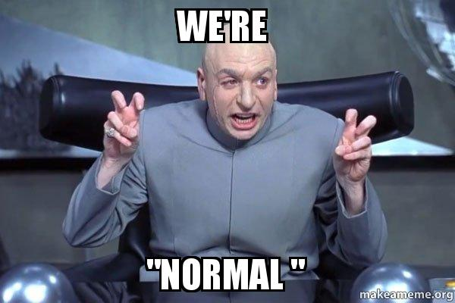
Database Design and Normalization

Slide 58
Today
Recap Window Functions
Schema normalization and normal forms

Slide 59
Window Functions
hour | minute
4 | 30
1 | 15
2 | 00
times (hour int, minute int, animalid int)
Compute the value of window_func for each row of each partition
SELECT x, y, ..., window_func(params)
OVER (PARTITION BY alist1 ORDER BY alist2)
Split the rows into partitions by alist1
Within each partition order rows by alist2
Example:
SELECT hour, minute, RANK() OVER (ORDER BY hour, minute) FROM times
Compute the rank of each row
hour | minute
1 | 15
2 | 00
4 | 30
1
2
3

Slide 60
Window Functions
hour | min | animalid
4 | 30 | 1
1 | 15 | 2
2 | 00 | 2
3 | 10 | 1
5 | 00 | 2
1 | 30 | 1
times (hour int, minute int, animalid int)
Example:
SELECT animalid hour, minute, RANK()
OVER (PARTITION BY animalid ORDER BY hour, minute) FROM times
animal | hour | minute
1 | 4 | 30
1 | 2 | 00
1 | 3 | 10
animal | hour | minute
1 | 2 | 00
1 | 3 | 10
1 | 4 | 30
1
2
Split by animal, compute the rank of each row
order
3
animal | hour | minute
2 | 1 | 15
2 | 2 | 00
2 | 5 | 00
animal | hour | minute
2 | 1 | 15
2 | 2 | 00
2 | 5 | 00
1
2
3

Slide 61
Other Window Functions
cume_dist() : cumulative position of the row (between 0 and 1) in total ordering
lag(value, offset): return the value for the record offset records before this one
sum() / count() / avg() : sum / count / average of all rows in partition
For these expressions, OVER clause can include a frame that defines the subset of the partition to be included (Example on next slide)

Slide 62
Examples
times
hour | min | qty
4 | 30 | 10
1 | 15 | 20
2 | 00 | 30
3 | 10 | 40
Times with feed quantities
SELECT hour, min, cume_dist()
OVER (ORDER BY hour, min) as c FROM times
hour | min | c
1 | 15 | 0.25
2 | 0 | 0.5
3 | 10 | 0.75
4 | 30 | 1
SELECT hour, min, avg(qty)
OVER (ORDER BY hour, min
ROWS BETWEEN 2 PRECEDING AND CURRENT ROW) AS rolling_avg FROM times
“Frame”
hour | min | rolling_avg
1 | 15 | 20
2 | 0 | 25
3 | 10 | 30
4 | 30 | 26.67
SELECT hour, min, qty, lag(qty,1)
OVER (ORDER BY hour, min) as lag FROM times
hour | min | qty | lag
1 | 15 | 20
2 | 0 | 30 | 20
3 | 10 | 40 | 30
4 | 30 | 10 | 40

Slide 63
Study Break
Write a SQL query with window function to compute the difference between sales a week ago and today
Sales Table
Functions
Queries
Date | Sales
1/1/2022 | 5540
…
1/8/2022 | 7000
…
1/15/2022 | 9000
SELECT hour, min, cume_dist()
OVER (ORDER BY hour, min) as c FROM times
rank(): rank of items in ordering
cume_dist(): cumulative position of the row (between 0 and 1) in total ordering
lag(value, offset): return the value for the record offset records before this one
sum() / count() / avg() : sum / count / average of all rows in partition
SELECT hour, min, avg(qty)
OVER (ORDER BY hour, min
ROWS BETWEEN 2 PRECEDING AND CURRENT ROW) AS rolling_avg FROM times
+1460
+2000
SELECT hour, min, qty, lag(qty,1)
OVER (ORDER BY hour, min) as lag FROM times
Assume 1 row per day

Slide 64
Soln
Write a SQL query with window function to compute the difference between sales a week ago and today
Sales Table
Date | Sales
1/1/2022 | 5540
…
1/8/2022 | 7000
…
1/15/2022 | 9000
SELECT date, sales, sales - lag(sales,7)
OVER (ORDER BY date) difference FROM sales
+1460
+2000
Assume 1 row per day

Slide 65
Entity Relationship Modeling Already Saw with Zoo
1
Animal
n
contains
1
Cage
1
entity
relationship
entity
name
n
feedTime
1
1
Name
Time
keeps
1
age
Building
1
bldg
Age
n
species
Keeper
1
name
1
entity
Species
1
Name
Animals have names, ages, species
Keepers have names
Cages have cleaning times, buildings
Animals are in 1 cage; cages have multiple animals
Keepers keep multiple cages, cages kept by multiple keepers

Slide 66
ER Diagrams
Rectangle: Entity
Keeper
1
1
Age
Oval: Attribute
1
ID
Keeps
Underline: KEY
Diamond:
Relationship
N
Relationship Cardinality
N:1 Each keeper keeps 0 or more cages
Each cage kept by 0 or 1 keeper
N:N Each keeper keeps 0 or more cages
Each cage kept by 0 or more keeper
Cages

Slide 67
More ER Modeling
N
Supervisee
Supervises
Keeper
1
1
Age
1
Supervisor
Recursive relationship: Each keeper supervises 0 or more other supervisee keepers
1
ID
Keeps
keepTime
Double line: Total participation
Each cage kept by exactly one keeper
N
Relationship attributes
Cages

Slide 68
Converting to Relations
N
Supervisee
Supervises
Keeper
Age
1
Supervisor
1
ID
Keeps
keepTime
N
Cages
supervisor REFERENCES Keepers.ID …)
Keepers: (ID, age, …
Cages: (keptby NON NULL REFERENCES Keepers.id,
keepTime, … )

Slide 69
Study Break
N
Supervisee
Supervises
Keeper
Age
N
Supervisor
N
ID
Keeps
keepTime
N
Cages
What if we change the relationships to be N:N?
(I.e., employees can have multiple supervisors, cages can be kept by multiple keepers?)

Slide 70
Solution
N
Supervisee
Supervises
Keeper
Age
N
Supervisor
N
ID
Keeps
keepTime
N
Cages
Keeps: (ID, age)
Cages: (CageID, …)
Keeps: (kid, cid, keepTime)
Supervises: (supervisor_kid, supervisee_kid)

Slide 71
Hobbies Example
Consider a database about people & their hobbies
Entity Relationship Diagram
SSN
Name
Address
Person
Hobby
n:n
Cost
Name
People have names and addresses, hobbies have costs
People can have multiple hobbies, and hobbies can be practiced by multiple people

Slide 72
Hobby DB, Attempt 1
SSN | Name | Address | Hobby | Cost
123 | john | main st | dolls | $
123 | john | main st | bugs | $
345 | mary | lake st | tennis | $$
456 | joe | first st | dolls | $
Table key is Hobby, SSN
“Wide” schema
– has redundancy (wasted space)
– anomalies in the presence of updates, inserts, and deletes
+ avoids joins

Slide 73
Types of Anomalies
Update anomaly
E.g., address needs to change in several places
Creates possibility for inconsistency
Insertion anomaly - what if we want to add someone with no hobby?
Can we use NULLs?
Problem: hobby is a part of the key!
Solution: “Normalize”!

Slide 74
Hobby DB Attempt 2
SSN | Hobby
123 | dolls
123 | bugs
345 | tennis
456 | dolls
SSN | Name | Address | Cost
123 | john | main st | $
345 | mary | lake st | $$
456 | joe | first st | $
“Lossy decomposition”
No redundancy, but we have lost some information (cost of hobbies)

Slide 75
Normalization
Normalized: a schema that is redundancy free
As much as possible
And that preserves dependencies
As much as possible
Several methods:
ER Diagrams
Use functional dependencies and normal forms

Slide 76
Schema From ER Diagram
SSN | Name | Address
123 | john | main st
345 | mary | lake st
456 | joe | first st
Hobby | Cost
dolls | $
bugs | $
tennis | $$
SSN | Name | Address | Hobby | Cost
123 | john | main st | dolls | $
123 | john | main st | bugs | $
345 | mary | lake st | tennis | $$
456 | joe | first st | dolls | $
SSN→Name, Address
Hobby→Cost
Hobby | SSN
dolls | 123
bugs | 123
tennis | 345
dolls | 456
Schema is free of anomalies and redundancy
SSN
Entity Relationship Diagram
Name
Address
Person
n:n
Hobby
Cost
Hobby, SSN → Hobby, SSN
Name

Slide 77
Why Does Redundancy Arise?
When a subset of attributes are uniquely determined by a subkey
E.g., SSN determines name, address
Key is SSN, Hobby
Each row with same SSN will duplicate data!
SSN | Name | Address | Hobby | Cost
123 | john | main st | dolls | $
123 | john | main st | bugs | $
345 | mary | lake st | tennis | $$
456 | joe | first st | dolls | $

Slide 78
Functional Dependencies
X → Y
Attributes X uniquely determine Y
I.e., for every pair of instances x1, x2 in X, with y1, y2 in Y, if x1=x2, y1=y2
For Hobbies, we have:
SSN → Name, Addr
Hobby → Cost
SSN, Hobby → Name, Addr, Cost
1 & 2 imply 3, by union (“Armstrong’s Axioms”)
F1: A → B, F2: C→D, F1 U F2= A U C → B U D

Slide 79
FDs are a Property of the Application, Not the Data
Can’t necessarily tell the FDs by looking at the data
Given the FDs, can verify that the data satisfies them!
Example: Is cost property of hobby or person?
SSN | Name | Address | Hobby | Cost
123 | john | main st | dolls | $
123 | john | main st | bugs | $
345 | mary | lake st | tennis | $$
456 | joe | first st | dolls | $
SSN
ER Diagram forces DB designer to model this!
Name
Address
Person
n:n
Hobby
Cost
Name

Slide 80
Boyce-Codd Normal Form (BCNF)
For a relation R, with FDs of the form X→Y, it is in BCNF iff
Every FD is either:
1) Trivial (e.g., Y contains X) (SSN → SSN, Name)
2) X is a key of the table
If an FD violates 2), multiple rows with same X value may occur
Indicates redundancy, as rows with given X value all have same Y value
E.g., SSN → Name, Addr in non-decomposed hobbies schema
SSN is not a key of the whole table
Name, Addr repeated for each appearance of a given SSN
To put a schema into BCNF, create subtables of form XY
E.g., tables where key is left side (X) of one or more FDs
Repeat until all tables in BCNF
Effectively eliminates redundancy, while preserving (most) dependencies

Slide 81
BCNFify
BCNFify(schema R, functional dependency set F):
D = {(R,F)} // D is set of output relations
while there is a (schema ,FD set) pair (S,F') in D not in BCNF, do:
given X→Y as a BCNF-violating dependency in F’
replace (S,F’) in D with
S1 = (XY,F1) and
S2 = ((S-Y) U X, F2)
where F1 and F2 are the FDs in F’ over XY or (S-Y) U X, respectively
End
return D

Slide 82
BCNFify Example for Hobbies
Did we lose S,H → N,A,C? No!
S,H → N, A, C is implied by H→C and S→N,A
No, using union rule from Armstrong’s Axioms,
S+H -> N,A + C
Iter 1
S = SSN, H = Hobby, N = Name, A = Addr, C = Cost
Schema | FDs
(S,H,N,A,C) | S,H → N,A,C S → N, A H → C
Iter 2
Schema | FDs
(S, N,A) | S → N, A
violates bcnf
Schema | FDs
(S,H, C) | S,H → C H → C
key
violates bcnf
S,H → N, A, C implies
S,H → C
Schema | FDs
(H, C) | H → C
3 remaining tables are same as in ER decomposition
Schema | FDs
(S,H)

Slide 83
Account, Client, Office
FD’s
Client, Office → Account
Each client/office has only one account
Account → Office
All records for a given account at same office
Account | Client | Office
a | joe | 1
b | mary | 1
a | john | 1
c | joe | 2

Slide 84
Account, Client, Office
FD’s
Client, Office → Account
Each client/office has only one account
Account → Office
All records for a given account at same office
Account | Client | Office
a | joe | 1
b | mary | 1
a | john | 1
c | joe | 2
Redundancy!

Slide 85
A Dilemma
FD’s
Client, Office → Account
Account → Office
This is not in BCNF
Put account, office in separate tables?
ao_id | Account | Office
1 | a | 1
2 | b | 1
3 | c | 2
ao_id | Client
1 | joe
2 | mary
1 | john
3 | joe
BCNF, but can’t check CO → A without a join

Slide 86
BCNF vs 3NF
BCNF is not “dependency preserving”
3rd Normal Form (3NF) eliminates as much redundancy as possible while preserving all dependencies
We will skip the details
Neither form is “better”
You can choose either dependency preservation (3NF) or redundancy-free (BCNF)

Slide 87
Study Break
Patient database
Want to represent patients at hospitals with doctors
Patients have names, birthdates
Doctors have names, specialties
Hospitals have names, addresses
One doctor can treat multiple patients, each patient has one doctor
Each patient in one hospital, hospitals have many patients
1) Draw an ER diagram
2) What are the functional dependencies
3) What is the normalized schema? Is it redundancy free?

Slide 88
Solution
Patients have names, birthdates
Doctors have names, specialties
Hospitals have names, addresses
One doctor can treat multiple patients, each patient has one doctor
Each patient in one hospital, hospitals have many patients
Did
Pid
Pname
Patient
N
Treats
1
Doctor
Dname
N
Bday
IsIn
1
Specialty
Hospital
Hid
Hname
Addr
Patients (Pid, Pname, Bday, P_Did, P_Hid)
Pid → Pname, Bday, P_Did, P_Hid
Hospitals (Hid, Hname, Addr)
Hid → Hname, Addr
Did → Dname, Specialty
Doctors (Did, Dname, Speciality)

Slide 89
Recap
Properly normalized schemas avoid redundancy and preserve dependencies
Functional dependencies and normal forms (e.g., BCNF) give us a formal way to reason about these concepts
In practice, people use ER modeling to derive a schema in BCNF rather than the BCNFify algorithm

Slide 90
What is SimpleDB?
A basic database system
SQL Front-end (Provided for later labs)
Heap files (Lab 1)
Buffer Pool (Labs 1-6)
Basic Operators (Labs 1 & 2)
Scan, Filter, JOIN, Aggregate
Query optimizer (Lab 3)
Transactions (Lab 4)
B-Tree Indexes (Lab 5)
Recovery (Lab 6)
Javadoc is your friend!

Slide 91
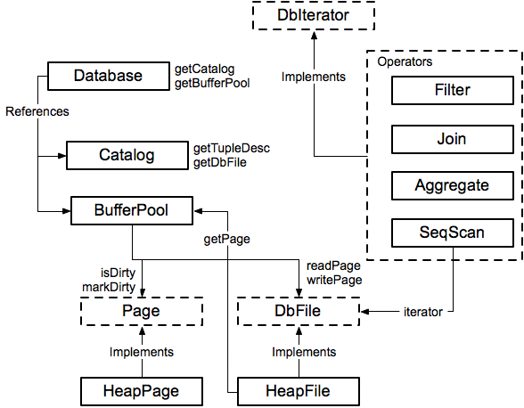
Module Diagram

Slide 92
Database
Singleton Database:
Database.getCatalog()
Database.getBufferPool()
Catalog
=> List of DB tables
BufferPool
=> Caches DB pages in memory
Database.getLogFile()
LogFile (Ignore for Lab 1)

Slide 93
Catalog
Catalog:
DbFile ID | Table
001 | Table1
002 | Table2
003 | Table3
Table:
DbFile file
String name
String primary_key
=> Stores a list of all tables in the database
Notes:
Catalog stores a list of available tables, TupleDesc
void addTable(DbFile d, TupleDesc d)‏
DbFile getTable(int tableid)‏
TupleDesc getTupleDesc(int tableid)‏
Not persisted to disk

Slide 94
BufferPool
Buffer Pool:
Page ID | Page
001 | Page1
003 | Page3
007 | Page7
Page:
PageId id
Tuple tuples[]
Byte header[]
=> Caches recently accessed database pages in memory
Notes:
Manages cache of pages
Evicts pages when cache is full [not lab 1]
All page accesses should use getPage
Even from inside DbFile!
You will eventually implement
locking for transactions
Flushing of pages for recovery

Slide 95
HeapFile (Implements DbFile)
File (on disk):
_______________
Heap File:
File file
TupleDesc td
DbFileIterator it
Tuple Descriptor:
Field1 Type Field1 Name | Field2 Type Field2 Name | Field3 Type Field3 Name | …
Iterate through Tuples in Heap Pages:
Page1 | Page2 | Page3 | …
Notes:
An array of HeapPages on disk
Javadoc is your friend!
Implement everything except addTuple and removeTuple

Slide 96
HeapPage (Implements Page)
Tuple Descriptor:
Heap Page:
Field1 Type Field1 Name | Field2 Type Field2 Name | Field3 Type Field3 Name | …
HeapPageId pid
TupleDesc td
Byte header[]
Tuple tuples[]
Header:
01100110 | 11111111 | 11101101 | …
Tuples:
Empty | Tuple1 | Tuple2 | …
Tuple:
Field1 | Field2 | Field3 | …
Fields and Tuples are Fixed Width!
Notes:
Format
Header is a bitmap
Page contents are an array of fixed-length Tuples
Full page size = BufferPool.PAGE_SIZE
Number of bits in Header = number of Tuples
Header size + size of tuples = BufferPool.PAGE_SIZE
Note endianness!

Slide 97
SeqScan (Implements DbIterator)
DbIterator class implemented by all operators
open()‏
close()‏
getTupleDesc()‏
hasNext()‏
next()‏
rewind()‏
Iterator model: chain iterators together
Use DbFileIterator from HeapFile

Slide 98
// construct a 3-column table schema
Type types[] = new Type[]{ Type.INT_TYPE, Type.INT_TYPE, Type.INT_TYPE };
String names[] = new String[]{ "field0", "field1", "field2" };
TupleDesc descriptor = new TupleDesc(types, names);
// create the table, associate it with some_data_file.dat
// and tell the catalog about the schema of this table.
HeapFile table1 = new HeapFile(new File("some_data_file.dat"), descriptor);
Database.getCatalog().addTable(table1);
// construct the query: we use a simple SeqScan, which spoonfeeds
// tuples via its iterator.
TransactionId tid = new TransactionId();
SeqScan f = new SeqScan(tid, table1.id());
// and run it
f.open();
while (f.hasNext()) {
Tuple tup = f.next();
System.out.println(tup);
}
f.close();
Database.getBufferPool().transactionComplete();

Slide 99
HeapFileEncoder.java
Because you haven’t implemented insertTuple, you have no way to create data files
HeapFileEncoder converts CSV files to HeapFiles
Usage:
java -jar dist/simpledb.jar convert csv-file.txt numFields
Produces a file csv-file.dat, that can be passed to HeapFile constructor.

Slide 100
Next Time
Relational database design
Normal forms

Slide 101
IDE Setup and Running Tests
Geoffrey to Demo

