Slide 1
6.5830 Lecture 4
Database Internals
September 18, 2023

Slide 2
What happens inside?
SELECT * FROM animals
WHERE species = ‘Giraffe’
id | name | age | species | cageno
2 | Mike | 12 | Giraffe | 1

Slide 3
What happens inside?
SELECT name, addr, balance FROM accounts
WHERE userid = ?
name | addr | balance
… | … | …

Slide 4
What happens inside?
SELECT image, imgid
FROM planet_images
WHERE likelyPlanet(image)=TRUE
Database systems can support
interactive queries
web applications
large-scale science
and many other workloads
image | imgid
… | …

Slide 5
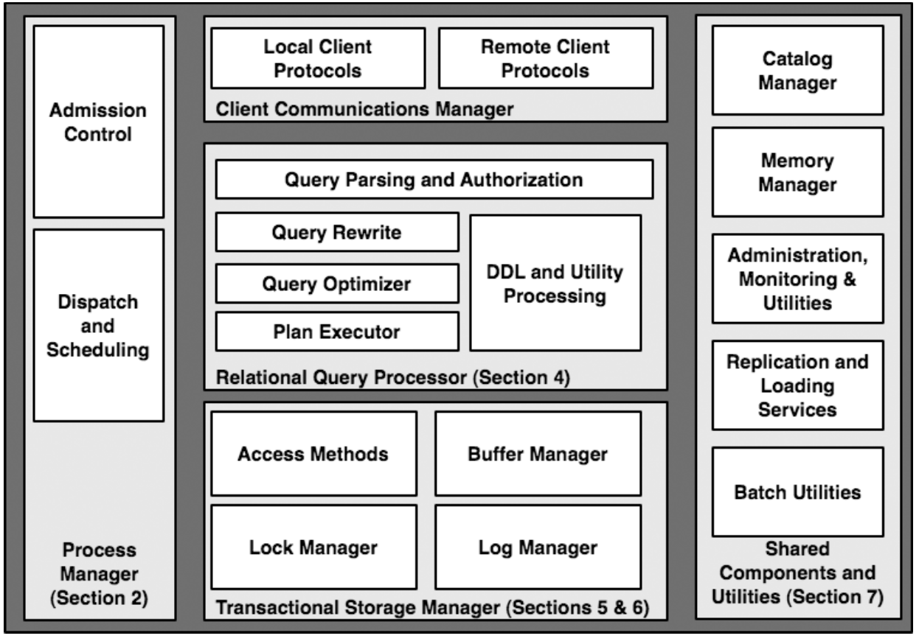
What happens inside?

Slide 6
What happens inside?
Why do you need admission control? Why is scheduling important?
Notes:
Process models --
why does this matter? (what happens if you get it wrong)
process per connection (why is this bad? why is it good? how does memory management work?)
process per server, w/ worker threads
additional processes for asynchronous I/O
how many threads/processes should i have?
- dispatch thread
- worker threads
- I/O for asynchrony

Slide 7
What happens inside?
Client makes conn, xmits SQL
Admission control prevents too much incoming work
Check role-based privileges
Query gets assigned to a “worker”
How should you do the work?
Process per worker
Thread per worker
Process pool
Notes:
Process models --
why does this matter? (what happens if you get it wrong)
process per connection (why is this bad? why is it good? how does memory management work?)
process per server, w/ worker threads
additional processes for asynchronous I/O
how many threads/processes should i have?
- dispatch thread
- worker threads
- I/O for asynchrony

Slide 8
What happens inside?

Slide 9
What happens inside?

Slide 10
What happens inside?

Slide 11
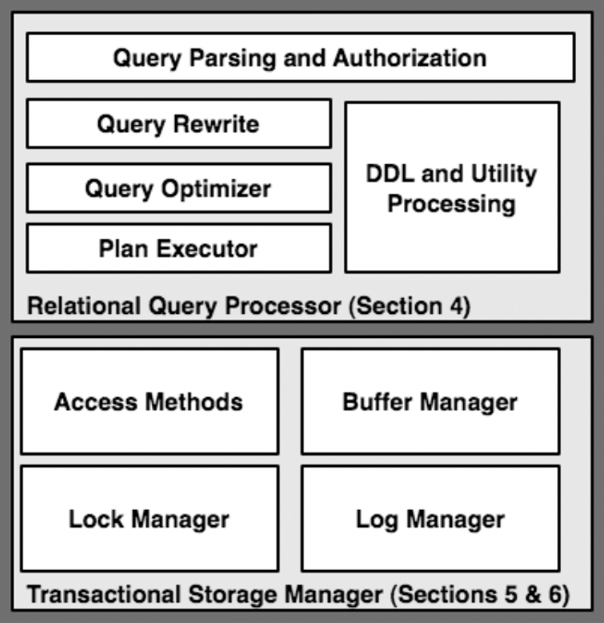
What happens inside?

Slide 12
DB Core Components
Admission Control
Connection Management
Query System
Parser
Rewriter
Planner
Optimizer
Executor
Storage System
Access Methods
Buffer Manager
Lock Manager
Log Manager

Slide 13
Flow of a Query
Admission Control
Connection Management
Query System
SQL
Parser
Parse Tree
Π_{movieTitle}
Rewriter
Π_{movieTitle}
⨝
starName = name
𝛔_{birthday…}
Planner
Optimizer
⨝
starName = name
𝛔_{birthday…}
starsIn
Query Plan
Executor
movieStar
movieStar
starsIn
Storage System
Access Methods
Buffer Manager
Lock Manager
Log Manager

Slide 14
Plan for Next Few Lectures
Admission Control
Connection Management
Query System
Parser
Today
Rewriter
Planner
Optimizer
(Lec 9)
Today+Lec 5
Lec 7 – Join Algos
Executor
Storage System
Access Methods
Buffer Manager
Lock Manager
Log Manager
Lec 6

Slide 15
Query Processing Steps
Admission Control
Query Rewriting
Plan Formulation (SQL → Tree)
Optimization

Slide 16
Query Processing Steps
Admission Control
Query Rewriting
Plan Formulation (SQL → Tree)
Optimization

Slide 17
Query Rewriting
View Substitution
Predicate Transforms
Subquery Flattening

Slide 18
View Substitution
emp : id, sal, age, dept
select sal from (
)where dept = 'eecs';
create view sals as (
)
select dept, avg(sal) as sal
from emp
group by dept
select sal from sals where dept = 'eecs';

Slide 19
Predicate Transforms
Remove & simplify expressions, improve
Constant Simplification
WHERE sal > 1000 + 4000 ➔ WHERE sal > 5000
Exploit constraints
a.did = 10 and a.did = dept.dno
Remove redundant expressions
a.sal > 10k and sal > 20k
and dept.dno = 10

Slide 20
Predicate Transforms
Remove & simplify expressions, improve
Constant Simplification
WHERE sal > 1000 + 4000 ➔ WHERE sal > 5000
Exploit constraints
a.did = 10 and a.did = dept.dno
Remove redundant expressions
a.sal > 10k and sal > 20k
and dept.dno = 10

Slide 21
Subquery Flattening
Many Subqueries Can Be Eliminated
select sal from (
select dept, avg(sal) as sal
from emp
group by dept
)where dept = 'eecs';
select avg(sal)
from emp
group by dept
having dept = 'eecs';
Can you come up with an example where this is not possible?

Slide 22
Subquery Flattening
Many Subqueries Can Be Eliminated
Not always possible; consider
select sal from (
select dept, avg(sal) as sal
from emp
group by dept
)where dept = 'eecs';
select avg(sal)
from emp
group by dept
having dept = 'eecs';
create view sals as {
select distinct dept, sal
from emp
}
?
select avg(sal) from (
select distinct dept, sal
from emp
)
select avg(distinct sal) from emp
select avg(sal) from sals

Slide 23
Study Break (Tricky)
Flatten this query (departments where number of machines is more than number of employees):
SELECT dept.name
FROM dept
WHERE dept.num_machines >=
(SELECT COUNT(emp.*)
FROM emp
WHERE dept.name=emp.dept_name)

Slide 24
https://clicker.mit.edu/6.5830/
SELECT dept.name FROM dept
WHERE dept.num_machines >= (SELECT COUNT(emp.*) FROM emp
WHERE dept.name=emp.dept_name)
Original
SELECT dept.name
FROM dept d, emp e
WHERE d.name=e.dept_name
and d.num_machines >= COUNT(e.*)
GROUP BY d.name, d.num_machines
SELECT dept.name
FROM dept d, emp e
WHERE d.name=e.dept_name
GROUP BY d.name
HAVING COUNT(d.num_machines) >= COUNT(e.*)
A
B
C
D
SELECT dept.name
FROM dept d, emp e
WHERE d.name=e.dept_name
GROUP BY d.name, d.num_machines
HAVING d.num_machines >= COUNT(e.*)
SELECT dept.name
FROM dept d
LEFT OUTER JOIN emp e
ON (d.name=e.dept_name)
GROUP BY d.name, d.num_machines
HAVING d.num_machines >= COUNT(e.*)
Notes:
D

Slide 25
Answer
“Query rewrite optimization rules in IBM DB2 universal database”
“Rule Engine for Query Transformation in Starburst and IBM DB2 C/S DBMS “
SELECT dept.name
FROM dept, emp
WHERE dept.name=emp.dept_name
GROUP BY dept.name,
dept.num_machines
HAVING dept.num_machines >= COUNT(emp.*)
SELECT dept.name
FROM dept
LEFT OUTER JOIN emp ON (dept.name=emp.dept_name)
GROUP BY dept.name,
dept.num_machines
HAVING dept.num_machines >= COUNT(emp.*)
Notes:
WHAT IS A LEFT-OUTER-JOIN?
Traditional join return tuples that are in the intersection between two tables.
LEFT OUTER JOIN always returns tuples from the left hand side, and returns results from the right when possible. If there is no join possible with the right-hand side, the tuple is still returned, just with NULLs in the right hand values.
WHAT IS THE SYNTAX FoR COUNT()?
The parameter tells you what’s COUNTed. Why does that matter here?
Well, COUNT doesn’t increment the count when the value is NULL. So this asks us to count the rows that have non-NULL emp values

Slide 26
Sample DB
test=# select * from dept;
name | num_machines
------+--------------
eecs | 10
me | 1
(2 rows)
test=# select * from emp;
eid | dept_name
-----+-----------
1 | me
2 | me
(2 rows)

Slide 27
Query Processing Steps
Admission Control
Query Rewriting
Plan Formulation (SQL → Tree)
Optimization

Slide 28
Plan Formulation
Π_{ename,count}
emp (eno, ename, sal, dno)
dept (dno, dname, bldg)
kids (kno, eno, kname, bday)
SELECT ename, count(*)
FROM emp, dept, kids
AND emp.dno=dept.dno
AND kids.eno=emp.eno
AND emp.sal > 50000
AND dept.name = 'eecs'
GROUP BY ename
HAVING count(*) > 7
𝛔_{count > 7}
𝛂_{agg:count(*), group by ename}
⨝
eno=eno
⨝
dno=dno
kids
𝛔_{name=‘eecs’}
𝛔_{sal>50k}
dept
emp
Notes:
Pi for projection
Sigma for selection
Alpha for aggregation

Slide 29
Query Optimization
Π_{ename,count}
Logical planning: operator ordering (exponential search space)
Physical planning: operator implementation & access methods (indexes vs heap files)
𝛔_{count > 7}
𝛂_{agg:count(*), group by ename}
⨝
eno=eno
Order?
⨝
dno=dno
kids
𝛔_{name=‘eecs’}
𝛔_{sal>50k}
Implementation?
Storage model & access methods?
dept
emp
Notes:
Several different approaches to building an optimizer:
1) heuristic -- a set of rules that are designed to lead
to a good plan (e.g., push selections to leaves, perform cross products last, etc.)
2) cost-based -- enumerate all possible plans, pick one of lowest cost -- we will discuss how this works in a couple weeks
-------------------------------------------------------------------------
(discuss pipelining)
pipelining -- means that results of one operator can be fed into another operator

Slide 30
Joins and Ordering
Consider a nested loop join operator of tables Outer and Inner
for tuple1 in Outer for tuple2 in Inner if predicate(tuple1, tuple2) then emit join(tuple1, tuple2)
What if Inner is itself a join result?
Plans might be “left-deep” or “bushy”
Notes:
Left deep vs. bushy
What happens if you have a nested join algorithm?
"left deep" plan

Slide 31
Plan for Next Few Lectures
Admission Control
Connection Management
Query System
Parser
Today
Rewriter
Planner
Optimizer
(Lec 9)
Today+Lec 5
Lec 7 – Join Algos
Executor
Storage System
Access Methods
Buffer Manager
Lock Manager
Log Manager
Lec 6
Notes:
OK, so let’s now take a quick tour of EXECUTION and THE STORAGE SYSTEM. We will go into these in detail later, but we need to know a bit right now to make progress.

Slide 32
Query Execution
Executing a query involves chaining together a series of operators that implement the query
Operator types: scan from disk/mem
filter records
join records
aggregate records
→ Requires a model of data representation
Π_{movieTitle}
⨝
starName = name
𝛔_{birthday…}
starsIn
movieStar

Slide 33
Physical Layout
Arrangement of records on disk / in memory
Disk / memory are linear, tables are 2D
 | A | B | C | D
1
2
3
How would you store the table on disk?
Knowing that you must efficiently support
inserts, deletes, and that some records are more often read than others?
1
2
3
Notes:
In order to understand how these queries are actually executed, we need to develop a model of how data is stored on disk.
All records are stored in a region on disk ("extent" in system R); probably easiest to just think of each table being in a file in the file system.
Tuples are arranged in pages in some order --> "heap file"
Access path is a way to access these tuples on disk.
Several alternatives:

Slide 34
Physical Layout
Arrangement of records on disk / in memory
Disk / memory are linear, tables are 2D
”Row Major” - Row at a time
 | A | B | C | D
1
2
3
Disk
1
2
3
0 1 2 3 4 5
6 7 8 9 10 11
Notes:
In order to understand how these queries are actually executed, we need to develop a model of how data is stored on disk.
All records are stored in a region on disk ("extent" in system R); probably easiest to just think of each table being in a file in the file system.
Tuples are arranged in pages in some order --> "heap file"
Access path is a way to access these tuples on disk.
Several alternatives:

Slide 35
Physical Layout
Arrangement of records on disk / in memory
Disk / memory are linear, tables are 2D
”Row Major” - Row at a time
“Column Major” Column at a time
Disk
A | B | C | D
For now, let’s assume row-major!
A
B
C
0 1 2 3 4 5
6 7 8 9 10 11

Slide 36
How would you store records on disk?

Slide 37
Accessing Data
Access Method: way to read data from disk
Heap File: unordered arrangement of records
Arranged in pages
You read/write/cache data in the granularity of pages.
Hdr | R1 | R2 | R3 | R4
Hdr | R4 | R5 | R6 | R7
Hdr | R8 | R9 | R10 | R11
…
Page 1 Page 2 Page 3
Header: Start offset of each record, which parts of page are occupied, etc
Get Page 3 = Page# * PageSize
Notes:
heap scan
heap file is a unordered collection of records split into fixed size pages
header on each page to indicate where tuples begin
pages chained together (e.g., in a linked list)

Slide 38
Heap Scan
Read Heap File In Stored Order
Even with a predicate, read all records
Hdr | R1 | R2 | R3 | R4
Hdr | R4 | R5 | R6 | R7
Hdr | R8 | R9 | R10 | R11
…
Page 1 Page 2 Page 3

Slide 39
https://clicker.mit.edu/6.5830/
Hardware (e.g., SSDs) and OS (e.g., virtual memory) also use pages. They often are 4KB large. Why does a database management introduce yet another paging mechanism?

Slide 40
Page designs
Strawman idea: Keep track of tuples in a page?
Any problems with this design?
numUsed = 3
Tuple1
Tuple2
Tuple3

Slide 41
Page designs
Strawman idea: Keep track of tuples in a page?
What happens with deletes?
What happens with variable length tuples (e.g., variable length strings)?
numUsed = 3
Tuple1
Tuple3

Slide 42
Slotted pages
Common layout scheme
Slot array maps "slots" to tuples starting postion
The header keeps track of: → The # of used slots → The offset of the starting location of the last slot used.
Header
Tuple1
Tuple4
Tuple3
Tuple3
Tuple2
Tuple1

Slide 43
Slotted pages
Header
How would you simplify the layout if tuples have a fixed length?
Do you need to store the slot map?
Tuple1
Tuple4
Tuple3
Tuple3
Tuple2
Tuple1

Slide 44
Index
Index maps from a value or range of values of some attribute to records with that value or values
Several types of indexes, including trees (most commonly B+Trees) and hash indexes
API:
Lookup(value) → records
Lookup(v1 .. vn) → records
Value is an attribute of the table, called the “key” of the index
Notes:
what is an index? what does it do?
insert (key, recordid) --> points from a key to a record on disk
{records} = lookup (key)
{records} = lookup ([lowkey ... highkey])
Hierarchical indices are the most commonly used-- e.g., B-Trees
In most databases, indexes point from key values to records in the heap file.
Typically, in a database, indexes are keyed on a particular attribute (e.g., employee salary), which allows efficient lookup on that attribute.

Slide 45
Tree Index
<3 | ≥3, <5 | ≥5, <7 | ≥8, 9
Index File
0 | 1 | 2 | 2 | 2
3 | 4
5 | 6
8 | 9 | 9
Hdr | R1 | R2 | R3 | R4
 | 3 | 2 | 9 | 4
Hdr | R4 | R5 | R6 | R7
 | 6 | 1 | 0 | 2
Hdr | R8 | R9 | R10 | R11
 | 9 | 8 | 2 | 5
Heap File
Attr1
…
Attrn

Slide 46
Index Scan
Traverse the records in Attr1 order, or lookup a range
<3 | ≥3, <5 | ≥5, <7 | ≥8, 9
0 | 1 | 2 | 2 | 2
3 | 4
5 | 6
8 | 9 | 9
Attr1 >= 6 &
Attr1 < 9
Hdr | R1 | R2 | R3 | R4
 | 3 | 2 | 9 | 4
Hdr | R4 | R5 | R6 | R7
 | 6 | 1 | 0 | 2
Hdr | R8 | R9 | R10 | R11
 | 9 | 8 | 2 | 5
Heap File
Attr1
Note random vs sequential access!
Notes:
index scan ("image" in system R) provide an efficient way to find particular tuples.

Slide 47
Clustered Index
Order pages on disk in index order
<3 | ≥3, <5 | ≥5, <7 | ≥8, 9
Index File
0 | 1 | 2 | 2 | 2
3 | 4
5 | 6
8 | 9 | 9
Hdr | R1 | R2 | R3 | R4
 | 3 | 2 | 9 | 4
Hdr | R4 | R5 | R6 | R7
 | 6 | 1 | 0 | 2
Hdr | R8 | R9 | R10 | R11
 | 9 | 8 | 2 | 5
Heap File
Attr1
…
Attrn

Slide 48
Clustered Index
Order pages on disk in index order
<3 | ≥3, <5 | ≥5, <7 | ≥8, 9
Index File
0 | 1 | 2 | 2 | 2
3 | 4
5 | 6
8 | 9 | 9
Eliminates random I/O for index scans on Attr1 (but only Attr1!)
Hdr | R6 | R8 | R2 | R7
 | 0 | 1 | 2 | 2
Hdr | R10 | R1 | R4 | R11
 | 2 | 3 | 4 | 5
Hdr | R4 | R9 | R3 | R8
 | 6 | 8 | 9 | 9
Heap File
Attr1
…
Attrn

Slide 49
Let’s take a short break

Slide 50
Connecting Operators: Iterator Model
Each operator implements a simple iterator interface:
open(params)
getNext() → record
close()
Any iterator can compose with any other iterator
Π_{movieTitle}
⨝
starName = name
𝛔_{birthday…}
starsIn
Data flows from bottom to top
it1 = Scan.open(“movieStar”, …)
it2 = Filter.open(it1, bday=x, …)
it3 = Scan.open(“starsIn”, …)
it4 = Join.open(it2, it3,
starName=name)
it5 = Proj.open(it4, movieTitle)
movieStar

Slide 51
Iterator Model
it1 = Scan.open(“movieStar”, …)
it2 = Filter.open(it1, bday=x, …)
it3 = Scan.open(“starsIn”, …)
it4 = Join.open(it2, it3,
starName=name)
it5 = Proj.open(it4, movieTitle)
getNext
(”Brad Pitt”)
it5
(”Brad Pitt”, “Ad Astra”)
getNext
it4
“Brad Pitt”
getNext
”Ad Astra”
getNext
it2
it3
starsIn
“Brad Pitt”
getNext
it1
movieStar
Notes:
Why is this model good? What makes it bad?

Slide 52
Lab1: What is GoDB?
A basic database system implemented in Go
A simple storage layer, based on Heap Files (Lab 1)
A buffer pool for caching pages and implementation page-level locking for transactions (Labs 1-3)
A set of operators (Labs 1 & 2): Scan, Filter, Join, Aggregate, Order By, Project ...
A SQL parser (Lab 2), which we implement for you
Simple transactions (Lab 3)
Previous years we included recovery, B+Trees, and query optimization, but have reduced the labs because this is our first year in Go.
Students in 6.5831 may implement one of these for their final project

Slide 53
What is GoDB Missing?
Focus is on a simple architecture rather than a complete or high-performance implementation
Only supports fixed length records with strings and ints
Only supports sequential scan access methods
No NULLs
Uses a simple iterator method, so not super efficient

Slide 54
GoDB Storage Layout
Each table is stored in one file on disk, called a heap file
Heap files are an unordered collections of records
Only way to access records from a heap file is to scan from beginning to end: “Sequential scan” via an iterator
Each heap file consists of a number of fixed size heap pages
Each heap page contains a number of fixed size tuples
Methods in heap_file.go are used to access the contents of the heap file

Slide 55
Tuples and Tuple Descriptors
In a given heap file, each tuple has the same layout
Layout is specified by a TupleDesc object, which specifies the field names and types in the tuple
// FieldType is the type of a field in a tuple, e.g., its name, table, and [godb.DBType].
// TableQualifier may or may not be an empty string, depending on whether the table
// was specified in the query
type FieldType struct {
Fname string
TableQualifier string
Ftype DBType
}
// TupleDesc is "type" of the tuple, e.g., the field names and types
type TupleDesc struct {
Fields []FieldType
}

Slide 56
Tuples and Tuple Descriptors (cont.)
Tuple objects contain the values of each record in Fields
Field is an interface, implemented by IntField and StringField
All ints are 64 bits; all string are StringLength characters, padded with zeros
// Tuple represents the contents of a tuple read from a database
// It includes the tuple descriptor, and the value of the fields
type Tuple struct {
Desc TupleDesc
Fields []DBValue
Rid recordID //used to track the page and position this page was read from
}

Slide 57
Storage Layout Diagram
HeapFile (table1)
Bytes
0 …
Page size
Page
Heap Page 1
P1
Hdr
P1
T2
P1
Tn
NSlots
32 bits
NUsed
32 bits
age1
64 bits
dept1
64 bits
age2
64 bits
dept2
64 bits
…
Heap Page 2
P2
Hdr
P2
T2
P2
Tn
Header
Tuple1
Tuple2
…
TupleDesc:
age int
dept int
Heap Page m
Pm
Hdr
Pm
T2
Pm
Tn
Note: you need a way to deal with deletes!

Slide 58
Buffer Pool
Buffer pool is an in-memory cache of pages
Allows GoDB to control how much memory is used and support tables larger than memory
For transactions, will be responsible for implementing page-level locking and two-phase commit (not until lab 3)
All iterators and operators should use the buffer pool GetPage method to access pages from heap files
Only the heap file readPage method directly reads data from disk

Slide 59
Iterators
Each database operator (filter, project, join, etc) implements an Iterator
Iterator() returns a function that iterates through the operator’s records
Most operators take a child operator as a part of their constructor
Heap file Iterator iterates through pages on disk; other operators iterate through their child tuples
E.g., filter iterates through child tuples, applied the filter to them, and returns satisfying tuples
type Operator interface {
Descriptor() *TupleDesc
Iterator(tid TransactionID) (func() (*Tuple, error), error)
}
func NewIntFilter(constExpr Expr,
op BoolOp, field Expr, child Operator) (*Filter[int64], error) { … }

Slide 60
Iterator Implementation
Returns a function that when called returns the next tuple
Needs to keep state of where it was in its child
func (f *Filter[T]) Iterator(tid TransactionID) (func() (*Tuple, error), error) {
childIter, _ := f.child.Iterator(tid) //childIter is current iterator state
…
return func() (*Tuple, error) {
for {
// get child tuple from childIter
// get tuple fields (e.g., using EvalExpr)
// apply predicate
// if matches, return tuple
// else go onto next tuple
}, _
}

Slide 61
Example
Client
pageCache
hf:HeapFile
bp:BufferPool

Slide 62
Example
Client
Iterator()
Project(hf)
f()
pageCache
hf:HeapFile
bp:BufferPool

Slide 63
Example
Client
Iterator()
Project(hf)
f()
pageCache
Iterator()
hf:HeapFile
bp:BufferPool
f2()

Slide 64
Example
Client
Iterator()
Project(hf)
f()
pageCache
Iterator()
hf:HeapFile
readPage()
bp:BufferPool
p
p
GetPage()
f2()
p
&p

Slide 65
Example
Client
Iterator()
Project(hf)
t’
f()
pageCache
Iterator()
hf:HeapFile
readPage()
bp:BufferPool
p
t
p
GetPage()
f2()
p
Iterator()
&p
t
f3()

Slide 66
Deleting Records and Rids
Consider a query like: DELETE FROM x WHERE f > 10 This is translated into a plan like
Delete
Q: How does the delete operator know which records to delete?
Filter
A: Each record from the HeapFile is annotated with a record id that is used to identify the position of the record in the heap file to be deleted
Heap File

Slide 67
Deleting Records and Rids
// Remove the provided tuple from the HeapFile. This method should use the
// [Tuple.Rid] field of t to determine which tuple to remove.
// This method is only called with tuples that are read from storage via the
// [Iterator] method, so you can so you can supply the value of the Rid
// for tuples as they are read via [Iterator]. Note that Rid is an empty interface,
// so you can supply any object you wish. You will likely want to identify the
// heap page and slot within the page that the tuple came from.
func (f *HeapFile) deleteTuple(t *Tuple, tid TransactionID) error {
deleteTuple will be called by the delete operator
Using the t.Rid object, you can clear out the position in the heap file containing the record
Your heapfile implementation supplies the Rid in the iterator, and so you can identify this position however you like
A standard Rid implementation is a page number and a slot within the page
Recall that all pages have the same number of slots

Slide 68
func computeFieldSum(fileName string, td TupleDesc, sumField string
) (int, error) {
//Create buffer pool
bp := NewBufferPool(10)
hf, err := NewHeapFile("myfile.dat", &td, bp)
…
err = hf.LoadFromCSV(CSVfile, true, ",", false)
//find the column
fieldNo, err := findFieldInTd(FieldType{sumField, "", IntType}, &td)
//Start a transaction -> we will do the implementation in another lab
tid := NewTID()
bp.BeginTransaction(tid)
iter, err := hf.Iterator(tid)
//Iterate through the tuples and sum them up.
sum := 0
for {
tup, err := iter()
f := tup.Fields[fieldNo].(IntField)
sum += int(f.Value)
}
bp.CommitTransaction() //commit transaction
return sum, nil //return the value
}

Slide 69
Have Fun!
Start early
Let us know what you find confusing on Piazza!

Slide 70
What is GoDB?
A basic database system written in Go
SQL Front-end (Provided for later labs)
Heap files & Buffer Pool (Lab 1)
Basic Operators (Labs 2)
Transactions & Recovery (Lab 3)
Indexes (Lab 4)

Slide 71
Module Diagram
catalog
buffer_pool
GetPage()
FlushAllPages()
…
GetTable()
findTablesWithColumn()
…
1
Reads/write pages
from file
Buffers pages
Marks pages as direty
n
1
n
heap_file
heap_page
readPage(…)
insertTuple(…)
deleteTuple(…)
flushPage(…)
Iterator(…)
isDirty() setDirty(…) insertTuple(…)
deleteTuple(…) tupleIter(…)
Parser
Operators
All operators return iterators as closures
Scan
//heap_file.Iterator
Optimizer
Projection
Expr
…

Slide 72
Catalog
Catalog:
Tablename | Table
t1 | Table1
t2 | Table2
Table:
String name
desc TupleDesc
=> Stores a list of all tables in the database
Notes:
Catalog stores a list of available tables, TupleDesc
void addTable(DbFile d, TupleDesc d)‏
DbFile getTable(int tableid)‏
TupleDesc getTupleDesc(int tableid)‏
Not persisted to disk
YOU WILL HAVE TO IMPLEMENT SOME OF THIS

Slide 73
buffer_pool
Buffer Pool:
Page ID | Page
001 | Page1
003 | Page3
007 | Page7
Page:
PageNo TupleDesc/Header
Tuple tuples[]
=> Caches recently accessed database pages in memory
=> Manages read/write locks
Notes:
YOU WILL HVE TO IMPLEMENT CODE THAT RETURNS A PAGE FROM THE BUFFER POOL!
Manages cache of pages
Evicts pages when cache is full [not lab 1]
All page accesses should use getPage
Even from inside DbFile!
You will eventually implement
locking for transactions
Flushing of pages for recovery

Slide 74
heap_page
Tuple Descriptor:
Heap Page:
Field1 Type Field1 Name | Field2 Type Field2 Name | Field3 Type Field3 Name | …
desc TupleDesc
numSlots int32
numUsed int32
dirty bool
tuples []*Tuple
pageNo int
file *HeapFile
Slotted Heap Page:
01100110 | 11111111 | 11101101 | …
Tuples:
Empty | Tuple1 | Tuple2 | …
Tuple:
Field1 | Field2 | Field3 | …
Fields and Tuples are Fixed Width!
Notes:
YOU WILL HAVE TO IMPLEMENT THE SKELETON METHODS HERE
Format
Header is a bitmap that tells you how many tuples are actually in the page
Page contents are an array of fixed-length Tuples
Full page size = BufferPool.PAGE_SIZE
Number of bits in Header = number of Tuples
Header size + size of tuples = BufferPool.PAGE_SIZE
Note endianness!

Slide 75
HeapFile (Implements DbFile)
File (on disk):
_______________
Heap File:
backingFile string
td *TupleDesc
Iterator
Tuple Descriptor:
Field1 Type Field1 Name | Field2 Type Field2 Name | Field3 Type Field3 Name | …
Iterate through Tuples in Heap Pages:
Page1 | Page2 | Page3 | …
Notes:
YOU WILL HAVE TO IMPLEMENT SKELETON METHODS ON THIS
An array of HeapPages on disk
Javadoc is your friend!
Implement everything except addTuple and removeTuple

