Slide 1

6.5830 Lecture 6
Florent Willems, “The Accountant”
September 25, 2023
Buffer pool & cost estimation ctd. and indexing

Slide 2
Buffer Pool Optimizations
Multiple Buffer Pools
Pre-Fetching
Scan Sharing
Buffer Pool Bypass
Notes:
The sequential scan operator will not store fetched
pages in the buffer pool to avoid overhead.
→ Memory is local to running query.
→ Works well if operator needs to read a large sequence of
pages that are contiguous on disk.
→ Can also be used for temporary data (sorting, joins).
Called "Light Scans" in Informix.

Slide 3
Scan Sharing
How does Scan Sharing work?
PostgreSQL: synchronize_seqscans (Boolean)
This allows sequential scans of large tables to synchronize with each other, so that concurrent scans read the same block at about the same time and hence share the I/O workload. …. This can result in unpredictable changes in the row ordering returned by queries that have no ORDER BY clause. Why?

Slide 4
Postgres Query Plans
create table dept (
dno int primary key,
bldg int);
create table emp (
eno int primary key,
dno int references dept(dno),
sal int,
ename varchar);
create table kids (
kno int primary key,
eno int references emp(eno),
kname varchar);
insert into dept (dno, bldg)
select x.id, (random() * 10)::int
FROM generate_series(0,100000) AS x(id);
insert into emp (eno, dno, sal, ename)
select x.id,
(random() * 100000)::int,
(random() * 55000)::int,
'emp' || x.id
from generate_series(0,10000000) AS x(id);
insert into kids (kno,eno,kname)
select x.id,
(random() * 1000000)::int,
'kid' || x.id
from generate_series(0,3000000) AS x(id);
Notes:
explain select ename, count(*)
from emp, dept, kids
where emp.dno=dept.dno
and kids.eno=emp.eno
and emp.sal > 50000
and dept.bldg = 1
group by ename
having count(*) > 7
;
|| → Concatenate

Slide 5
Postgres Costs
explain select * from emp;
QUERY PLAN
----------------------------------------------------------------
Seq Scan on emp (cost=0.00..163696.15 rows=10000115 width=22)
(1 row)
test=# select relpages from pg_class where relname = 'emp';
relpages
----------
63695
(1 row)
test=# show cpu_tuple_cost;
cpu_tuple_cost
----------------
0.01
(1 row)
Cost =
cpu_tuple_cost * rows + pages =
.01 * 10000115 + 63695 = 163696.15

Slide 6
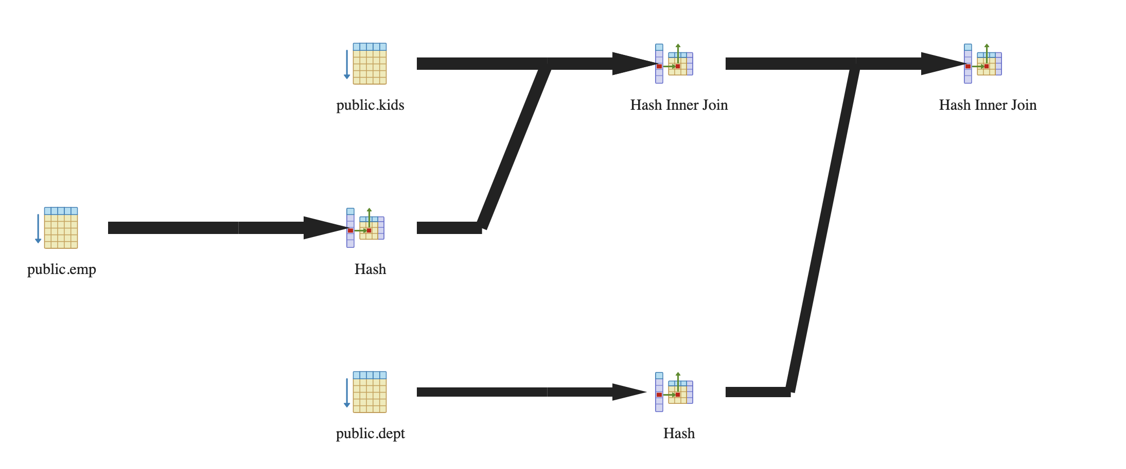
Postgres Plans
SELECT * FROM emp, dept, kids
WHERE sal > 10000
AND emp.dno = dept.dno
AND emp.eno = kids.eno
QUERY PLAN
---------------------------------------------------------------------------------
Hash Join (cost=342160.30..527523.82 rows=2457233 width=48)
Hash Cond: (emp.dno = dept.dno)
-> Hash Join (cost=339076.28..479202.29 rows=2457233 width=40)
Hash Cond: (kids.eno = emp.eno)
-> Seq Scan on kids (cost=0.00..49099.01 rows=3000001 width=18)
-> Hash (cost=188696.44..188696.44 rows=8190867 width=22)
-> Seq Scan on emp (cost=0.00..188696.44 rows=8190867 width=22)
Filter: (sal > 10000)
-> Hash (cost=1443.01..1443.01 rows=100001 width=8)
-> Seq Scan on dept (cost=0.00..1443.01 rows=100001 width=8)
(10 rows)

Slide 7
https://clicker.mit.edu/6.5830/
Assuming disk can do 100 MB/sec I/O, and 10ms / seek
And the following schema:
grades (cid int, g_sid int, grade char(2))
students (s_int, name char(100))
Estimate time to sequentially scan grades, assuming it contains 1M records (Consider: field sizes, headers)
Estimate time to join these two tables, using nested loops, assuming students fits in memory but grades does not, and students contains 10K records.

Slide 8
https://clicker.mit.edu/6.5830/
Assuming disk can do 100 MB/sec I/O, and 10ms / seek
And the following schema:
grades (cid int, g_sid int, grade char(2))
students (s_int, name char(100))
Estimate time to sequentially scan grades, assuming it contains 1M records (Consider: field sizes, headers (4B) )
21 seconds
23 seconds
25 seconds
I don’t know

Slide 9
Seq Scan Grades
grades (cid int, g_sid int, grade char(2))
8 bytes (cid) + 8 bytes (g_sid) + 2 bytes (grade) + 4 bytes (header) = 22 bytes
22 x 1M = 22 MB / 100 MB/sec = .22 sec + 10ms seek
➔ .23 sec

Slide 10
https://clicker.mit.edu/6.5830/
Assuming disk can do 100 MB/sec I/O, and 10ms / seek
And the following schema:
grades (cid int, g_sid int, grade char(2))
students (s_int, name char(100))
Estimate the time to join these two tables, using nested loops, assuming students fits in memory but grades does not, and students contains 10K records (grades contains 1M records).
0.244 s
2300.0 s
4000.0 s
I don’t know.

Slide 11
NL Join Grades and Students
grades (cid int, g_sid int, grade char(2))
students (s_int, name char(100))
10 K students x (100 + 8 + 4 bytes) = 1.1 MB
Students Inner (Preferred)
Cache students in buffer pool in memory: 1.1/100 s = .011 s
One pass over students (cached) for each grade (no additional cost beside caching)
Time to scan grades (previous slide) = .23 s
.244 s
Grades Inner
One pass over grades for each student, at .22 sec / pass, plus one seek at 10 ms (.01 sec) ➔ .23 sec / pass
2300 seconds overall
(Time to scan students is .011 s, so negligible)

Slide 12
Today: Access Methods
Access method: way to access the records of the database
3 main types:
  Heap file / heap scan
  Hash index / index lookup
  B+Tree index / index lookup / scan ← next time
Many alternatives: e.g., R-trees ← next time
Each has different performance tradeoffs

Slide 13
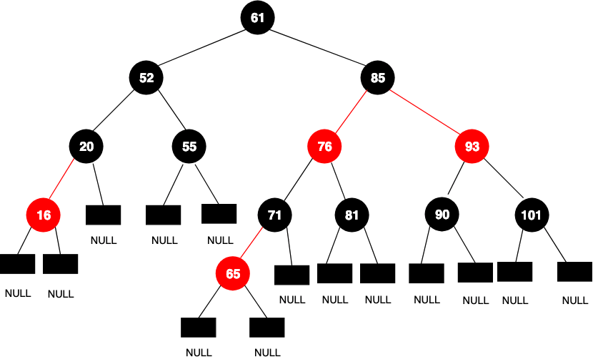
Design Considerations for Indexes

Slide 14
Design Considerations for Indexes
What attributes to index?
  Why not index everything?
Index structure:
  Leaves as data
    Only one index?
    “Primary Index” (no duplicates)
  Leaves as pointers to heap file
    “Secondary Index”
    Clustered vs unclustered
Primary Index
Data
R1 R2
R3 R4
…
Secondary Index
Pointers
…
In 6.5830 we will use secondary indexes, and distinguish between clustered and unclustered
Heap File
R1 R2
R3 R4
…
Notes:
Each index is usually a copy of at least one column, so there’s a space penalty
BUT ALSO, updates get more expensive!
THERE ARE tradeoffs between different storage representations
scan vs. search vs. insert vs. delete

Slide 15
Tree Index
<3 | ≥3, <5 | ≥5, <7 | ≥8, 9
Index File
0 | 1 | 2 | 2 | 2
3 | 4
5 | 6
8 | 9 | 9
Hdr | R1 | R2 | R3 | R4
 | 3 | 2 | 9 | 4
Hdr | R4 | R5 | R6 | R7
 | 6 | 1 | 0 | 2
Hdr | R8 | R9 | R10 | R11
 | 9 | 8 | 2 | 5
Heap File
Attr1
…
Attrn

Slide 16
Index Scan
Traverse the records in Attr1 order, or lookup a range
<3 | ≥3, <5 | ≥5, <7 | ≥8, 9
0 | 1 | 2 | 2 | 2
3 | 4
5 | 6
8 | 9 | 9
Attr1 >= 6 &
Attr1 < 9
Hdr | R1 | R2 | R3 | R4
 | 3 | 2 | 9 | 4
Hdr | R4 | R5 | R6 | R7
 | 6 | 1 | 0 | 2
Hdr | R8 | R9 | R10 | R11
 | 9 | 8 | 2 | 5
Heap File
Attr1
Note random access! – this is an “unclustered” index

Slide 17
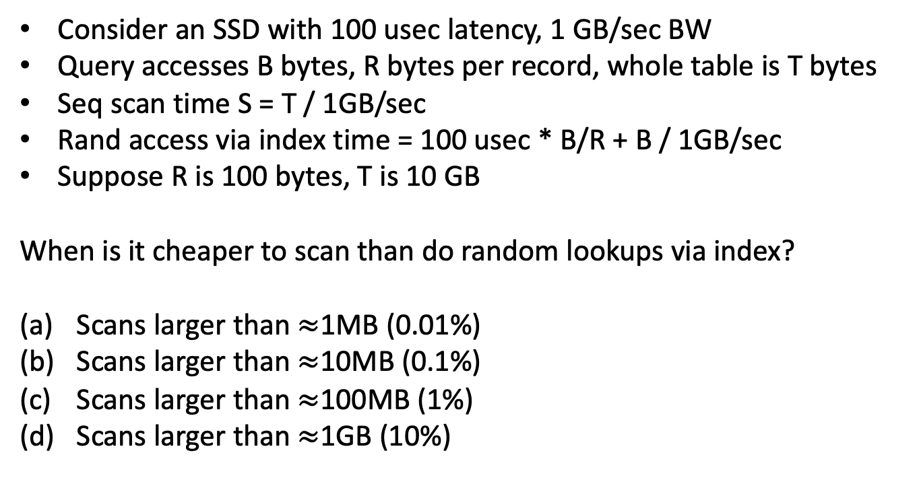
Costs of Random Access https://clicker.mit.edu/6.5830/
Portion Read
(B bytes)
Entire Table
T bytes
Consider an SSD with 100 usec latency, 1 GB/sec BW
Query accesses B bytes, R bytes per record, whole table is T bytes
Seq scan time S = T / 1GB/sec
Rand access via index time = 100 usec * B/R + B / 1GB/sec
Suppose R is 100 bytes, T is 10 GB
When is it cheaper to scan than do random lookups via index?
Scans larger than $≈$1MB (0.01%)
Scans larger than $≈$10MB (0.1%)
Scans larger than $≈$100MB (1%)
Scans larger than $≈$1GB (10%)

Slide 18
Costs of Random Access
Portion Read
(B bytes)
Entire Table
T bytes
Consider an SSD with 100 usec latency, 1 GB/sec BW
Query accesses B bytes, R bytes per record, whole table is T bytes
Seq scan time S = T / 1GB/sec
Rand access via index time = 100 usec * B/R + B / 1GB/sec
Suppose R is 100 bytes, T is 10 GB
When is it cheaper to scan than do random lookups via index?
  100x10⁻⁶ * B / 100 + B/1x10⁹ > 10x10⁹ / 1x10⁹
  1x10⁻⁶B + 1x10⁻⁹B > 10
  B > 9.99x10⁶
For scans of larger than 10 MB, cheaper to scan entire 10 GB table than to use index

Slide 19
Clustered Index
Order pages on disk in index order
<3 | ≥3, <5 | ≥5, <7 | ≥8, 9
Index File
0 | 1 | 2 | 2 | 2
3 | 4
5 | 6
8 | 9 | 9
Hdr | R1 | R2 | R3 | R4
 | 3 | 2 | 9 | 4
Hdr | R4 | R5 | R6 | R7
 | 6 | 1 | 0 | 2
Hdr | R8 | R9 | R10 | R11
 | 9 | 8 | 2 | 5
Heap File
Attr1
…
Attrn

Slide 20
Clustered Index
Order pages on disk in index order
<3 | ≥3, <5 | ≥5, <7 | ≥8, 9
Index File
0 | 1 | 2 | 2 | 2
3 | 4
5 | 6
8 | 9 | 9
Per record random I/O → per page random I/O for index scans on Attr1 (but only Attr1!)
Hdr | R6 | R8 | R2 | R7
 | 0 | 1 | 2 | 2
Hdr | R10 | R1 | R4 | R11
 | 2 | 3 | 4 | 5
Hdr | R4 | R9 | R3 | R8
 | 6 | 8 | 9 | 9
Heap File
Attr1
…
Attrn

Slide 21
Benefit of Clustering
Consider an SSD with 100 usec latency, 1 GB/sec BW
Query accesses B bytes, R bytes per record, whole table is T bytes
Pages are P bytes
Seq scan time S = T / 1GB/sec
Clustered index access time = 100 usec * B/PR + B / 1GB/sec
Suppose R is 100 bytes, T is 10 GB, P is 1 MB
When is it cheaper to scan than do random lookups via clustered index?
  100x10⁻⁶ * B / 1x10⁶ + B/1x10⁹ > 10x10⁹ / 1x10⁹
  1x10⁻¹²B + 1x10⁻⁹B > 10
  B > 9.99x10⁹
For scans of larger than 9.9 GB, cheaper to scan entire 10 GB table than to use ^{clustered index}

Slide 22
Rest of Lecture
Details of access methods
Heap files (already seen)
Hash indexes
Trees (B+/R)

Slide 23
Access Method Costs
 | Heap File | Hash File | B+Tree
Insert | O(1)
Delete | O(P)
Scan | O(P) sequential
Lookup | O(P)
n : number of tuples
P : number of pages in file
B : branching factor of B-Tree
R : number of pages in scanned range
P1
P2
Pn
Heap File
R1 R2
R3 R4
…
Sequentially stored pages, no seeks between records or pages

Slide 24
Hash Indexing Idea
Store a hash table with pointers to records in heap file
Hash table keyed on a particular attribute
  Composite keys also possible
Supports O(1) equality lookup of records
  E.g., employees named “sam”

Slide 25
Hash Index
n buckets, on n disk pages
Disk page 1
…
Disk Page n
On Disk Hash Table
(‘sam’, 10k, …)
(‘mike’, 20k, …)
H(f1)
e.g., H(x) = x mod n
Issues
How big to make table?
If we get it wrong, either
waste space, or
end up with long overflow chains, or
have to rehash
Notes:
map(key) -> {rid} -- could also store map(key) -> {record}
suppose we have a hash-table that for employees stored on disk hashed on the 'name' attribute.
h(name) -> {1..k}
h(x) = x mod k; //not very uniform but works
(consider performance when number of distinct values is small, or all numbers even)

Slide 26
Extensible Hashing
Create a family of hash tables parameterized by k
H_{k}(x) = H(x) mod 2^{k}
Start with k = 1 (2 hash buckets)
Use a directory structure to keep track of which bucket (page) each hash value maps to
When a bucket overflows, increment k (if needed), create a new bucket, rehash keys in overflowing bucket, and update directory

Slide 27
Example
Directory
k=1
Hash Table
H_{k}(x) | Page
0 | 0
1 | 1
Page Number | Page Contents
0
1
H_{k}(x) = x mod 2^k
Insert records with keys 0, 0, 2, 3, 2

Slide 28
Example
Directory
k=1
Hash Table
H_{k}(x) | Page
0 | 0
1 | 1
Page Number | Page Contents
0
1
0
0 mod 2 = 0
H_{k}(x) = x mod 2^k
Insert records with keys 0, 0, 2, 3, 2

Slide 29
Example
Directory
k=1
Hash Table
H_{k}(x) | Page
0 | 0
1 | 1
Page Number | Page Contents
0 | 0 | 0
1
0 mod 2 = 0
H_{k}(x) = x mod 2^k
Insert records with keys 0, 0, 2, 3, 2

Slide 30
Example
Directory
k=1
Hash Table
H_{k}(x) | Page
0 | 0
1 | 1
Page Number | Page Contents
0 | 0 | 0 | 2
1
2 mod 2 = 0
H_{k}(x) = x mod 2^k
Insert records with keys 0, 0, 2, 3, 2

Slide 31
Example
Directory
k=1
Hash Table
H_{k}(x) | Page
0 | 0
1 | 1
Page Number | Page Contents
0 | 0 | 0 | 2
1 | 3
3 mod 2 = 1
H_{k}(x) = x mod 2^k
Insert records with keys 0, 0, 2, 3, 2

Slide 32
Example
Directory
k=1
Hash Table
H_{k}(x) | Page
0 | 0
1 | 1
Page Number | Page Contents
0 | 0 | 0 | 2
1 | 3
- FULL!
2 mod 2 = 0
H_{k}(x) = x mod 2^k
Insert records with keys 0, 0, 2, 3, 2

Slide 33
Example
Directory
k=1 2
Hash Table
H_{k}(x) | Page
0 | 0
1 | 1
2
3
Page Number | Page Contents
0 | 0 | 0 | 2
1 | 3
H_{k}(x) = x mod 2^k
Insert records with keys 0, 0, 2, 3, 2

Slide 34
Example
Directory
k=1 2
Hash Table
H_{k}(x) | Page
0 | 0
1 | 1
2 | 2
3
Page Number | Page Contents
0 | 0 | 0 | 2
1 | 3
2
Allocate new page!
H_{k}(x) = x mod 2^k
Insert records with keys 0, 0, 2, 3, 2

Slide 35
Example
Directory
k=1 2
Hash Table
H_{k}(x) | Page
0 | 0
1 | 1
2 | 2
3 | 1
Page Number | Page Contents
0 | 0 | 0 | 2
1 | 3
2
Rehash
Only allocate 1 new page!
H_{k}(x) = x mod 2^k
Insert records with keys 0, 0, 2, 3, 2

Slide 36
Example
Directory
k=1 2
Hash Table
H_{k}(x) | Page
0 | 0
1 | 1
2 | 2
3 | 1
Page Number | Page Contents
0 | 0 | 0
1 | 3
2 | 2
2 mod 4 = 2
H_{k}(x) = x mod 2^k
Insert records with keys 0, 0, 2, 3, 2

Slide 37
Example
Directory
k=1 2
Hash Table
H_{k}(x) | Page
0 | 0
1 | 1
2 | 2
3 | 1
Page Number | Page Contents
0 | 0 | 0
1 | 3
2 | 2 | 2
2 mod 4 = 2
Extra bookkeeping needed to keep track of fact that pages 0/2 have split and page 1 hasn’t
H_{k}(x) = x mod 2^k
Insert records with keys 0, 0, 2, 3, 2

Slide 38
Access Method Costs
 | Heap File | Hash File | B+Tree
Insert | O(1) | O(1)
Delete | O(P) | O(1)
R-Scan | O(P) sequential | - / O(P)
Lookup | O(P) | O(1)
n : number of tuples
P : number of pages in file
B : branching factor of B-Tree
R : number of pages in range

Slide 39
B+Trees
Root node
Index on Attr A
ptr | val11 | ptr | val12 | ptr | val13 | …
<val11
ptr | val21 | ptr | val22 | ptr | val23 | …
Inner nodes
>val21, <val22
ptr | valn1 | ptr | valn2 | ptr | valn3 | …
<valn1
RIDn | RIDn+1 | RIDn+2 | ptr
RIDn+3 | RIDn+4 | RIDn+5 | ptr
RID: Record ID → a reference (pointer) to a record in heap file
Leaf nodes; records in Attr A order, w/ link pointers
Notes:
This is a balanced tree structure, like a binary red-black tree or an AVL tree you might have seen in an intro to algs course.
B in a B+Tree refers to the branching factor. We choose B to reflect what we can fit on a page. Not just a binary tree!
If we had 4096 pages and 8 bytes per slot, we’d have 512 values as the branching factor. So to figure out the depth, take the number of values and find log_B, or log base 512.

Slide 40
B+Trees
Root node
ptr | val11 | ptr | val12 | ptr | val13 | …
<val11
ptr | val21 | ptr | val22 | ptr | val23 | …
Inner nodes
>val21, <val22
ptr | valn1 | ptr | valn2 | ptr | valn3 | …
<valn1
RIDn | RIDn+1 | RIDn+2 | ptr
RIDn+3 | RIDn+4 | RIDn+5 | ptr
Leaf nodes; records in Attr A order, w/ link pointers

Slide 41
B+Trees
<valn1
RIDn | RIDn+1 | RIDn+2 | ptr
RIDn+3 | RIDn+4 | RIDn+5 | ptr
Leaf nodes; records in Attr A order, w/ link pointers

Slide 42
Properties of B+Trees
Branching factor = B
Log_{B}(tuples) levels
Logarithmic insert/delete/lookup performance
Support for range scans
Link pointers
No data in internal pages
Balanced (see text “rotation”) algorithms to rebalance on insert/delete
Fill factor: All nodes except root kept at least 50% full (merge when falls below)
Clustered / unclustered

Slide 43
Indexes Recap
 | Heap File | B+Tree | Hash File
Insert | O(1) | O( log_{B} n ) | O(1)
Delete | O(P) | O( log_{B} n ) | O(1)
R-Scan | O(P) | O( log_{B} n + R ) | -- / O(P)
Lookup | O(P) | O( log_{B} n ) | O(1)
n : number of tuples
P : number of pages in file
B : branching factor of B-Tree
R : number of pages in range
Notes:
Note that simply quantifying the amount of data accessed doesn't capture sequential vs random. (Slides)

Slide 44

https://clicker.mit.edu/6.5830/
Study Break
What indexes would you create for the following queries (assuming each query is the only query the database runs and emp is really really large)
SELECT MAX(sal) FROM emp
SELECT sal FROM emp WHERE id = 1
SELECT name FROM emp
WHERE sal > 100k
SELECT name FROM emp
WHERE sal > 100k AND dept = 2

Slide 45
https://clicker.mit.edu/6.5830/
Study Break
What indexes would you create for the following queries (assuming each query is the only query the database runs and emp is really really large)
SELECT MAX(sal) FROM emp
SELECT sal FROM emp WHERE id = 1
SELECT name FROM emp WHERE sal > 100k
SELECT name FROM emp WHERE sal > 100k AND dept = 2
(A) BTree, Btree, None, Hash
(B) BTree, Hash, BTree, none
(C) None, Hash, BTree, BTree
(D) BTree, Hash, BTree, BTree

Slide 46
Study Break
What indexes would you create for the following queries (assuming each query is the only query the database runs)
SELECT MAX(sal) FROM emp
B+Tree on emp.sal
SELECT sal FROM emp WHERE id = 1
Hash index on emp.id
SELECT name FROM emp WHERE sal > 100k
B+Tree on emp.sal (maybe)
SELECT name FROM emp WHERE sal > 100k AND dept = 2
B+tree on emp.sal (maybe), Hash on dept.dno (maybe)

Slide 47
B+Trees are Inappropriate For Multi-dimensional Data
Consider points of the form (x,y) that I want to index
Suppose I store tuples with key (x,y) in a B+Tree
Problem: can’t look up y’s in a particular range without also reading x’s
Two multidimension indexes: R-Tree & QuadTree

Slide 48
Example Index with Key = X, Y
Index sorts data on X, then Y
X | Y
1 | 2
1 | 3
1 | 5
3 | 12
4 | 3
4 | 9
4 | 11
4 | 15
5 | 1
7 | 1
9 | 4
9 | 6
9 | 7
11 | 2
Supports efficient range lookups on X
Allows further filtering on Y, but may be inefficient
Doesn’t support lookups on Y

Slide 49
Example of the Problem
Query:
1 ≤ X ≤ 5, 4 < Y< 5
Have to scan every
X value to look for matching Ys!
B+Tree on X,Y
Y=5
Y=4
Y=3
Y=2
Y=1

Slide 50
R-Trees / Spatial Indexes
y
x

Slide 51
R-Trees / Spatial Indexes
y
x

Slide 52
R-Trees / Spatial Indexes
y
x

Slide 54
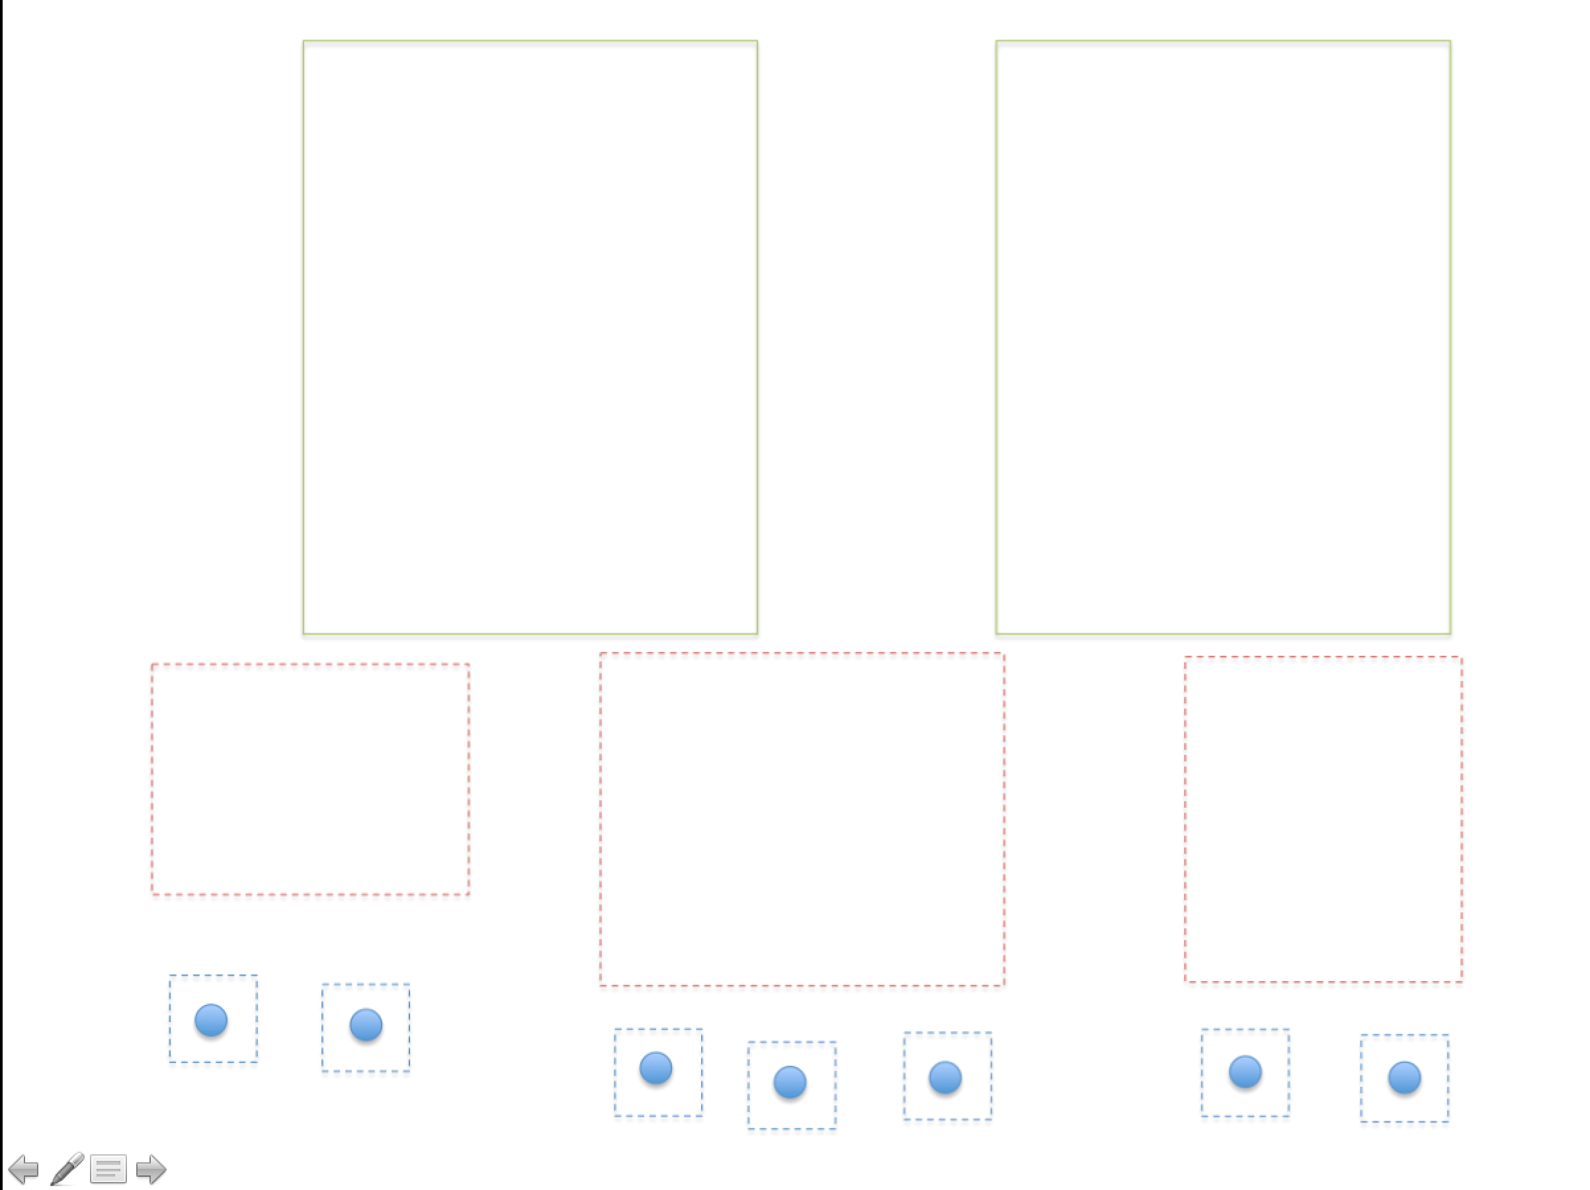
Q
Allows lookups on any sized region of X or Y
Heap File

Slide 55
Quad-Tree
y
x

Slide 56
Quad-Tree
y
x

Slide 57
Quad-Tree
y
x

Slide 58
Quad-Tree
Intermediate node – points to 4 child nodes
Leaf pages – 1 pointer
Heap File

Slide 59
Study Break
What indexes would you create for the following queries (assuming each query is the only query the database runs)
SELECT MAX(sal) FROM emp
B+Tree on emp.sal
SELECT sal FROM emp WHERE id = 1
Hash index on emp.id
SELECT name FROM emp WHERE sal > 100k
B+Tree on emp.sal (maybe)
SELECT name FROM emp WHERE sal > 100k AND dept = 2
B+tree on emp.sal (maybe), Hash on dept.dno (maybe)

Slide 60
Typical Database Setup
“Extract, Transform, Load”
Analytics / Reporting Database
“Warehouse”
Lots of reads of many records
Bulk updates
Typical query touches a few columns
Transactional database
Lots of writes/updates
Reads of individual records

