Slide 1

6.5830 Lecture 9
Column Stores
10/4/2023
PS2 Due 10/10

Slide 2
Plan for Next Few Lectures
Admission Control
Connection Management
Query System
Lec 9 – Column Stores (This Lecture)
Parser
Rewriter
Lec 8
– Optimizer (Last Time)
Planner
Executor
Lec 7 – Join Algos
Storage System
Access Methods
Buffer Manager
Lock Manager
Log Manager

Slide 3

Optimization Recap
Selinger Optimizer is the foundation of modern cost-based optimizers
  Simple statistics
  Several heuristics, e.g., left-deep
  Dynamic programming algo for join ordering
Easy to extend, e.g., with:
  More sophisticated statistics
  Fewer heuristics

Slide 4
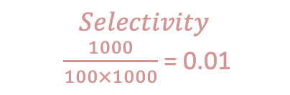
Optimization Steps
SELECT * FROM emp, dept, kids
WHERE sal > 10k
AND emp.dno = dept.dno
AND emp.eid = kids.eid
100 tuples/page
10 pages RAM
10 KB/page
Kids is foreign key;
Each kid joins w/ 3 emps
|dept| = 100 records = 1 page = 10 KB
|emp| = 10K = 100 pages = 1 MB
|kids| = 30K = 300 pages = 3 MB
$$Selectivity$$
$\frac{1000}{100×1000}$ = 0.01
3000
⨝ eno=eno
1000
30000
Join algo?
kids
Join Ordering? Why not kids / emp first?
⨝ dno=dno
Steps:
For each plan alternative:
Estimate sizes of relations
Estimate selectivities
Compute intermediate sizes
Evaluate cost of plan operations
Select best plan
1000
100
𝛔_{sal>10k}
0.1 (selectivity)
10K (cardinality)
dept
emp
Index vs scan?

Slide 5
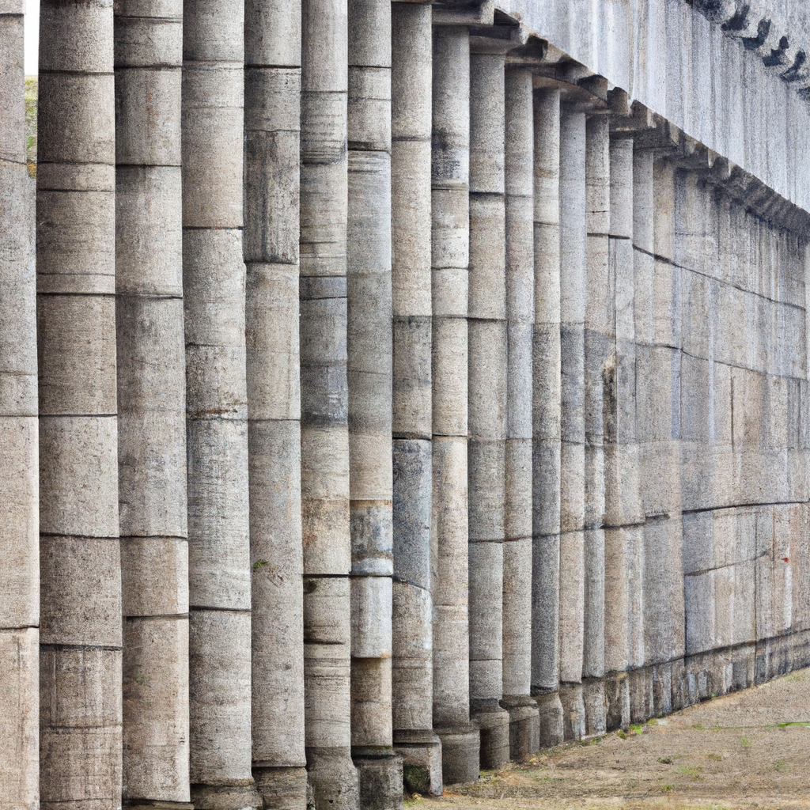
Today: Column Stores
A different way to build a database system

Slide 6

Typical Database Setup
“Extract, Transform, Load”
Analytics / Reporting Database
“Warehouse”
Lots of reads of many records
Bulk updates
Typical query touches a few columns
Transactional database
Lots of writes/updates
Reads of individual records

Slide 7
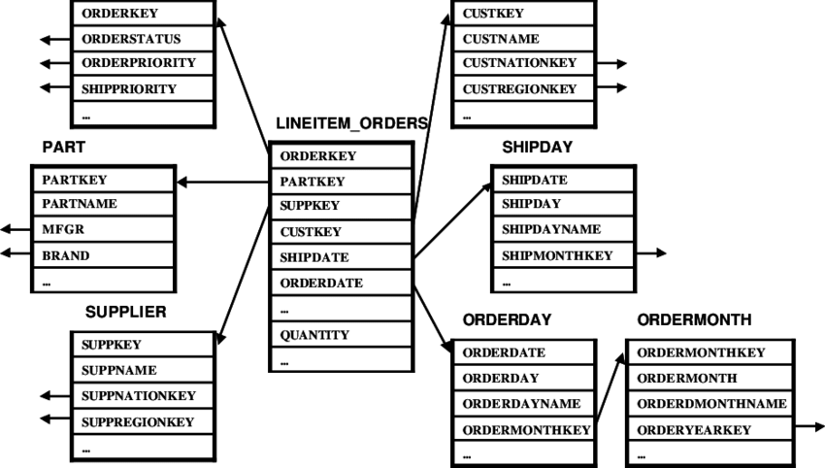
Example Warehouse: TPC-H
All use through lineitem_orders – I.e., products purchased by day, or by customer …
“star schema”

Slide 8

How Long Does a Scan Take?
SELECT avg(price) FROM tickstore WHERE symbol = ‘GM’ and date = ‘1/17/2007’
Time proportional to amount of data read
Example
“Row” Representation
symbol
price
quantity
exchange
date
GM | 30.77 | 1,000 | NYSE | 1/17/2007
GM | 30.77 | 10,000 | NYSE | 1/17/2007
GM | 30.78 | 12,500 | NYSE | 1/17/2007
AAPL | 93.24 | 9,000 | NQDS | 1/17/2007
Even though we only need price, date and symbol, if data is on disk, must scan over all columns
Magnetic Disk
Memory and SSD also transfer a block at a time, so same issue arises.

Slide 9

Column Representation Reduces Scan Time
Idea: Store each column in a separate file
Column Representation
GM
GM
GM
AAPL
30.77
30.77
30.78
93.24
1,000
10,000
12,500
9,000
NYSE
NYSE
NYSE
NQDS
1/17/2007
1/17/2007
1/17/2007
1/17/2007
Reads Just 3 Columns
Assuming each column is same size, reduces bytes read from disk by factor of 3/5
In reality, databases are often 100’s of columns

Slide 10
Linearizing a Table – Row store
Memory/Disk (Linear Array)
R1 C1
R1 C2
R1 C3
R1 C4
R1 C5
R1 C6
C1 | C2 | C3 | C4 | C5 | C6
R2 C1
R2 C2
R2 C3
R2 C4
R2 C5
R2 C6
R3 C1
R3 C2
R3 C3
R3 C4
R3 C5
R3 C6
R4 C1
R4 C2
R4 C3
R4 C4
R4 C5
R4 C6

Slide 11
Linearizing a Table –
Column Store
Memory/Disk (Linear Array)
R1 C1
R2 C1
R3 C1
R4 C1
R5 C1
R6 C1
C1 | C2 | C3 | C4 | C5 | C6
R1 C2
R2 C2
R3 C2
R4 C2
R5 C2
R6 C2
R1 C3
R2 C3
R3 C3
R4 C3
R5 C3
R6 C3
R1 C4
R2 C4
R3 C4
R4 C4
R5 C4
R6 C4

Slide 12
Tables Often Super Wide
Data warehouse at Cambridge Mobile Telematics
Table #columns
t1 | 251
t2 | 248
t3 | 134
t4 | 107
t5 | 87
t6 | 83
t7 | 71
t8 | 54
t9 | 52
t10 | 45
Average query access 4-5 fields
Top 2-3 tables involved in nearly every query
Using a row-store would impose ~200/4 = 50x performance overhead

Slide 13
When Are Columns Right?
Warehousing (OLAP)
  Read-mostly; batch update
  Queries: Scan and aggregate a few columns
Vs. Transaction Processing (OLTP)
  Write-intensive, mostly single record ops.
Column-stores: OLAP optimized
In practice >10x performance on comparable HW, for many real world analytic applications
  True even if w/ Flash or main memory!
Different architectures for different workloads
Notes:
XXX note that won’t work well if reading a single record, or updating – explain why -- retitle

Slide 14


C-Store: Rethinking Database Design from the Ground Up
Inserts
Column-oriented query executor
Write optimized storage
Tuple
Mover
SYM
PRICE
VOL
EXCH
TIME
SYM
PRICE
VOL
EXCH
TIME
IBM |  | 100 |  | 10244 |  | NYSE |  | 1.17.07
IBM |  | 102 |  | 11245 |  | NYSE |  | 1.17.07
SUN |  | 58 |  | 3455 |  | NQDS |  | 1.17.07
Shared nothing
horizontal partitioning
IBM |  | 100 |  | 10244 |  | NYSE |  | 1.17.07
IBM |  | 102 |  | 11245 |  | NYSE |  | 1.17.07
SUN |  | 58 |  | 3455 |  | NQDS |  | 1.17.07
Separate Files
Column-based Compression
“C-Store: A Column-oriented DBMS” -- VLDB 05

Slide 15
Query Processing Example
SELECT avg(price)
FROM tickstore
WHERE symbol = ‘GM’
AND date = ‘1/17/2007’
Traditional Row Store
AVG
price
Complete tuples
SELECT
date=’1/17/07’
Complete tuples
SELECT
sym = ‘GM’
Complete tuples
Disk
GM | 30.77 | 1,000 | NYSE | 1/17/2007
GM | 30.77 | 10,000 | NYSE | 1/17/2007
GM | 30.78 | 12,500 | NYSE | 1/17/2007
AAPL | 93.24 | 9,000 | NQDS | 1/17/2007
Notes:
Disco picture/hippie joke

Slide 16

Query Processing Example
Basic Column Store
“Early Materialization”
SELECT avg(price)
FROM tickstore
WHERE symbol = ‘GM’
AND date = ‘1/17/2007’
Complete tuples
AVG
price
Complete tuples
Row-oriented plan
SELECT
date=’1/17/07’
Complete tuples
Construct Tuples
SELECT
sym = ‘GM’
GM | 30.77 | 1/17/07
Disk
GM
GM
GM
AAPL
30.77
30.77
30.78
93.24
1,000
10,000
12,500
9,000
1/17/2007
1/17/2007
1/17/2007
1/17/2007
Fields from same tuple at same index (position) in each column file
NYSE
NYSE
NYSE
NQDS

Slide 17
Query Processing Example
AVG
Much less data flowing through memory
C-Store
  “Late Materialization”
Prices
Position Lookup
Position Bitmap
(1,1,1,0)
AND
Position Bitmap
(1,1,1,0)
Position Bitmap
(1,1,1,1)
Pos.SELECT
sym = ‘GM’
Pos.SELECT
date=’1/17/07’
Disk
GM
GM
GM
AAPL
30.77
30.77
30.78
93.24
1,000
10,000
12,500
9,000
NYSE
NYSE
NYSE
NQDS
1/17/2007
1/17/2007
1/17/2007
1/17/2007
See Abadi et al
ICDE 07
Notes:
Reread IQ papers on bitmap indexes and index ANDing

Slide 18
Why Compress?
Database size is 2x-5x larger than the volume of data loaded into it
Database performance is proportional to the amount of data flowing through the system
Abadi et al, SIGMOD 06

Slide 19
Column-Oriented Compression
Query engine processes compressed data
  Transfers load from disk to CPU
Multiple compression types
    Run-Length Encoding (RLE), LZ, Delta Value, Block Dictionary Bitmaps, Null Suppression
    System chooses which to apply
  Typically see 50% - 90% compression
  NULLs take virtually no space
Columns contain similar data, which makes compression easy
RLE
Delta
LZ
RLE
RLE
GM
GM
GM
AAPL
3xGM
1XAPPL
30.77
+0
+.01
+62.47
30.77
30.77
30.78
93.24
1,000
10,000
12,500
9,000
1,000
10,000
12,500
9,000
NYSE
NYSE
NYSE
NQDS
3xNYSE
1XNQDS
1/17/2007
1/17/2007
1/17/2007
1/17/2007
4 x 1/17/2007
Notes:
As mentioned in the previous slide, another way you can minimize disk I/O is through aggressive compression
Vertica makes use of the following compression techniques
RLE, LZ, Block Delta Values, Common Delta Value, Block Dictionary, and ? (chuck’s)
By doing aggressive compression, Vertica:
Increases performance, by reducing disk I/O
Reduces storage
You can store more in less space, less physical data on disk means less reads
Offloads the work from disk to CPU
The advantage of offloading to CPU is it is better at multiprocessing; it is easy to have several users on the same CPU. With disk, it’s much harder, the head on a disk can only read one section at a time. CPU allows for more concurrency.
CPU scales out much easier. You get a better bang for the buck.
Not all encodings are necessarily CPU intensive; both RLE and Block Dictionary often require less CPU because Vertica’s operators are built to process data natively in those formats; they don’t have to be decoded before being computed or retrieved.
Data only uncompresses when results are sent (vs. other DBs have to uncompress at query time which slows it down)
Database Designer makes choosing the right compression types easy since it recommends the best projections to use based on your sample queries (more on that in number 5).
Typically in a row store with indexing, padding, MVs etc they end up storing 5x more than the actual data
Possible questions:
How does this compare to row stores?
Row stores only really use LV
How does this differ from Sybase IQ?
Sybase IQ only uses bitmap compressions
Definitions of Compression types
RLE – instead of storing every instance of a value (state) instead we store one instance and the number of times it is repeated (basically eliminates columns)
LZ – Zipping. Used for data that isn’t well organized (comments fields etc)
Delta Value – when you have unique numberic data that’s related (phone number) – instead of storing all 10 digits, you’ll store the lowest level and then the difference between the next
Block Dictionary -

Slide 20
Run Length Encoding
Replace repeated values with a count and a value
For single values, use a run length of 1
  Naively, can increase storage space
  Can use a shorter bit sequence for 1s, at the cost of more expensive decompression
E.g., 1110002 → 3x1, 3x0, 1x2
Works well for mostly-sorted, few-valued columns

Slide 21
Dictionary Encoding
Many variants; simplest is to replace string values with integers and maintain a dictionary
I.e., AAPL, AAPL, IBM, MSFT →
  1,1,2,3 + 1:AAPL, 2:IBM, 3:MSFT
Works well for few-valued string columns
  Choice of dictionary not obvious
  Words? Records?

Slide 22
Lempel Ziv Encoding
LZ (“Lempel Ziv”) Compression
General purpose lossless data compression
Builds data dictionary dynamically as it runs
  Add new bit strings to the dictionary as they are encountered
Treat entire column as a document

Slide 23
LZ Example
AAPLAAPLIBMAAPL
Dictionary: A:1, B:2, … ,F:6, … ,I:9, …, L:12, M:13, …, P:16
Output:

Slide 24
LZ Example
AAPLAAPLIBMAAPL
Dictionary: A:1, B:2, … ,F:6, … ,I:9, …, L:12, M:13, …, P:16
Output: 1

Slide 25
LZ Example
AAPLAAPLIBMAAPL
Dictionary: A:1, B:2, … ,F:6, … ,I:9, …, L:12, M:13, …, P:16, .., AA:27
Output: 1

Slide 26
LZ Example
AAPLAAPLIBMAAPL
Dictionary: A:1, B:2, … ,F:6, … ,I:9, …, L:12, M:13, …, P:16, .., AA:27, AP:28
Output: 1 1

Slide 27
LZ Example
AAPLAAPLIBMAAPL
Dictionary: A:1, B:2, … ,F:6, … ,I:9, …, L:12, M:13, …, P:16, .., AA:27, AP:28
Output: 1 1 16

Slide 28
LZ Example
AAPLAAPLIBMAAPL
Dictionary: A:1, B:2, … ,F:6, … ,I:9, …, L:12, M:13, …, P:16, .., AA:27, AP:28, PL: 29
Output: 1 1 16 12

Slide 29
LZ Example
AAPLAAPLIBMAAPL
Dictionary: A:1, B:2, … ,F:6, … ,I:9, …, L:12, M:13, …, P:16, .., AA:27, AP:28, PL: 29, LA: 30
Output: 1 1 16 12

Slide 30
LZ Example
AAPLAAPLIBMAAPL
Dictionary: A:1, B:2, … ,F:6, … ,I:9, …, L:12, M:13, …, P:16, .., AA:27, AP:28, PL: 29, LA: 30
Output: 1 1 16 12 27

Slide 31
LZ Example
AAPLAAPLIBMAAPL
Dictionary: A:1, B:2, … ,F:6, … ,I:9, …, L:12, M:13, …, P:16, .., AA:27, AP:28, PL: 29, LA: 30, AAP:31
Output: 1 1 16 12 27

Slide 32
LZ Example
AAPLAAPLIBMAAPL
Dictionary: A:1, B:2, … ,F:6, … ,I:9, …, L:12, M:13, …, P:16, .., AA:27, AP:28, PL: 29, LA: 30, AAP:31
Output: 1 1 16 12 27

Slide 33
LZ Example
AAPLAAPLIBMAAPL
Dictionary: A:1, B:2, … ,F:6, … ,I:9, …, L:12, M:13, …, P:16, .., AA:27, AP:28, PL: 29, LA: 30, AAP:31, PLI: 32
Output: 1 1 16 12 27 29

Slide 34
LZ Example
AAPLAAPLIBMAAPL
Dictionary: A:1, B:2, … ,F:6, … ,I:9, …, L:12, M:13, …, P:16, .., AA:27, AP:28, PL: 29, LA: 30, AAP:31, PLI: 32, LI: 33, IB: 34
Output: 1 1 16 12 27 29 9

Slide 35
LZ Example
AAPLAAPLIBMAAPL
Dictionary: A:1, B:2, … ,F:6, … ,I:9, …, L:12, M:13, …, P:16, .., AA:27, AP:28, PL: 29, LA: 30, AAP:31, PLI: 32, LI: 33, IB: 34, BM: 35
Output: 1 1 16 12 27 29 9 2

Slide 36
LZ Example
AAPLAAPLIBMAAPL
Dictionary: A:1, B:2, … ,F:6, … ,I:9, …, L:12, M:13, …, P:16, .., AA:27, AP:28, PL: 29, LA: 30, AAP:31, PLI: 32, LI: 33, IB: 34, BM: 35, MA:36
Output: 1 1 16 12 27 29 9 2 13

Slide 37
LZ Example
AAPLAAPLIBMAAPL
Dictionary: A:1, B:2, … ,F:6, … ,I:9, …, L:12, M:13, …, P:16, .., AA:27, AP:28, PL: 29, LA: 30, AAP:31, PLI: 32, LI: 33, IB: 34, BM: 35, MA:36
Output: 1 1 16 12 27 29 9 2 13

Slide 38
LZ Example
AAPLAAPLIBMAAPL
Dictionary: A:1, B:2, … ,F:6, … ,I:9, …, L:12, M:13, …, P:16, .., AA:27, AP:28, PL: 29, LA: 30, AAP:31, PLI: 32, LI: 33, IB: 34, BM: 35, MA:36
Output: 1 1 16 12 27 29 9 2 13 31

Slide 39
LZ Example
AAPLAAPLIBMAAPL
Dictionary: A:1, B:2, … ,F:6, … ,I:9, …, L:12, M:13, …, P:16, .., AA:27, AP:28, PL: 29, LA: 30, AAP:31, PLI: 32, LI: 33, IB: 34, BM: 35, MA:36 AAPL:37
Output: 1 1 16 12 27 29 9 2 13 31

Slide 40
LZ Example
AAPLAAPLIBMAAPL
Dictionary: A:1, B:2, … ,F:6, … ,I:9, …, L:12, M:13, …, P:16, .., AA:27, AP:28, PL: 29, LA: 30, AAP:31, PLI: 32, LI: 33, IB: 34, BM: 35, MA:36 AAPL:37
Output: 1 1 16 12 27 29 9 2 13 31 12

Slide 41
LZ Example
AAPLAAPLIBMAAPL
Dictionary: A:1, B:2, … ,F:6, … ,I:9, …, L:12, M:13, …, P:16, .., AA:27, AP:28, PL: 29, LA: 30, AAP:31, PLI: 32, LI: 33, IB: 34, BM: 35, MA:36 AAPL:37
Output: 1 1 16 12 27 29 9 2 13 31 12
Reduced from 15 to 11 symbols
But future AAPL patterns will be emitted as 1 byte instead of 4
Dictionary can be further encoded, e.g., using entropy encoding to make most common patterns use least bits (“Huffman encoding”)

Slide 42
Bit Packing
Encode values with fewest possible bits
Each value becomes bit-length (e.g., 0-8 or 0-32), followed by value in that many bits
E.g.,: 1 2 37 7
  Need 1, 2, 6, and 3 bits respectively
  Each number becomes 3 bit header and encoded value
    1: 0x001, 0x1
    2: 0x010, 0x10
    37: 0x110, 0x100101
    7: 0x011, 0x111
  3 x 4 + 12 = 24 bits to encode, vs e.g., 8x4 = 32

Slide 43
Delta Encoding
Consecutive values encoding as difference to previous values
1.1, 1.2, 1.3 → 1.1, +.1, +1
  After encoding as deltas, bit-pack
  Works if deltas can be represented in fewer bits than whole values
Works well for e.g., floats with small variations

Slide 44
Bitmap Encoding
Encode few valued columns as bitmaps
M M M F F → 11100, 00011
  If fewer distinct values than bitwidth of field, saves space
  Bitmaps can be further compressed, e.g., using RLE
Bitmaps are very good for certain kinds of operations, e.g., filtering

Slide 45
Sorted Data
Delta and RLE work great on sorted data
Trick: Secondary sorting
X | Y
a | 2
b | 2
a | 1
b | 1
X | Y
a | 1
a | 2
b | 1
b | 2
Y is not sorted, but if many duplicates of X, will be “mostly” sorted
Sort on X, then Y

Slide 46
Operating on Compressed Data
AVG
Only possible with late materialization!
Prices
Position Lookup
Position Bitmap
(3x1,1x0)
AND
Position Bitmap
(3x1,1x0)
Position Bitmap
(4x1)
Compression Aware
Pos.SELECT
sym = ‘GM’
Pos.SELECT
date=’1/17/07’
Disk
3xGM
1xAPPL
30.77
+0
+.01
+62.47
1,000
10,000
12,500
9,000
NYSE
NYSE
NYSE
NQDS
4x1/17/2007

Slide 47
Direct Operation Optimizations
Compressed data used directly for position lookup
  RLE, Dictionary, Bitmap
Direct Aggregation and GROUP BY on compressed blocks
  RLE, Dictionary
Join runs of compressed blocks
  RLE, Dictionary
Min/max directly extracted from sorted data

Slide 48
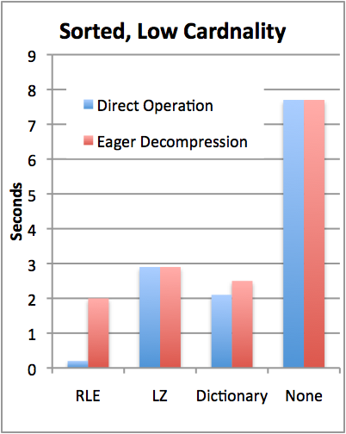
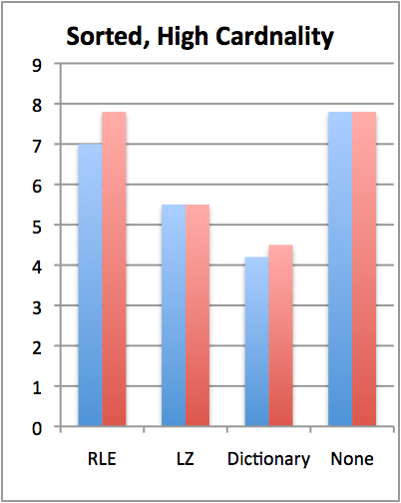

TPC-H Compression Performance
Y | X
1 | A
1 | C
1 | D
2 | B
2 | C
3 | A
  Query: SELECT colY, SUM(colX)
  FROM lineItem GROUP BY colY
TPC-H Scale 10 (60M records)
Sorted on colY, then colX
colY uncompressed, cardinality varies
Notes:
Consider redesigning

Slide 49
Compression + Sorting is a Huge Win
How can we get more sorted data?
Store duplicate copies of data
    Use different physical orderings
Improves ad-hoc query performance
  Due to ability to directly operate on sorted, compressed data
Supports fail-over / redundancy
Notes:
We need a new slide that discusses high availability. (Possibly add in a diagram in Vertica tech whitepaper that has a good picture of HA).
Physical schema design duplicates columns on various machines so if one machine goes down you still have a copy.
With traditional systems, you usually have to have two identical systems
No benefit to having two systems
Only use second system on the slim chance that the first goes down.
Wouldn’t it be better if both systems had the same data, but both were optimized for different query workloads?
Vertica makes use of both systems through node clustering
We rope it all into one system,
We provide High Availability and the k-safety you need
k is a measure of the meantime to failure, meantime to recovery
We can do this without dulling computing, because the columns are compressed
We can duplicate columns while still saving space and maintaining k-safe
Redundancy – will get restored by querying the nodes that were running for what happened.
Replication – a DB feature used to replicate a transaction in another DB in order to keep the data in 2 places (use ETL, golden gate etc)
Mirroring (disk) - for redundancy (HW solution). We don’t need that extra cost (all machines do stufff)

Slide 50
Study Break: Compression
For each of the following columns, what compression method would you recommend?
(Choose from A. RLE, B. Dictionary, C. Bitmap, D. Delta, E. Bit-packing)
https://clicker.mit.edu/6.5830/
An unsorted column of integers in the range 0-100
A mostly sorted column of arbitrary strings
A mostly sorted column of integers in the range 0-10
A sorted column of floats
An unsorted column of strings w/ 3 values
Delta/Bit-packing (LZ/dictionary also OK)
LZ
RLE
Delta
Bitmap

Slide 51
Write Performance
Trickle load: Very Fast Inserts
Tuple Mover
Asynchronous Data
Movement
Batched
Amortizes seeks
Amortizes recompression
Enables continuous load
Queries read from both WOS and ROS
Notes:
Writes performance was a surprise

Slide 52
When to Rewrite ROS Objects?
Store multiple ROS objects, instead of just one
  Each of which must be scanned to answer a query
Tuple mover writes new objects
  Avoids rewriting whole ROS on merge
Periodically merge ROS objects to limit number of distinct objects that must be scanned (“Log structured merge tree”)
Older objects
Tuple Mover
WOS
ROS

Slide 53
Problem: Lots of Partitions
Performance will degrade as you get many partitions
Idea: merge some partitions together, but how?
Log structured merge tree: arrange so partitions merge a logarithmic number of times
P1
P2
P3

Slide 54
Problem: Lots of Partitions
Performance will degrade as you get many partitions
Idea: merge some partitions together, but how?
Log structured merge tree: arrange so partitions merge a logarithmic number of times
P1-2
P3
P4
P5

Slide 55
Problem: Lots of Partitions
Performance will degrade as you get many partitions
Idea: merge some partitions together, but how?
Log structured merge tree: arrange so partitions merge a logarithmic number of times
P1-2
P3-4
P5
P6
P7

Slide 56
Problem: Lots of Partitions
Performance will degrade as you get many partitions
Idea: merge some partitions together, but how?
Log structured merge tree: arrange so partitions merge a logarithmic number of times
P1-2
P3-4
P5-6
P7

Slide 57
Problem: Lots of Partitions
Performance will degrade as you get many partitions
Idea: merge some partitions together, but how?
Log structured merge tree: arrange so partitions merge a logarithmic number of times
P1-4
P5-6
P7
P1 has merged 2 times, but won’t merge again until after 8 more partitions arrive

Slide 58
Log Structure Merge Tree
Exponentially Larger & Less Frequent Merges
1-4
1-2
3-4
5-6
7-8
P1
P2
P3
P4
P5
P6
P7
P8

Slide 59
C-Store Performance
How much do these optimizations matter?
Wanted to compare against best you could do with a commercial system

Slide 60
Emulating a Column Store
Two approaches:
  Vertical partitioning: for n column table, store n two-column tables, with ith table containing a tuple-id, and attribute i
    Sort on tuple-id
    Merge joins for query results
  Index-only plans
    Create a secondary index on each column
    Never follow pointers to base table

Slide 61
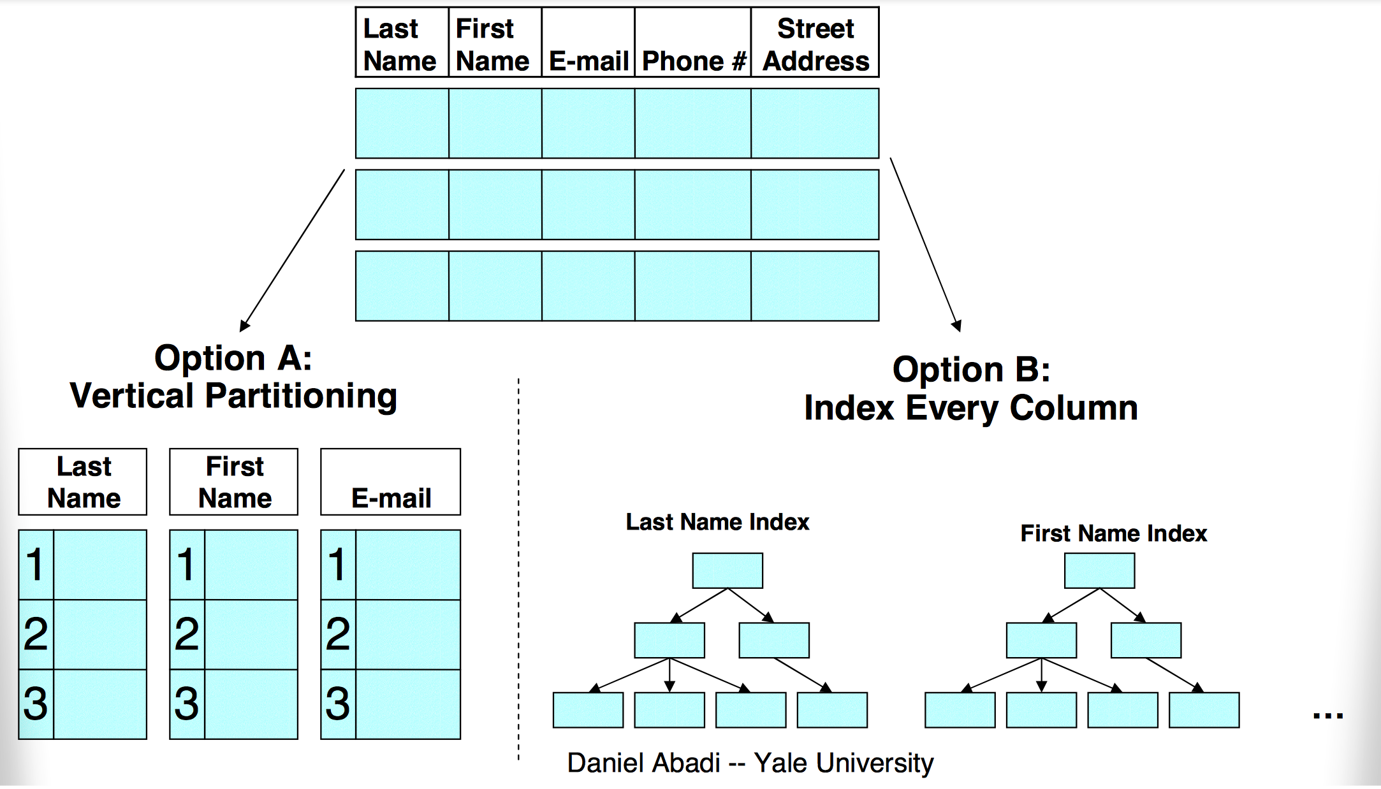
Two Emulation Approaches

Slide 62
Bottom Line
        SSBM (Star Schema Benchmark -- O’Neil et al ICDE 08)
          Data warehousing benchmark based on TPC-H
          Scale 100 (60 M row table), 17 columns
          Average across 12 queries
          Row store is a commercial DB, tuned by professional DBA vs C-Store
Commercial System Does Not Benefit From Vertical Partitioning
Time (s)
Notes:
Row store partitions on date

Slide 63
Problems with Vertical Partitioning
Tuple headers
  Total table is 4 GB
  Each column table is ~1.0 GB
  Factor of 4 overhead from tuple headers and tuple-ids
Merge joins
  Answering queries requires joins
  Row-store doesn’t know that column-tables are sorted
    Sort hurts performance
Would need to fix these, plus add direct operation on compressed data, to approach C-Store performance

Slide 64
Problems with Index-Only Plans
Consider the query:
SELECT store_name, SUM(revenue) FROM Facts, Stores
WHERE fact.store_id = stores.store_id AND stores.country = “Canada”
GROUP BY store_name
Two WHERE clauses result in a list of tuple IDs that pass all predicates
Need to go pick up values from store_name and revenue columns
But indexes map from value→tuple ID!
Column stores can efficiently go from tuple ID→value in each column using position lookups

Slide 65
Recommendations for Row-Store Designers
Might be possible to get C-Store like performance
  Need to store tuple headers elsewhere (not require that they be read from disk w/ tuples)
  Need to provide efficient merge join implementation that understands sorted columns
  Need to support direct operation on compressed data
    Requires “late materialization” design

Slide 66
Column-Oriented Data In Modern Systems
C-Store commercialized as Vertica
Although it wasn’t the first column-oriented DB, it led to a proliferation of commercial column-oriented systems
Now the de-facto way that analytic database systems are built, including Snowflake, Redshift, and others.
One popular open-source option: Parquet

Slide 67

Efficient Data Loading: Parquet
Parquet is column-oriented file format that is MUCH more efficient than CSV for storing tabular data
Vs CSV, Parquet is stored in binary representation
  Uses less space
  Doesn’t require conversion from strings to internal types
  Doesn’t require parsing or error detection
  Column-oriented, making access to subsets of columns much faster

Slide 68
Parquet Format
Data is partitioned sets of rows, called “row groups”
Within each row group, data from different columns is stored separately
Header: Offset of start of each row / column group, and ranges of records in each row group
Using header, can efficiently read any subset of columns or rows without scanning whole file (unlike CSV)
Within a row group, data for each column is stored together
Row Group 1
Col 1 Block 1
Col 2 Block 1
Col 3 Block 1
Col 1 Block 2
Col 2 Block 2
Col 3 Block 2
…
Col 1 Block 3
Col 2 Block 3
Row Group 2
Col 1 Block 4
Col 2 Block 4
Col 3 Block 3
Col 1 Block 5
Col 2 Block 5
Col 3 Block 4
…
Col 1 Block 6
…
Row Group N
Col 1 Block i
Col 2 Block j
Col 3 Block k
Col 1 Block i+1
Col 2 Block j+1
Col 3 Block k+1
…
Col 1 Block i+1

Slide 69
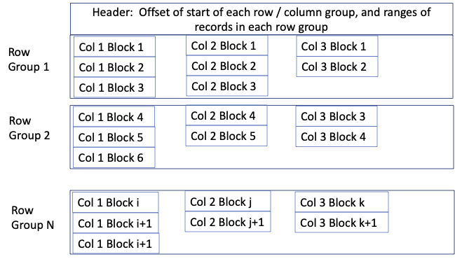
Predicate Pushdown w/ Parquet & Pandas
pd.read_parquet(‘file.pq’, columns=[‘Col 1’, ‘Col 2’])
Only reads col1 and col2 from disk
For a wide dataset saves a ton of I/O

Slide 70
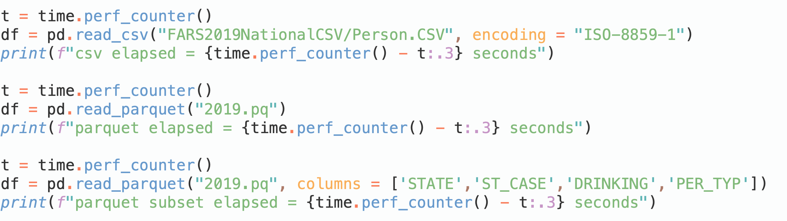
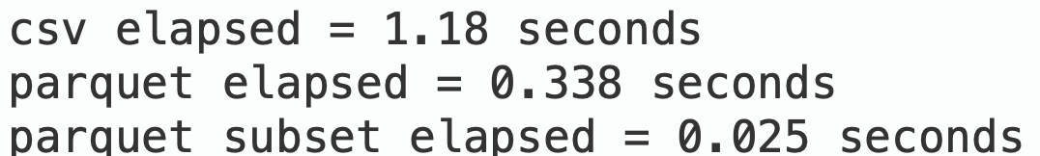
Performance Measurement
Compare reading CSV to parquet to just columns we need
47x speedup

Slide 71
When to Use Parquet?
Will always be more efficient than CSV
Converting from Parquet to CSV takes time, so only makes sense to do so if working repeatedly with a file
Parquet requires a library to access/read it, whereas many tools can work with CSV
Because CSV is text, it can have mixed types in columns, or other inconsistencies
  May be useful sometimes, but also very annoying!
  Parquet does not support mixed types in a column

Slide 72
Summary
Column oriented databases are a different way to “linearize” data to disk than the row-oriented representation we have studied
A good fit for “warehousing” workloads that mostly read many records of a few tables
C-Store system implements many additional ideas:
  “Late materialization” execution
  Column-specific compression and direct execution on compressed data
  Read/write optimized stores
Ideas have found their way into many modern systems and libraries, e.g., Parquet

