Slide 1
6.5830 / 6.5831
Quiz 2 Review 🔍
November 27, 2023

Slide 2
Logistics
What: Covers lectures 10 to 20 (inclusive)
When: Wednesday during lecture (November 29, 2023 at 2:30 pm)
Where: Lecture classroom (32-155)
Length: 80 minutes
How: Quiz will be on paper
Open book/notes/laptop, but no Googling / LLMs please.
Only class website is permitted.
Email staff for special accommodation (6.5830-staff@mit.edu)

Slide 3
Topics
Transactions
Logging and recovery (ARIES)
Parallel/distributed databases (analytics and transactions)
Systems “potpourri”
High-performance transactional systems (H-Store / Calvin / Aurora)
Eventual consistency (DynamoDB)
Cluster computing (Spark)
Cloud analytics (Snowflake)
Cardinality estimation

Slide 4
Transactions
🔑 Groups a sequence of operations into an all-or-nothing unit
A powerful abstraction!
Desirable properties (ACID)
Atomicity: All or nothing
Consistency: Maintains application-specific invariants
Isolation: Transaction “appears” to run alone on the database
Durability: Committed transactions’ writes persist even if the system crashes
Transactions can be aborted by the user or DBMS
🔑 denotes a key idea

Slide 5
Transaction Isolation
Want: Run transactions in parallel for performance reasons
How to ensure “correctness”?
🔑 Create illusion of transactions running alone, one-by-one, on the database
Serial
Serializable

Slide 6
🔑

Slide 8
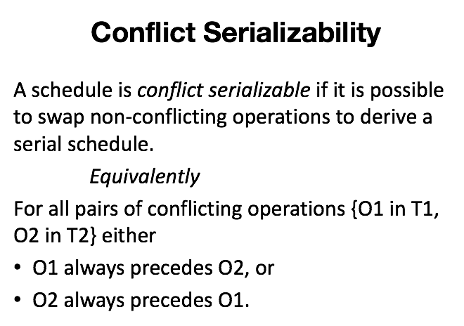
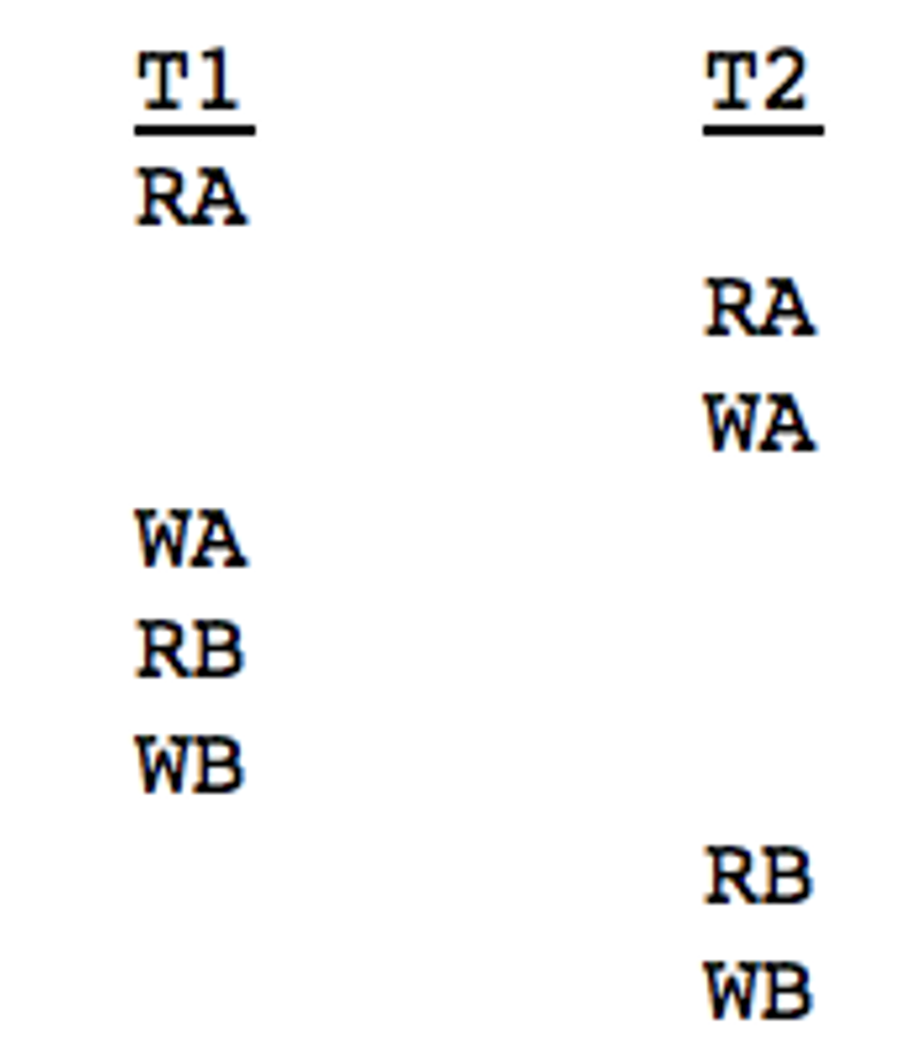
Not conflict serializable:
🔑

Slide 9
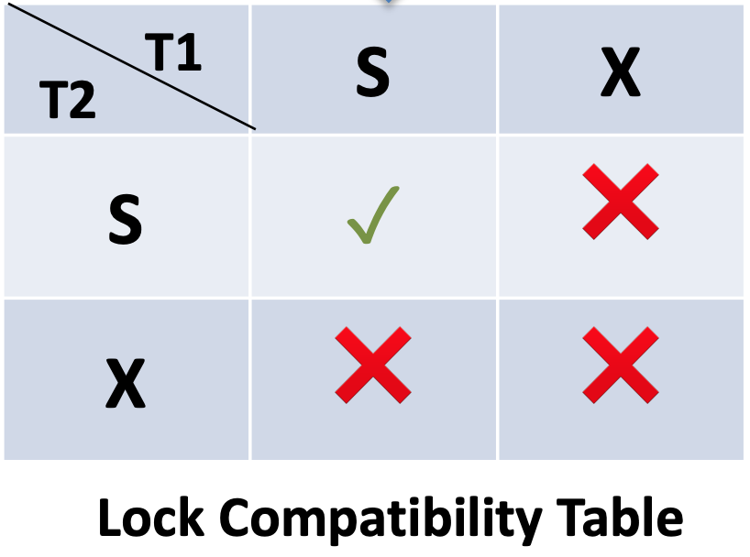
🔑

Slide 10
Problem: Cascading aborts
If T1 aborts, T2, T3 and T4 also need to abort
Solution: Just keep write locks until the end!
T1 | T2 | T3 | T4
WA
 | RA
 |  | RA
 |  |  | RA
ABORT
 | ABORT
 |  | ABORT
 |  |  | ABORT
Growing phase

Slide 11
🔑

Slide 12
🔑

Slide 13
Example
Permitted under strict 2PL but not rigorous 2PL:
T1: | T2:
RA
 | WA
 | COMMIT
COMMIT

Slide 18
Preventing phantom reads
Easy way: Acquire table locks
But if we have a clustered index we don’t need to scan the whole table for the range query. We can do better using “gap locks” / next key locking.
Example:
DB Entries: 10, 11, 13, 20
T1: Scan entries > 18 → Also lock “gaps”, i.e. lock gap 14 - 20 and 20 - ∞.
T2: Insert record 19 → Also needs to acquire the gap lock that T1 holds.
T1: Scan entries > 18 → No phantom read since T2 is waiting on the gap lock.
🔑

Slide 19
🔑

Slide 20
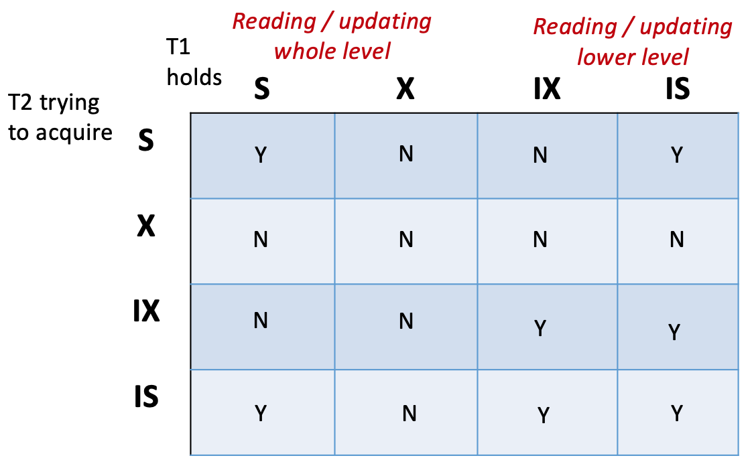
Locking Granularity / Intention Locks
🔑

Slide 21
🔑

Slide 23
🔑 Do not acquire read locks.
🔑 “Short” read locks.
🔑 No gap locks.

Slide 24
Topics
Transactions
Logging and recovery (ARIES)
Parallel/distributed databases (analytics and transactions)
Systems “potpourri”
High-performance transactional systems (H-Store / Calvin / Aurora)
Eventual consistency (DynamoDB)
Cluster computing (Spark)
Cloud analytics (Snowflake)
Cardinality estimation

Slide 25
Assumptions about crash
Assume any data in memory is gone
Data on disk is preserved
→ Recovery algorithms depend on when your system flushes pages

Slide 26
Steal: Can write dirty pages to disk before the txn commits.
Force: Force writes to disk on txn commit.
🔑
In GoDB, we do FORCE / NO STEAL and assume DB won’t crash between FORCE and COMMIT

Slide 27
🔑 Write-ahead log!
🔑

Slide 28
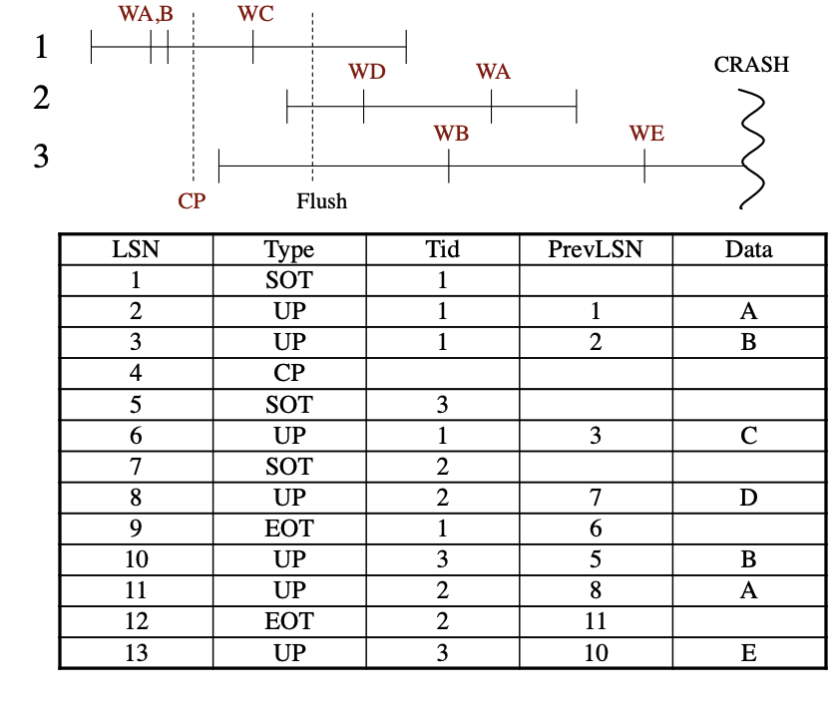
Simplistic protocol
Normal execution: Physical write-ahead-logging
Recovery: Replay log from beginning. We can recover the exact state at the crash (physical logging)

Slide 29
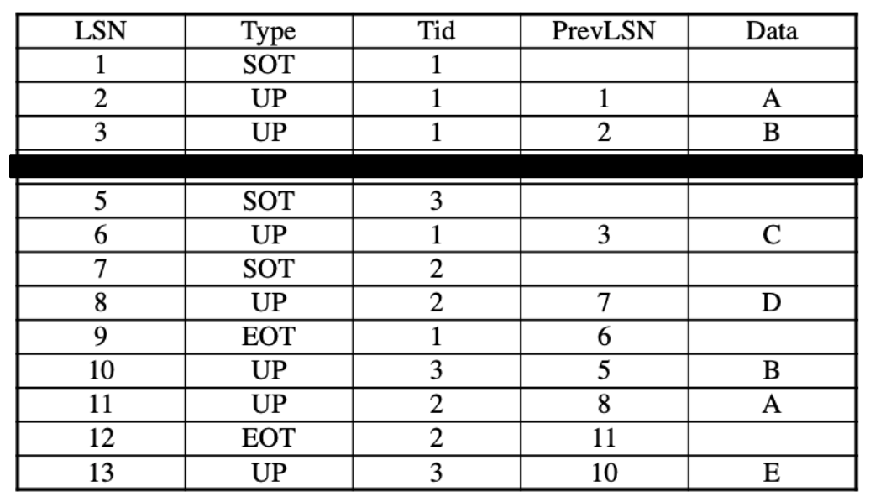
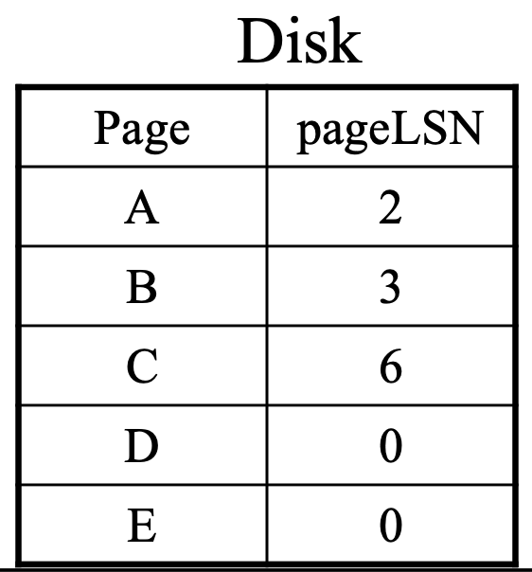
Simplistic protocol: Problem #1
We don’t want to REDO things that are already reflected on disk (i.e. do an operation twice). That’s a problem for escrows (e.g. record += 1).
Easy: Just keep a pageLSN field in the page header that tells you the last LSN that modified the page (at the time the page was flushed).
1. REDO
🔑 Skip if LSN <= pageLSN

Slide 30
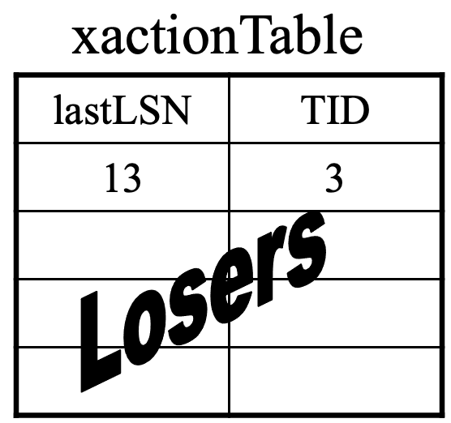
Simplistic protocol: Problem #2
We want to recover to a state from which the user can resume normal operation (no pending transactions that were uncommitted at crash).
Easy: Just keep track of which transactions were not committed at crash and UNDO them. Can undo them logically (makes our life easier).
1. REDO
2. UNDO 🔑

Slide 31
Simplistic protocol: Problem #3 (last one!)
This is super slow! Imagine we need to replay a log containing months of transactions.
🔑 Only the last couple of log entries really need to be REDOne and UNDOne (with time pages get flushed & transactions commit)
1. REDO
🔑 Skip if LSN <= pageLSN

Slide 32
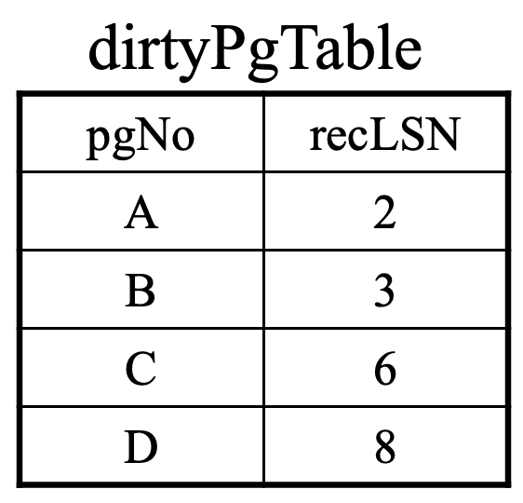
Simplistic protocol: Problem #3 (last one!)
This is super slow! Image we need to replay a log containing months of transactions.
Only the last couple of log entries really need to be REDOne and UNDOne
🔑 For each dirty page in the buffer pool, we keep track which was the first LSN that dirtied it. → For this page, we only need to REDO the log from there.

Slide 33
Simplistic protocol: Problem #3 (last one!)
For each dirty page in the buffer pool, we keep track which was the first LSN that dirtied it. → For this page, we only need to REDO the log from there.
But where to keep this “dirty page table”?
Persist: Lots of logging and we need to force these writes to disk.
Memory: It will be lost at crash, so we need to start scanning the log from beginning again to build it.
🔑 Solution: Checkpoints: Keep in memory but periodically write to disk.
You will need to scan some of the log to rebuild the dirty pages table, but not all of it!
At the same time you avoid doing a lot of forced writes!

Slide 34
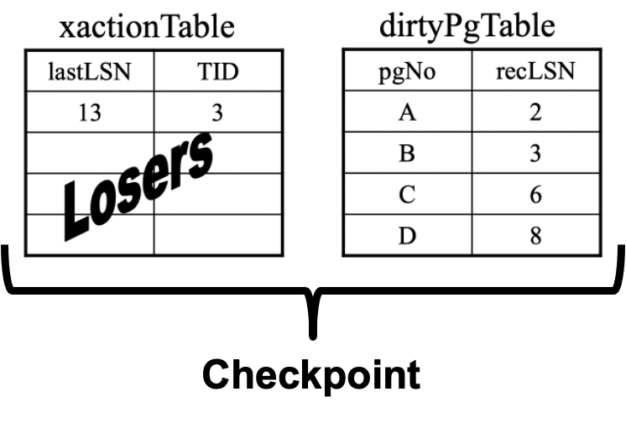
Simplistic protocol: Problem #3 (last one!)
What do we need to checkpoint to only re-scan some of the log?
Dirty page table
Transaction table

Slide 35
Simplistic protocol: Problem #3 (last one!)
What do we need to checkpoint to only re-scan some of the log?
Dirty page table
Transaction table
“UNDO table”
“REDO table”

Slide 36
Summary / ARIES
Normal operation:
Physical write-ahead-logging
Include LSN of last update in page headers (pageLSN)
Keep track of active transactions (for UNDO) and LSNs that first dirtied a page (for REDO) → checkpoint that periodically.
Recovery:
Analysis phase: Start from last checkpoint in log and reconstruct transaction table and dirty page table at time of crash.
REDO phase: Physically REDO log records that haven’t been flushed before crash. After that, your system will be in the state at the crash.
UNDO phase: UNDO transactions that weren’t committed at the time of the crash (“losers”).

Slide 38
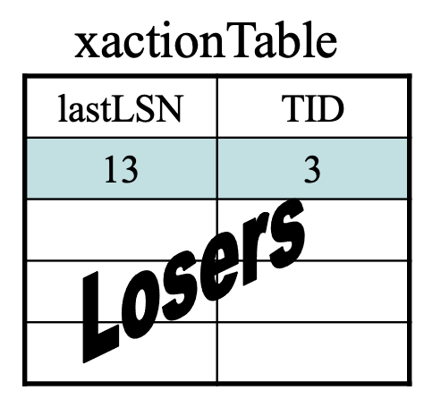
UNDO
🔑 We need to log UNDOs
If we crash during recovery
If we crash while rolling back an aborted transaction
These log records are called Compensation Log Records (CLRs)
Check where to start UNDO (lastLSN in Transaction Table) and UNDO each update going backwards using the prevLSN field in log

Slide 39
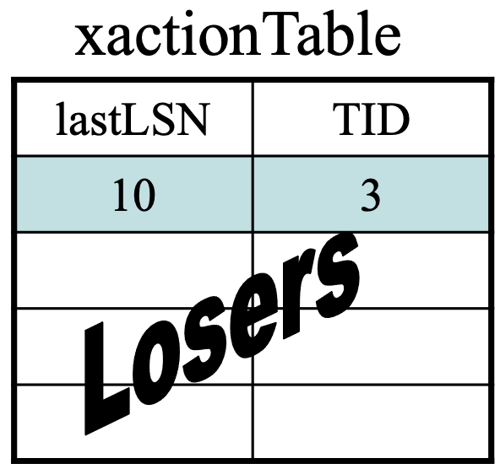
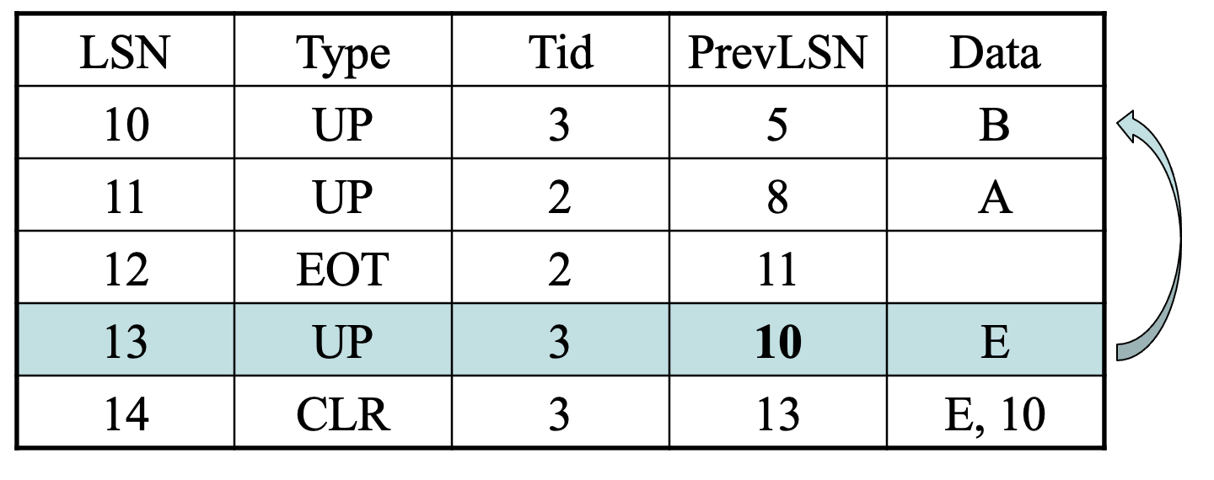
UNDO
🔑 We need to log UNDOs
If we crash during recovery
If we crash while rolling back an aborted transaction
These log records are called Compensation Log Records (CLRs)
Check where to start UNDO (lastLSN in Transaction Table) and UNDO each update going backwards using the prevLSN field in log

Slide 40
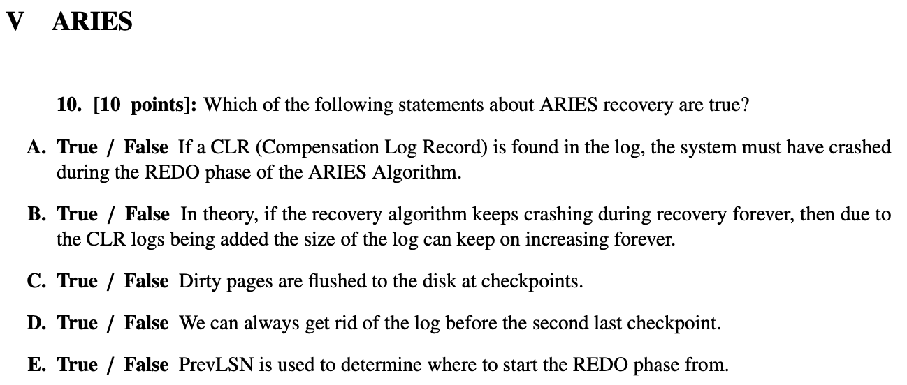
Notes:
2021, false
A: CLRs are used to record that an UNDO took place, it is useful in the event of a crash, i.e. preparation does not mean disaster happened
B: one CLR per update max, can’t CLR a CLR (it logs the physical state of the page after the UNDO was performed, the UNDO was logical)
C: checkpoints are only for the dirty page table & transactions table
D: REDO starts at the minimum recLSN, which could be earlier than the second-to-last checkpoint
E: we start the REDO phase on the minimum recLSN from the dirty page table (the earliest unflushed update)
D: analysis starts at the last checkpoint, nothing to worry about there; REDO starts at either the last checkpoint or minimum recLSN, which could be earlier than the second-to-last checkpoint; UNDO starts at the end of the log and walks backwards until all losers are reverted

Slide 41
Topics
Transactions
Logging and recovery (ARIES)
Parallel/distributed databases (analytics and transactions)
Systems “potpourri”
High-performance transactional systems (H-Store / Calvin / Aurora)
Eventual consistency (DynamoDB)
Cluster computing (Spark)
Cloud analytics (Snowflake)
Cardinality estimation

Slide 42
Distributed and Parallel Databases
🔑 Same semantics as a single-node ACID SQL database, but on multiple cores/machines
Distributed databases must deal with node failures

Slide 43
Ways to Partition the Data
Round-robin
Perfect load-balancing (data-wise)
Often all nodes need to participate in a query
Hash
Pretty good load balancing (unless many duplicates)
Bad at range analytical queries (cannot easily skip partitions)
Range
Good at range / localized analytical queries
Can be bad at load-balancing (data skew)

Slide 44
Parallel Joins (Hash Partitioning and Equijoins)
Partitioned on join attributes? Run join locally on each partition.
Otherwise, two options (non-exhaustive):
Re-partition (one or both tables): “shuffle join”
Each node transmits and receives (|T| / n) / n * (n - 1) bytes per repartitioned table
Replicate table across all nodes
Each node transmits and receives (|T| / n) * (n - 1) bytes

Slide 45
Distributed Transactions: Two Phase Commit
🔑 Distributed algorithm used to make a commit/abort decision for multiple “sites”
“Commit only if all participants agree to commit”
Requires a coordinator
Often considered a performance bottleneck

Slide 46
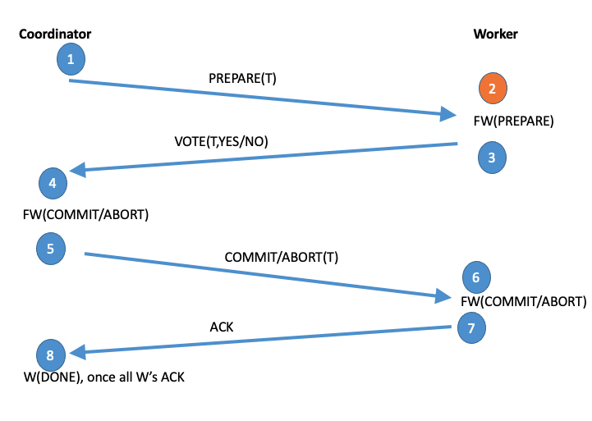
Two Phase Commit
Notes:
To refresh your memory, 2PC is a complicated thing that requires multiple rounds of communication, and things have to be on-disk at the end of many steps
This is required because components can independently fail, communications can be delayed or lost, the usual distributed system fun

Slide 47
Topics
Transactions
Logging and recovery (ARIES)
Parallel/distributed databases (analytics and transactions)
Systems “potpourri”
High-performance transactional systems (H-Store / Calvin / Aurora)
Eventual consistency (DynamoDB)
Cluster computing (Spark)
Cloud analytics (Snowflake)
Cardinality estimation

Slide 48
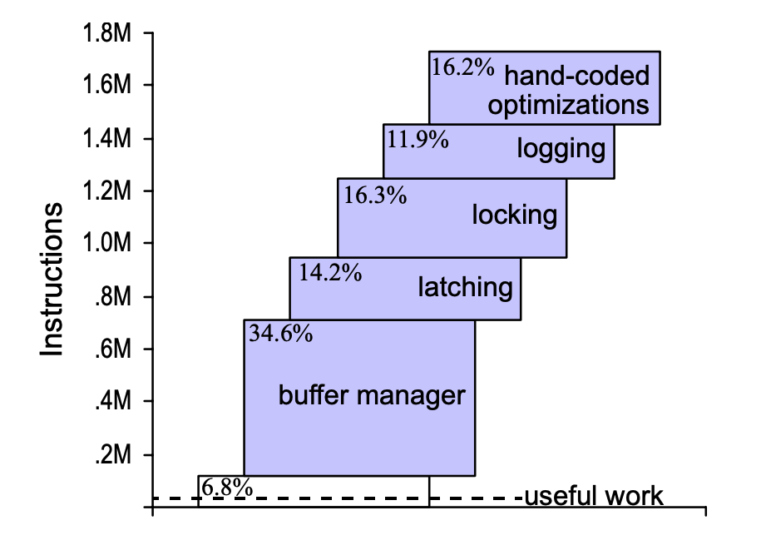
High-Performance Transactions
Running old code on new hardware ⇏ speed-up
New performance bottlenecks
2PC is slow
Consider new architectures!
Stavros Harizopoulos, Daniel J. Abadi, Samuel Madden, and Michael Stonebraker. OLTP through the looking glass, and what we found there. SIGMOD 2008
Notes:
No.
Take a query, execute it in SQL vs. by hand. Take a look at the number of instructions executed in each component.
Most instructions are not doing actual work.
E.g., if you treat a main-memory system simply as a disk-based system that never evicts pages from buffer pool, still pay 34.6% overhead
Basically: original system was bottlenecked by hardware limitations. That is, the implementation only needs to be faster than disk. If you take away disk, the implementation becomes the bottleneck.
To get full performance, need a rewrite. (This is why over the last 20 years, many innovations happen in new systems rather than on top of old ones)

Slide 49
H-Store
Distributed in-memory DBMS
Often enough memory to store the entire dataset
🔑 Partition the data; single-thread per partition
Eliminate coordination overhead within a partition
Stored-procedure transactions
Optimize partitioning for the workload
Avoid waiting for the client
Weaknesses
Stored-procedure assumption
Multi-partition transactions?
“Classical” design
Thread-per-partition
Diagrams courtesy of Prof. Andy Pavlo

Slide 50
Calvin
Distributed DBMS
🔑 Deterministic execution
Avoid distributed coordination (2PC) during transaction execution by determining a non-conflicting, deterministic execution order up front!
Ordering performed in batches
Weaknesses
Need to know transactions & read/write sets up front
Stored-procedure assumption
If lot of contention (e.g. all txns contend for one record) you can only issue them one at a time (no other way to avoid conflicts)

Slide 51
Topics
Transactions
Logging and recovery (ARIES)
Parallel/distributed databases (analytics and transactions)
Systems “potpourri”
High-performance transactional systems (H-Store / Calvin / Aurora)
Eventual consistency (DynamoDB)
Cluster computing (Spark)
Cloud analytics (Snowflake)
Cardinality estimation

Slide 52
CAP theorem
Consistency, availability, partition-tolerance: You can have 2, not all 3
ACID has strong consistency but will appear down if machines go down or network becomes partitioned
Many systems choose availability over consistency (e.g. NoSQL)
🔑

Slide 53
Dynamo
Availability
Partitioning
for scaling
consistent hashing
Replication
for fault tolerance and performance
‘N’ successors in the ring stores the key
Vector clocks for detecting conflicting writes
🔑

Slide 54
Vector Clock Updates
Each coordinator maintains a version counter for each data item that increments for every write it coordinates
If a node stores m objects, it stores m vector clocks along with them
Each vector clock has n entries, which denote the number of writes done by each of n coordinators
Clock for one data item A at coordinator i
before: $V_{A}$[1], …, $V_{A}$[i], …, $V_{A}$[n]
after: : $V_{A}$[1], …, $V_{A}$[i]+1, …, $V_{A}$[n]
🔑

Slide 55
Vector Clock
Read - Read from the quorums
E.g.: Read V1, V2, V3 - If one of these, say V1, is greater than the others for every component, V1 is the latest value and we can reconcile based on vector clocks
What if they are incomparable? ---> i.e., can’t decide which is the latest version of the data
V1 = [1, 1], V2 = [2, 0]
Return both data versions, and use application-specific reconciliation 🔑

Slide 56
Dynamo Question (2015)
Which of the following statements are true?
V1 =< R1 : 0, R2 : 3, R3 : 2 >
V2 =< R1 : 1, R2 : 3, R3 : 2 >
V3 =< R1 : 0, R2 : 0, R3 : 3 >
A) The writer that produced V1 observed V2
B) The writer that produced V2 observed V1
C) V2 and V3 are :”concurrent writes” (cannot be reconciled)
Notes:
FTT

Slide 57
Topics
Transactions
Logging and recovery (ARIES)
Parallel/distributed databases (analytics and transactions)
Systems “potpourri”
High-performance transactional systems (H-Store / Calvin / Aurora)
Eventual consistency (DynamoDB)
Cluster computing (Spark)
Cloud analytics (Snowflake)
Cardinality estimation

Slide 58
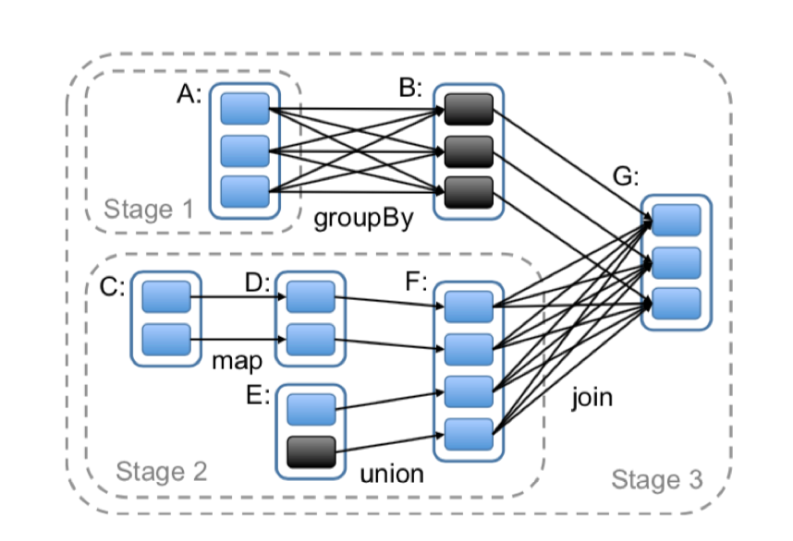
Spark
Distributed “dataflow” language
Resilient Distributed Dataset (RDD) which you can perform operations on
Programs operate on partitions of data in parallel

Slide 59
Spark: Memory use
🔑
Intermediate results are kept in-memory (e.g. in contrast to MapReduce)
Very useful for interactive or iterative workloads, e.g., ML tasks that train over same data periodically

Slide 60
Spark: Lineage
Limit operations to coarse-grained transformations and only log the transformations instead of replicating data for recovering ---> Lineages
Use cases to recover from failure:
Short lineage chain? 🔑
Just recompute from lineage
Long lineage chain?
Checkpoint intermediate results to stable storage!

Slide 61
Topics
Transactions
Logging and recovery (ARIES)
Parallel/distributed databases (analytics and transactions)
Systems “potpourri”
High-performance transactional systems (H-Store / Calvin / Aurora)
Eventual consistency (DynamoDB)
Cluster computing (Spark)
Cloud analytics (Snowflake)
Cardinality estimation

Slide 62
🔑

Slide 63
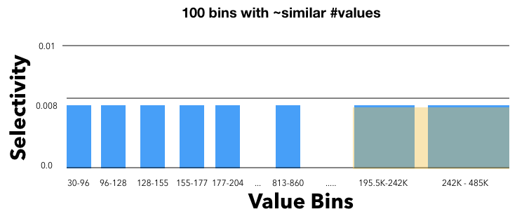
Cardinality Estimation for one column
Equal width vs Equal depth histograms
Pros
More detail where there is more data ---> uniformity assumption more accurate
Fast to compute
Cons
Less detail in other regions (e.g., in the large bins)
🔑
Source of error: Within this large bucket, assume uniformity

Slide 64
Cardinality Estimation for 2 columns
Take selectivity estimates for single columns, and assume they are independent, i.e. multiply selectivities.
🔑
Pros
Fast to compute
Don’t need to store 2d distributions etc.
Cons
Columns are often correlated (might severely misestimate then)
Errors will accumulate as more columns / joins added

Slide 65
Main Assumptions
Uniformity
Within a bin of histogram; (or when computing joins)
Independence
When combining selectivities for multiple columns

